Slide 1

CalAPA Version 7 Deep Dives
Cycle 3
September 4, 2024
Presented by Gay Roby
Consultant, CTC

Slide 2
Please download the Version 7 Assessment Guide and follow along with markers and pen!

Slide 3
Accessing 2024-2025 (Version 07) CalAPA Assessment Materials
Preparation programs may download the 2024-2025 (Version 07) CalAPA assessment materials via password-protected a zip file located on the CalAPA Faculty Policies and Resources web page.
2024-2025 Zip File Password: C@lapa24

Slide 4

CalAPA Overview

Slide 5
Why performance assessment?
Demonstration of pertinent skills for today’s school leaders
Commission: “Focus on school site needs” for the Preliminary ASC program
Focus on the PURPOSE of each cycle, not the activities
    Cycle 1: Gathering and Using Data to Improve our Schools
    Cycle 2: Leading Colleagues in Taking Action to Improve our Schools
    Cycle 3: Coaching Certificated Staff to Improve Classroom Practice

Slide 6
Equity Driven Leadership:
Woven throughout the assessment cycles
Conceptualize schools as complex organizations composed of a network of dynamic and interdependent thinking components
Pursue school change and improvement through systemic change and capacity building
Create and articulate a shared vision of a school as a place where all students are seen as fully engaged, inspired, and empowered, and their voices are heard.
San Diego State University (2018). Five types of equity driven leadership thinking. In SDSU Handbook for Educational Leadership {Brochure}. San Diego, CA: Author.

Slide 7
CalAPA Structure: Three Leadership Cycles – Four Steps
Leadership Cycle 1: Analyzing Data to Inform School Improvement and Promote Equity
Leadership Cycle 2: Facilitating Communities of Practice
Leadership Cycle 3: Supporting Teacher Growth
Investigate
Plan
Act
Reflect
Notes:
The focus is on leadership, not on completing activities
Recursive 4-step process runs throughout the cycles
Note: there is no video component for cycle 1 but there is for cycles 2 and 3

Slide 8
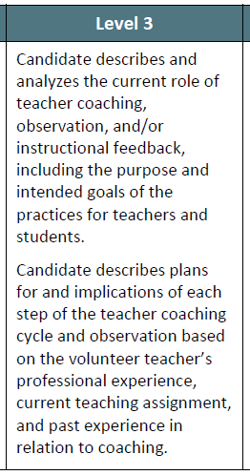
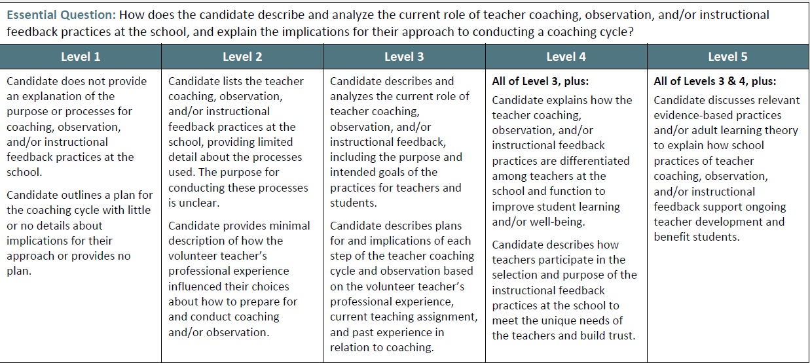
Sample Rubric
Notes:
This performance assessment is an analytic evaluation of one’s skills. The skills evaluated in each cycle are outlined in a 5-point rubric scale, with Level 3 being the baseline level for MET, echoing the Essential Question that is being asked.

Slide 9
Passing Requirements
Cycle 2
  7 rubrics
  Agendas and minutes
  Video clips of meetings
  Narrative analysis of skills
  14 points to pass NEW!
Cycle 1
  8 rubrics
  Quantitative data sets over time
  Qualitative data to illuminate gap
  No video component
  15 points to pass NEW!
Cycle 3
  7 rubrics
  Lesson plans, student work
  Video clips of a coaching cycle
  Narrative analysis of skills
  14 points to pass NEW!

Slide 10
When Something Goes Amiss: Condition Codes!
A letter/number code (e.g., B3) identifies the submission’s problem; score assignment is suspended. Candidate works with program support to identify and fix the misstep.
Common errors
    Submitted wrong cycle or step
    Video, Audio Clips not continuous and unedited; unplayable, or inaudible
            Duplicate clips submitted
            Required personnel not visible
    Uploaded document is illegible or wrong file type
    State indicator not identified
    Evidence (data sets, agendas, minutes, student work, lesson plans) were not submitted
    Incorrect file was uploaded
    Not original content (candidate subject to institution’s policy/discipline)
Condition Coded submissions require the candidate to fully re-submit

Slide 11
Executive Order/CASC Candidates Differ from PASC Candidates
Ways a CASC Candidate is Different
They hold an administrative position and have admin responsibilities
They are involved in the running of a school
It may be easier to access data
It may be more difficult to find “colleagues” to serve on a COP
It may be challenging to assume a “coaching” vs. evaluative role
Considerations in Supporting a CASC Candidate
The cycle tasks should be embedded in their daily responsibilities whenever possible
Time to work on the tasks of each cycle can be part of their regular workday hours (analyzing data, implementing a change, coaching teachers)
Having a site administrator who understands the tasks and paves the way for the candidate can be very helpful...“our” task, not “their” task attitude
Notes:
Executive Order CalAPA candidates (those allowed to receive their CE or preliminary ASC before passing the three CalAPA cycles are still required to pass them before being recommended for the clear ASC.

Slide 12

Cycle Three
Supporting Teacher Growth

Slide 13
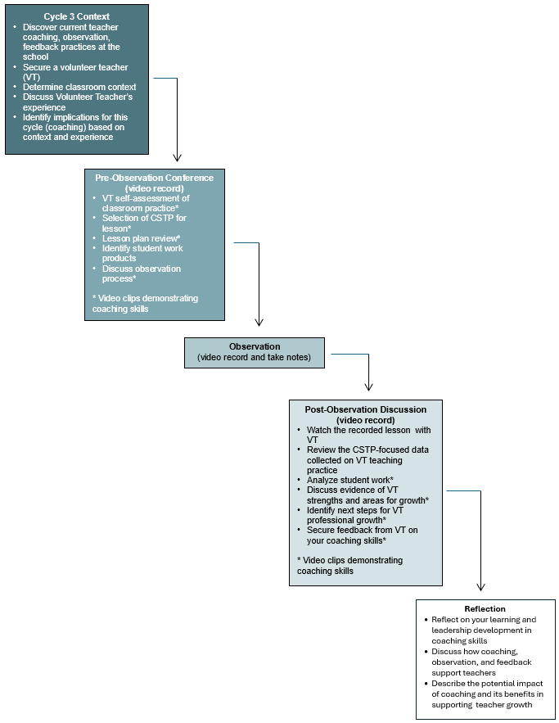
Cycle 3 Graphic

Slide 14

Illustration of a Throughline

Slide 15

Cycle 3
Step 1: Investigate
(1 Rubric)

Slide 16
Cycle 3 Step 1: Investigate
Assessment Guide (p 5-7)
Part A: Written Narrative: Coaching, Observation, and/or Instructional Feedback Practices at the School and the Volunteer Teacher (no more than 5 pages)
Current Coaching and Observation Practices at the School
  current teacher coaching, observation, and/or instructional feedback practices
  Understand how the California Standards for the Teaching Profession (CSTP) are used to guide teacher development at the school.
  Provide an overview of the processes used at the school for coaching (not evaluation), classroom observations, and pre-observation, and post-observation meetings
Volunteer Teacher and Context for Coaching Cycle

Slide 17
Use the Glossary of Terms!
Coaching (instructional). Instructional coaching involves two people: the classroom teacher and the coach. Coaches work one-on-one and in small groups with teachers, providing guidance, training, and other resources as needed. Together, they focus on practical strategies for engaging students and improving their learning.
California Standards for the Teaching Profession (CSTP). These delineate and define six interrelated domains of teaching practice.
Evidence-based practice. “Evidence-based interventions are practices or programs that have evidence to show that they are effective at producing results and improving outcomes when implemented. The kind of evidence described in ESSA [Every Student Succeeds Act] has generally been produced through formal studies and research. Examples....

Slide 18
Cycle 3 Step 1: Investigate (1 rubric)
Step 1: Investigate
Rubric 3.1 How does the candidate describe and analyze the current role of teacher coaching, observation, and/or instructional feedback practices at the school with the volunteer teacher, and explain the implications of how current practices impact their approach to conducting a coaching cycle?

Slide 19
Understanding Language is Key!
Rubric 3.1
Level 1 | Level 2 | Level 3 | Level 4 | Level 5
does not provide outlines with little/no detail provides no plan” | lists providing limited detail minimal description | describes and analyzes describes | all of level 3 plus describes | all of levels 3 and 4 plus discusses to explain ...support
Absence of...”NOT”
Reflects the Essential Question in statement form
Essential Question plus something additional
Level 3 + Level 4 + even more!
Parts are evident, parts are missing

Slide 20
The Throughline Concept
Each step builds upon the previous step until Step 4 asks the candidate to reflect on their learning during the entire cycle
Each submission should have obvious linkages to former Steps
  “current practice”
  “that were completed in Step 1 (or 2 or 3)”
  “Using (the work) done in the previous step”

Slide 21
Cycle 3
Step 1:
Tips and Considerations
Research/Analyze Current Practices
  Administration view
  Volunteer Teacher view
Select Volunteer Teacher carefully
    More experienced is preferred
Implications for EACH step
Based on experience and background of volunteer teacher
Through-line very visible

Slide 22

Cycle 3
Step 2: Plan
(1 Rubric)

Slide 23
Cycle 3 Step 2: Plan
Assessment Guide (p 8-11)
Part B: Written Narrative: Classroom Context, Lesson, and Observation (no more than 4 pages)
Part C: Volunteer Teacher’s Lesson Plan, including student work product description
Part D: 2 Annotated Video Clips of the Pre-Observation Meeting (no more than 4 minutes each)
I. Conducting the Pre-Observation Meeting
  Conduct and video-record a pre-observation meeting with the volunteer teacher (learning goals, classroom context, teacher’s perspective)
    identify teacher’s self-assessment (instructional needs and challenges), student assets and learning needs (academic and affective)
    Co-determine student work products
    jointly select 1-2 elements of a specific CSTP to focus on during the observation
    Submit volunteer teacher’s lesson plan with student work product description.

Slide 24
Cycle 3 Step 2: Plan
Assessment Guide (p 8-11)
Part B: Written Narrative: Classroom Context, Lesson, and Observation (no more than 4 pages)
Part C: Volunteer Teacher’s Lesson Plan, including student work product description
Part D: 2 Annotated Video Clips of the Pre-Observation Meeting (no more than 4 minutes each)
II. Video Evidence of Your Pre-Observation Meeting
  Discuss the instructional components of the lesson (learning environment, learning goals, prior knowledge, instructional strategies key learning activities, work products)
  Discuss student assets, learning needs, supports for English learners, students with identified learning needs, students who have experienced trauma
  Discuss planned protocol for the observation or form
  Discuss additional information relevant to the coaching cycle shared by volunteer teacher

Slide 25
Cycle 3 Step 2: Plan
AG (p 8-11)
Part B: Written Narrative: Classroom Context, Lesson, and Observation (no more than 4 pages)
Part C: Volunteer Teacher’s Lesson Plan, including student work product description
Part D: 2 Annotated Video Clips of the Pre-Observation Meeting (no more than 4 minutes each)
II. Video Evidence of Your Pre-Observation Meeting
  v. Select two video clips of no more than 4 minutes each demonstrating.
  vi. Provide 4 annotations to the 2 video clips on your collaborative coaching conversation
      Volunteer Teacher’s Self-Assessment
      Lesson Plan Review
      CSTP Selection
      Coaching and Observation Process
These annotations must identify the specific moments in the video clips that demonstrate the required actions and analyze how those moment(s) support the specific coaching practices

Slide 26
Cycle 3 Step 2: Plan (1 rubric)
Step 2: Plan
Rubric 3.2 How does the candidate demonstrate and analyze their ability to listen to and talk with the volunteer teacher to understand the learning goals, classroom context, and student assets and learning needs; jointly select with the volunteer teacher one or two CSTP elements, including evidence to be collected; and plan for the observation?

Slide 27
Understanding Language is Key!
Rubric 3.2
Level 1 | Level 2 | Level 3 Restates the essential question | Level 4 | Level 5
do not discuss does not provide no plan is established | broadly discuss occasionally provides minimally involves is not clear | engages...in discussion consistently provides jointly selects plan | all of level 3 plus uses... facilitative questioning strategies | all of levels 3 and 4 plus to deepen discussion regarding equitable opportunities

Slide 28
Remember the Throughline!
The school’s context (Step 1) should be reflected in the discussions held in the preconference meeting (Step 2)
For example, if teachers have no coaching structure at the school, time is spent on discussing coaching vs. evaluation processes

Slide 29
Cycle 3
Step 2:
Tips and Considerations
Classroom Contextual Elements
Student Assets
Student Learning Needs
Lesson Goal
Student Work
Selection of CSTP is Crucial
One or two elements
Evidence to be collected during observation
Conversion if another system used
Discussion of Observation Plan
When/where
Other considerations

Slide 30
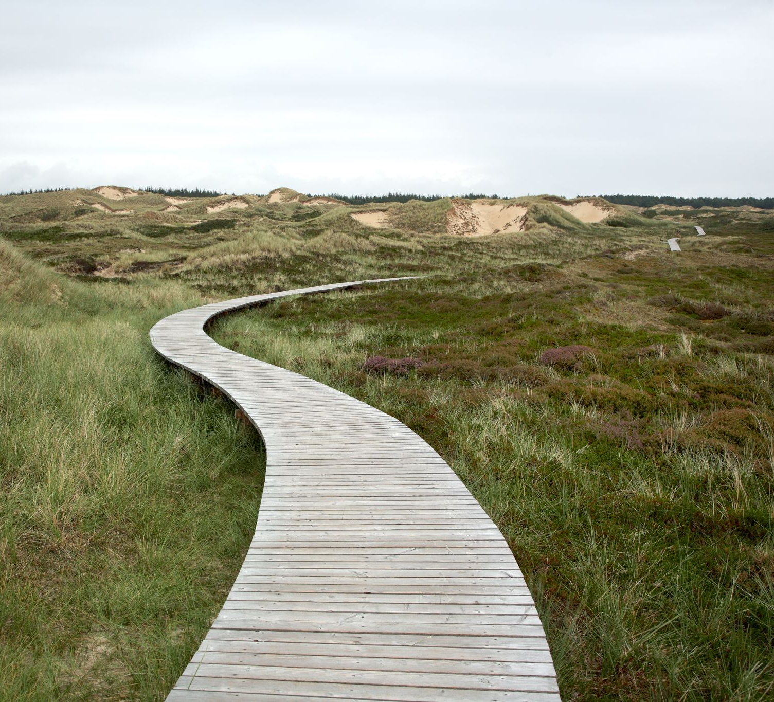
Cycle 3
Step 3: Act
(3 Rubrics)

Slide 31
Cycle 3 Step 3: Act
Assessment Guide (p 12-15)
Part E: Specific Notes from the Observation and/or Forms Used to Document the Observation
Evidence Related to CSTP Element(s)
Part F: Student Work Product Example(s) from the lesson used in the post-observation meeting
I. Focused Classroom Observation
  Conduct the CSTP-focused classroom observation (20 minute minimum)
  Video-record the teacher’s instruction for the full duration of the observation
  Use an observation tool to collect evidence on the selected 1-2 CSTP elements
  Collect pre-determined student work products

Slide 32
Cycle 3 Step 3: Act
Assessment Guide (pages 12-15)
Part E: Specific Notes from the Observation....Evidence Related to CSTP Element(s)
Part F: Student Work Product Example(s) from the lesson used in the post-observation meeting
Part G: 1 to 5 Annotated Vide Clips of the Post-Observation Meeting
II. Preparation for the Post-Observation Meeting
  Watch the video recording of the lesson and analyze the VT’s performance
  Develop guiding questions to promote professional learning...on the CSTP element(s)
  Watch the video of the lesson together during the post-observation meeting to guide the two-way CSTP-focused conversation
  Ask the volunteer teacher for feedback regarding what was helpful and not helpful throughout the coaching cycle—their impressions of your coaching skills

Slide 33
Cycle 3 Step 3: Act
AG (p 12-15)
Part E: Specific Notes from the Observation....Evidence Related to CSTP Element(s)
Part F: Student Work Product Example(s) from the lesson used in the post-observation meeting
Part G: 1 to 5 Annotated Vide Clips of the Post-Observation Meeting
III. Post-Observation Meeting
  Conduct and video-record the entire post-observation meeting with VT including when you watch the lesson observation video together.
  Review student work products
  Conduct a two-way conversation with the teacher (VT self-assessment, observation notes, effectiveness of teaching practices, next steps for VT growth, feedback on your coaching)

Slide 34
Cycle 3 Step 3: Act
Assessment Guide (page 12-15)
Part G: 1 to 3 Annotated Video Clips of the Post-Observation Meeting
III. Evidence of Your Coaching
  Select 1 to 3 video clips (totaling no more than 15 minutes; a single clip should be at least 1 minute in length) to provide evidence of collaborative discussion (you + VT)
  Annotation titles
    Volunteer Teacher’s Assessment of Student Learning
    Effectiveness of Teaching Practices including Next Steps
    for Volunteer Teacher Growthh
    Volunteer Teacher Feedback on Candidate’s Coaching Practices
These annotations must identify the specific moments in the video clips that demonstrate the required actions and analyze how those moment(s) support the specific coaching practices

Slide 35
Cycle 3 Step 3: Act (3 rubrics)
Step 3: Act
Rubric 3.3 How does the candidate recognize, document, and analyze the volunteer teacher’s qualities of teaching practice related to the selected CSTP element(s) and learning goals of the lesson?
Rubric 3.4 How does the candidate demonstrate and analyze their ability to foster a learning conversation in a post-observation meeting using CSTP-focused observation evidence, lesson observation video, and student work with the volunteer teacher regarding strengths and area(s) for growth?
Rubric 3.5 In partnership with the volunteer teacher, how does the candidate demonstrate and analyze their ability to co-determine next steps for professional growth, including resources and additional coaching support based on the CSTP-related evidence during the post-observation meeting?

Slide 36
Understanding Language is Key!
Rubric 3.3
Level 1 | Level 2 | Level 3 Restates the essential question | Level 4 | Level 5
provides.... unrelated... evidence does not provide | provides... evidence... mostly unrelated vague, general evidence only occasionally provides | accurately recognizes and documents provide detailed notes consistently provides | all of level 3 plus additional documentation...missed teaching opportunities or successful practices” | all of levels 4 and 5 plus documents how...VT [differentiates]

Slide 37
Understanding Language is Key!
Rubric 3.4
Level 1 | Level 2 | Level 3 Restates the essential question | Level 4 | Level 5
provides inaccurate or irrelevant... making limited use... does not provide no X....are discussed | provides... minimal limited discussion vaguely connects | fosters citing jointly identifies provides | all of level 3 plus establishes discusses make connections | all of levels 3 and 4 plus fosters a conversation that increases

Slide 38
Understanding Language is Key!
Rubric 3.5
Level 1 | Level 2 | Level 3 Restates the essential question | Level 4 | Level 5
solely determines little to no identification of... no relationship does not provide | Occasionally allows provides support...but lacks the inclusion of only occasionally provides | participates co-determine consistently provides | all of level 3 plus identify...addresses...needs | all of levels 3 and 4 plus provides specific resources to support engages

Slide 39
Throughline for Cycle 3
Current coaching practice at the school
Pre-conference meeting
Observation of the classroom lesson
Post-conference lesson
Volunteer feedback is gathered on your coaching skills throughout the cycle

Slide 40
Cycle 3
Step 3:
Tips and
Considerations
Observation Notes Include
- Evidence of CSTP element(s)
- Learning goals
- Possible guidance on VT practice
Post-observation Meeting
  Watch lesson video together
  Jointly discuss teacher strengths and areas of growth
  Discuss next steps and resources for teacher
  Volunteer Teacher Feedback on Your Coaching Skills

Slide 41

Cycle 3
Step 4: Reflect
(2 Rubrics)

Slide 42
Cycle 3 Step 4: Reflect
Assessment Guide (p 16)
Part H: Reflective Narrative (no more than 4 pages of written or 6 minutes of video)
I. Reflecting Narrative
  Reflect on your ability to provide coaching, observation, and/or instructional feedback to support teacher growth
  Cite the volunteer teacher’s feedback/input and evaluate your strengths and areas for growth in coaching and why you should work on them
  Cite evidence from Steps 1–3 to demonstrate your facilitation skills and maintenance of a two-way conversation throughout the cycle
  Reflect on your role as an equity-driven school leader and the impact of supporting teacher growth through coaching, observation, and/or instructional feedback.

Slide 43
Cycle 3 Step 4: Reflect (2 rubrics)
Step 2: Plan
Rubric 3.6 How does the candidate analyze their capacity to conduct a CSTP-focused coaching and observation process, based on their experience in this coaching cycle and feedback from the volunteer teacher, and cite evidence to demonstrate their ability to facilitate and maintain a coaching partnership?
Rubric 3.7 How does the candidate, informed by a continuous improvement mindset and focused on equitable leadership, reflect on the potential impact of coaching and explain the benefits to both teachers and students?

Slide 44
Understanding Language is Key!
Rubric 3.6
Level 1 | Level 2 | Level 3 Restates the essential question | Level 4 | Level 5
does not provide does not reflect on or cite... does not use | broadly describes minimally reflects... vaguely cites | analyzes identifies clearly drawing on... reflects upon and cites evidence encouraged... | all of level 3 plus provides extensive analysis discusses how...change | all of levels 3 and 4 plus cites evidence-based practices or research analyze....capacity ...maintain explain how...support...”

Slide 45
Understanding Language is Key!
Rubric 3.7
Level 1 | Level 2 | Level 3 Restates the essential question | Level 4 | Level 5
does not demonstrate does not explain | minimally reflects on and describes minimally explains | reflects explains to support | all of level 3 plus cites specific evidence drawing on...feedback to support reflection and analysis | all of levels 3 and 4 plus cites evidence-based practices or research to support

Slide 46
Cycle 3
Step 4:
Tips and Considerations
Strengths and Areas of Growth
  Personal Reflection
  Feedback from Volunteer Teacher
Equitable Leader
  Continuous Improvement lens
  School leader taking on role of instructional leader

Slide 47
Common Cycle 3 Errors
Submission Errors:
1. Does not analyze current practices
2. No discussion of student assets
3. Observation tool does not address CSTP
4. No resources included for next steps
5. No use of VT feedback in reflection
6. Does not reflect on THEIR role as an equity driven leader
Video Errors:
1. Annotations after video limit
2. Candidate/VT not seen in every
video

Slide 48


Technical questions: es-calapa@pearson.com
Policy questions: CalAPA@ctc.ca.gov
Website: www.ctcexams.nesinc.com

