Slide 1
CalAPA Year 6 Deep Dives
Cycle 2
September 4, 2024
Presented by Gay Roby
Consultant, CTC

Slide 2
Please download the Version 7 Assessment Guide and follow along with markers and pen!

Slide 3
Accessing 2024-2025 (Version 07) CalAPA Assessment Materials
Preparation programs may download the 2024-2025 (Version 07) CalAPA assessment materials via password-protected a zip file located on the CalAPA Faculty Policies and Resources web page.
2024-2025 Zip File Password: C@lapa24

Slide 4

CalAPA Overview

Slide 5
Why performance assessment?
Demonstration of pertinent skills for today’s school leaders
Commission: “Focus on school site needs” for the Preliminary ASC program
Focus on the PURPOSE of each cycle, not the activities
    Cycle 1: Gathering and Using Data to Improve our Schools
    Cycle 2: Leading Colleagues in Taking Action to Improve our Schools
    Cycle 3: Coaching Certificated Staff to Improve Classroom Practice

Slide 6
Equity Driven Leadership:
Woven throughout the assessment cycles
Conceptualize schools as complex organizations composed of a network of dynamic and interdependent thinking components
Pursue school change and improvement through systemic change and capacity building
Create and articulate a shared vision of a school as a place where all students are seen as fully engaged, inspired, and empowered, and their voices are heard.
San Diego State University (2018). Five types of equity driven leadership thinking. In SDSU Handbook for Educational Leadership {Brochure}. San Diego, CA: Author.

Slide 7
CalAPA Structure: Three Leadership Cycles – Four Steps
Leadership Cycle 1: Analyzing Data to Inform School Improvement and Promote Equity
Leadership Cycle 2: Facilitating Communities of Practice
Leadership Cycle 3: Supporting Teacher Growth
Investigate
Plan
Act
Reflect
Notes:
The focus is on leadership, not on completing activities
Recursive 4-step process runs throughout the cycles
Note: there is no video component for cycle 1 but there is for cycles 2 and 3

Slide 8
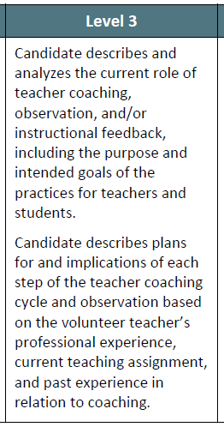
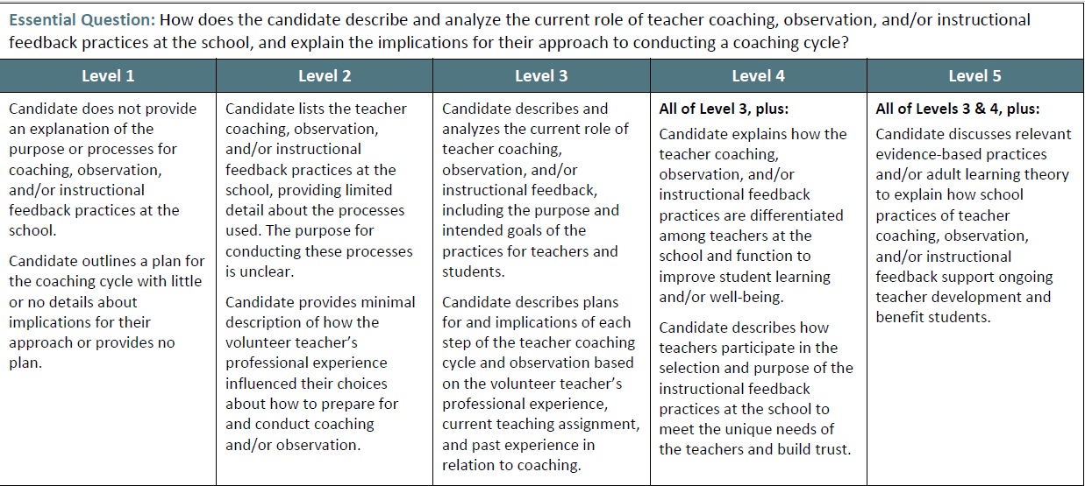
Sample Rubric
Notes:
This performance assessment is an analytic evaluation of one’s skills. The skills evaluated in each cycle are outlined in a 5-point rubric scale, with Level 3 being the baseline level for MET, echoing the Essential Question that is being asked.

Slide 9
Passing Requirements
Cycle 2
  7 rubrics
  Agendas and minutes
  Video clips of meetings
  Narrative analysis of skills
  14 points to pass NEW!
Cycle 1
  8 rubrics
  Quantitative data sets over time
  Qualitative data to illuminate gap
  No video component
  15 points to pass NEW!
Cycle 3
  7 rubrics
  Lesson plans, student work
  Video clips of a coaching cycle
  Narrative analysis of skills
  14 points to pass NEW!

Slide 10
When Something Goes Amiss: Condition Codes!
A letter/number code (e.g., B3) identifies the submission’s problem; score assignment is suspended. Candidate works with program support to identify and fix the misstep.
Common errors
    Submitted wrong cycle or step
    Video, Audio Clips not continuous and unedited; unplayable, or inaudible
            Duplicate clips submitted
            Required personnel not visible
    Uploaded document is illegible or wrong file type
    State indicator not identified
    Evidence (data sets, agendas, minutes, student work, lesson plans) were not submitted
    Incorrect file was uploaded
    Not original content (candidate subject to institution’s policy/discipline)
Condition Coded submissions require the candidate to fully re-submit

Slide 11
Executive Order/CASC Candidates Differ from PASC Candidates
Ways a CASC Candidate is Different
They hold an administrative position and have admin responsibilities
They are involved in the running of a school
It may be easier to access data
It may be more difficult to find “colleagues” to serve on a COP
It may be challenging to assume a “coaching” vs. evaluative role
Considerations in Supporting a CASC Candidate
The cycle tasks should be embedded in their daily responsibilities whenever possible
Time to work on the tasks of each cycle can be part of their regular workday hours (analyzing data, implementing a change, coaching teachers)
Having a site administrator who understands the tasks and paves the way for the candidate can be very helpful...“our” task, not “their” task attitude
Notes:
Executive Order CalAPA candidates (those allowed to receive their CE or preliminary ASC before passing the three CalAPA cycles are still required to pass them before being recommended for the clear ASC.

Slide 12


Cycle Two
Facilitating Communities of Practice

Slide 13
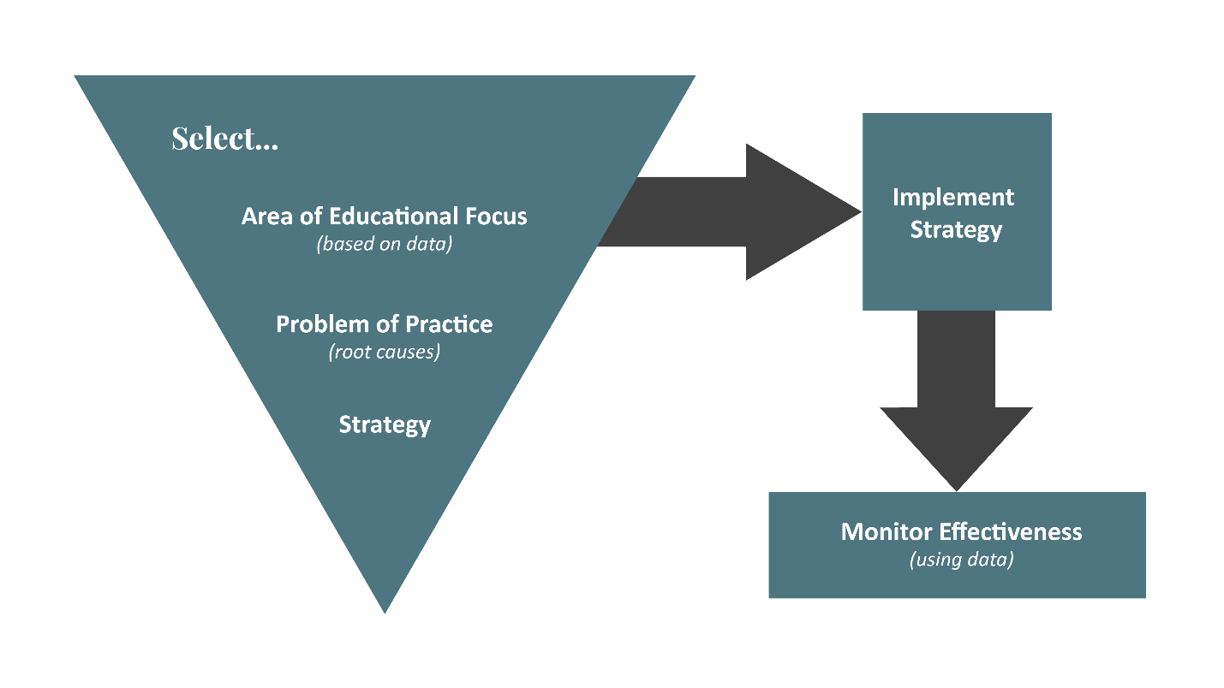
Cycle 2
Overview:

Slide 14
Cycle 2 “Builds Upon”/Throughline
1. Describe Professional Learning Context
2. Identify Educational Focus
3. Select Community of Practice
4. Co-facilitate Planning Meeting
5. Agree upon Problem of Practice
6. Jointly select evidence-based strategy
7. Implement and Monitor Strategy
8. Co-facilitate Implementation Meetings
9. Video-record Meeting/Annotate Evidence
10. Reflect on Equity Based Leadership in the process.

Slide 15

Visual of a Throughline

Slide 16

Cycle 2
Step 1 Investigate

Slide 17
Cycle 2 Step 1: Investigate
Assessment Guide (p 5-7)
Part A: Written Narrative: Context, Area of Educational Focus, Community of Practice (no more than 5 pages)
Inquiry into Collaborative Professional Learning at the School
  Describe and analyze the role of collaborative professional learning at the school as it relates to student learning and/or well-being (types of engagement, formal training, analysis of professional learning, relation to adult learning processes!)
  Considerations for you in leading a community of practice—glossary terms (see next slide)
Selecting an Area of Educational Focus Based on Data and Establishing a Community of Practice
  Choose an educational focus, based on local school context (e.g., data sets, school vision)
  Select 3-5 people to serve on your community of practice (who they are, why you included them, how you secured their support)

Slide 18
Use the Glossary of Terms
Community of practice:
Groups of people who share a concern or a passion for something they do and learn how to do it better as they interact regularly.

Slide 19
C2 Step 1: Investigate Essential Questions (2 Rubrics)
Step 1: Investigate
Rubric 2.1 How does the candidate describe and analyze the role of current practices of collaborative professional learning at the school and how these practices relate to student learning and/or well-being?
Rubric 2.2 How does the candidate select an area of educational focus based on student data that corresponds to the school’s vision, mission, and/or goals? How does the candidate choose a group of educators to participate in a community of practice in relation to the selected area of educational focus?
Notes:
2.1 describe and analyze…..as it relates to student learning and well-being
2.2 select focus, choose group, link back to school vision, mission, goals

Slide 20
Understanding Language is Key! Rubric 2.1
Level 1 | Level 2 | Level 3 | Level 4 | Level 5
Does not describe | Briefly describes | Describes and analyzes | All of level 3 plus explains impacted providing evidence | All of levels 3 and 4 plus critiques citing processes & research supports or refutes outlines implications
Absence of...”NOT”
Parts are evident, parts are missing
Reflects the Essential Question in statement form
Essential Question plus some additional
Level 3 + Level 4 + even more!

Slide 21
Understanding Language is Key!
Rubric 2.1
Level 1 | Level 2 | Level 3 Restates the essential question | Level 4 | Level 5
Does not describe | Briefly describes | Describes and analyzes | All of level 3 plus explains impacted providing evidence | All of levels 3 and 4 plus critiques citing processes & research supports or refutes outlines implications

Slide 22
Understanding Language is Key!
Rubric 2.2
Level 1 | Level 2 | Level 3 Restates the essential question | Level 4 | Level 5
selects, not based on [criteria] provides little detail does not provide reasons does not select an area | selects and minimally describes lists...and provides brief or irrelevant detail reasons... are not clear | selects...and cites data describes provides clear reason for inclusion | all of level 3 plus articulates... how group’s work will advance student learning/well-being | all of levels 3 and 4 plus provides a rational for inclusion; to ensure diverse viewpoints, to support student learning/well-being

Slide 23
Cycle 2
Step 1: Investigate Tips and Considerations
Collaborative Learning Environment varies among schools and within schools
Community of Practice is candidate plus 3-5 other educational partners (cannot dip below 3)
Educational partners can include administrators, teachers, classroom aides, school aides, family members

Slide 24
Cycle 2
Overview:
Step 1

Slide 25

Cycle 2
Step 2:
Plan

Slide 26
Cycle 2 Step 2: Plan
Assessment Guide (p 8-10)
Part B: Written Narrative: Identifying a Problem of Practice and Strategy to Address It
Part C: Planning Meeting Agenda
Part D: Planning Meeting Minutes
Conduct a Planning Meeting to Collaboratively Select a Problem of Practice Based on School and Student Data
  Create an agenda and co-facilitate a planning meeting (review data and education focus, determine a problem of practice, link to CA state standards, discuss student achievement)
  Record minutes of the meeting (what happened, agreements regarding next steps)
Identifying a Strategy to Address the Problem of Practice
  Collaboratively select one evidence-based strategy to address the problem of practice
  Plan for co-facilitation of learning strategy, implementation, monitoring, analyzing results

Slide 27
C2 Step 2: Plan Essential Questions
(2 Rubrics)
Step 2: Plan
Rubric 2.3 Using the agreed-upon area of educational focus as a starting point, how does the candidate work collaboratively with the group to review data sets and select a problem of practice related to student learning and/or well-being? How does the candidate work with the group members to acknowledge that the problem of practice might be addressed with a change in current instructional practice at the school?
Rubric 2.4 How does the candidate explain the collaborative process used during the planning meeting to select one relevant evidence-based strategy to address the selected problem of practice? How does the candidate describe the potential impact of the strategy on student learning and/or well-being?
Notes:
2.3 collaboratively work to select a PoP
2.4 Collaboratively work to choose, learn and monitor implementation of strategy to address problem

Slide 28
Understanding Language is Key!
Rubric 2.3
Level 1 | Level 2 | Level 3 Restates the essential question | Level 4 | Level 5
names a problem ...not related to learning/well-being or ed focus; names a problem that is reinstatement of the Problem of Practice does not focus on improvement provides no evidence | describes a problem with minimal relation not clear minimally involves | works collaboratively to select POP and explains how the group collaboratively analyzed, consensually selected, built ownership” | all of level 3 plus differentiates how POP looks between 2 student pops provides supporting evidence cofacilitated group to address these differences | all of levels 3 and 4 plus explains how and why cofacilitated collaboratively to analyze data, respect diverse views, co-identified POP

Slide 29
Understanding Language is Key!
Rubric 2.4
Level 1 | Level 2 | Level 3 Restates the essential question | Level 4 | Level 5
selects a strategy with no connection does not provide | selects a strategy that vaguely addresses seeks minimal input consensus identifies but does not build consensus | collaboratively works with group to learn...and monitor implementation to address POP describes potential impact | All of level 3 plus describes in detail....will improve learning/well-being | All of levels 3 and 4 plus thoroughly explains... implications and challenges.

Slide 30
Cycle 2
Step 2: Plan
Tips and Considerations
Educational Focus
  informed by data
Problem of Practice
  What changes in adult professional practice may mitigate the issue being addressed in the Educational Focus.
  Facilitates COP learning the strategy
Selected Strategy(ies)
  must be implemented in Step 3

Slide 31
Cycle 2
Overview:
Step 2

Slide 32
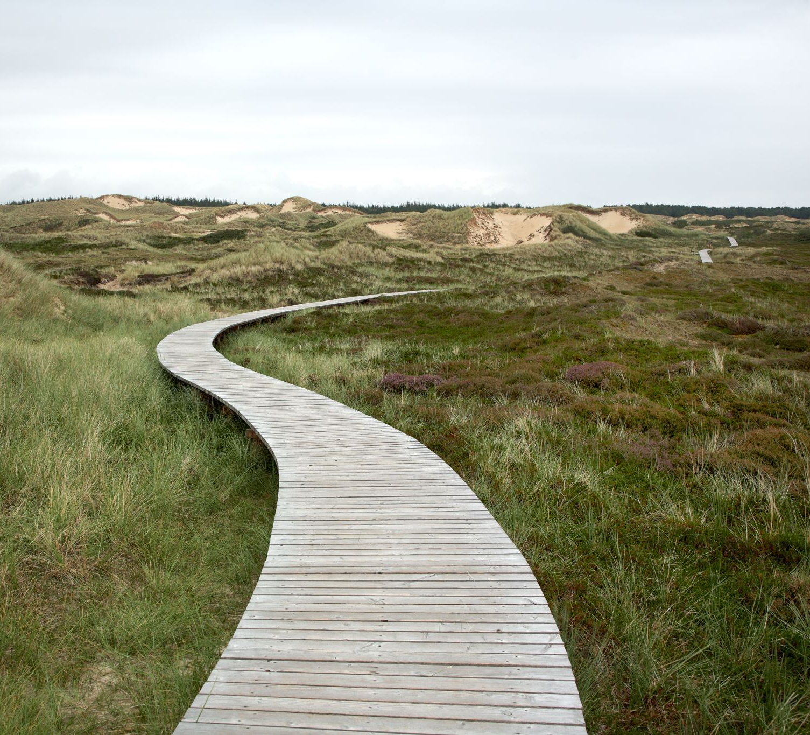
Cycle 2
Step 3:
Act
Notes:
Gay

Slide 33
Cycle 2 Step 3: Act
Assessment Guide (p 11-15)
Part E: Agendas for Implementation Meetings (at least 3 meetings)
Part F: Minutes for Implementation Meetings (at least 3 meetings)
Part G: Key Collaborative Work Products (no more than 10 pages)
Part H: 3 Annotated Video Clips (no more than 5 minutes each)
Co-facilitate Community of Practice Implementation Meetings
  Include required topics of discussion in each meeting (teach strategy, monitor results, support group needs, ensure engagement of all members)
Document Community of Practice Progress
  Maintain detailed agendas and minutes
  Develop and submit collaborative work products (10 page max)
  Document your support of each CoP member
  Documents implementation success, analyze results, determine next steps
  Video record all meetings, ensuring a minimum of three CoP members and yourself are visible

Slide 34
Cycle 2 Step 3 Videos
Three videos submitted (each no more than 5 minutes)
  Clip 1 Title -Opening of Meeting
  Clip 2 Title- Professional Collaboration
  Clip 3 Title-End of Meeting and Next Steps.
Three Annotations
Discussing the Value of Shared Norms and Meeting Purposes
  Building Consensus and Documenting Agreements and Decisions
  Analyzing Results and Jointly Determining Next Steps
Titles will be updated to match annotations
Annotations are not “assigned” to any specific video

Slide 35
C2 Step 3: Act Essential Questions
(2 Rubrics)
Step 3: Act
Rubric 2.5 How does the candidate demonstrate and analyze a variety of their co-facilitation skills of group learning—e.g., the value of establishing norms; documenting group decisions; supporting diverse viewpoints; and/or maintaining group focus and energy—while facilitating a collaborative process
Rubric 2.6 How does the candidate co-facilitate a discussion that leads to a consensual understanding of initial implementation results? How does the candidate collaboratively lead the group in jointly determining next steps?
Notes:
2.5 co-facilitate learning—see specific items
2.6 demo leadership through meeting facilitation

Slide 36
Understanding Language is Key!
Rubric 2.5
Level 1 | Level 2 | Level 3 Restates the essential question | Level 4 | Level 5
does not demonstrate does not provide.. analysis are not determined | facilitates and provides evidence but not not a process for using them...limited info on collaborations only occasionally provides analysis next steps not clearlydetermined jointly | demonstrates ...skills on list consistently provides analysis works to jointly determine” | All level 3 plus purposefully seeks diversity clearly encourages all...to speak and share | All of levels 3 and 4 plus critiques their co-facilitation skills used

Slide 37
Language is Important
Rubric 2.6
Level 1 | Level 2 | Level 3 Restates the essential question | Level 4 | Level 5
does not co-facilitate or support learning/implementation does not provide analysis does not ask for/collect results or feedback | minimally co-facilitates implementation/group learning little or unspecific support for group only occasionally provides analysis collects results feedback ...does not show use | cofacilitates meetings... implementation/learning, checking understanding, providing support to group consistently provides analysis collects and uses results and feedback from group to inform learning | All of level 3 plus consistently addresses results and feedback to inform learning within and between meetings,... with group, identifies challenges and successes | All of level 3 and 4 plus jointly proposes acts on potential solutions celebrating successes adjusting the strategy

Slide 38
Cycle 2
Step 3: Act Tips and Considerations
3 Annotated Video Clips
  Unedited
  Contiguous
  Candidate visible
  3 or more members of COP visible
  Co-facilitation is more than one person leading, planning, or designing a work project
  Implementation of Strategy Required
  Evidence Video—results and feedback on
  implementation
  At least 3 Implementation Agendas & Minutes

Slide 39
Cycle 2
Overview:
Step 3

Slide 40

Cycle 2
Step 4: Reflect

Slide 41
Cycle 2 Step 4: Reflect
Assessment Guide (p 16-17)
Part D: Reflective Narrative (no more than 5 pages of written or no more than 5 minutes of video explanation)
Analysis of Developing a Community of Practice through Co-facilitation
  Analyze what you have learned as a leader co-facilitating a group
  Gather feedback from CoP members
  Using data, identify successes and challenges in co-facilitating learning with the group
Reflectiv Narrative
  Reflect on your learning and equitable leadership development throughout Leadership Cycle 2
  Consider your leadership capacity to co-facilitate collaborative professional learning and implementation of an evidence-based strategy.

Slide 42
C2 Step 4: Reflect & Essential Question (1 Rubric)
Step 4: Reflection
Rubric 2.7 How does the candidate reflect upon initial implementation results and feedback from the group to analyze their leadership skills and practices to make specific connections to their areas for growth and identify next steps, citing specific evidence from any of the four steps? How does the candidate demonstrate a variety of leadership skills used to equitably co-facilitate a community of practice?
Notes:
2.7 use results and feedback---analyze results and feedback to analyze their leadership skills

Slide 43
Understanding Language is Key!
Rubric 2.7
Level 1 | Level 2 | Level 3 Restates the essential question | Level 4 | Level 5
“provides no connection” to identify strengths and growth” “does not describe equitable leadership in co-facilitating COP | “vaguely or inaccurately refers to results feedback” to identify strengths/growth/next steps “provides an inconsistent or uncertain approach to co-facilitate” “it is not clear (equitable approach)” | “uses initial results and feedback...to analyze skills for strengths and growth areas” “clearly and consistently demonstrates equitable leadership | All of level 3 plus “illustrates how they maintained ....list” | All of levels 3 and 4 plus “draws on and cites practices and research on equitable leadership/adult learning/group co-facilitation...to set goals for their future practice

Slide 44
Cycle 2
Step 4: Reflect
Tips and Considerations
Reflect on their abilities as an equitable leader
Discuss their leadership growth
  Implementation results
  Group feedback
Next steps is not about what happens next in implementation of strategy, but rather their equity journey

Slide 45
Cycle 2
Overview:
Step 4

Slide 46

Thanks for attending!
Technical questions: es-calapa@pearson.com
Policy questions: CalAPA@ctc.ca.gov
Website: www.ctcexams.nesinc.com

