Slide 1

CalAPA Year 7 Deep Dives
September 4, 2024
Presented by Gay Roby
Consultant, CTC

Slide 2
Please download this PowerPoint and the Version 7 Assessment Guide and follow along with markers and pen!

Slide 3
Accessing 2024-2025 (Version 07) CalAPA Assessment Materials
Preparation programs may download the 2024-2025 (Version 07) CalAPA assessment materials via password-protected a zip file located on the CalAPA Faculty Policies and Resources web page.
2024-2025 Zip File Password: C@lapa24

Slide 4

CalAPA Overview

Slide 5
Why performance assessment?
Demonstration of pertinent skills for today’s school leaders
Commission: “Focus on school site needs” for the Preliminary ASC program
Focus on the PURPOSE of each cycle, not the activities
    Cycle 1: Gathering and Using Data to Improve our Schools
    Cycle 2: Leading Colleagues in Taking Action to Improve our Schools
    Cycle 3: Coaching Certificated Staff to Improve Classroom Practice

Slide 6
Equity Driven Leadership:
Woven throughout the assessment cycles
Conceptualize schools as complex organizations composed of a network of dynamic and interdependent thinking components
Pursue school change and improvement through systemic change and capacity building
Create and articulate a shared vision of a school as a place where all students are seen as fully engaged, inspired, and empowered, and their voices are heard.
San Diego State University (2018). Five types of equity driven leadership thinking. In SDSU Handbook for Educational Leadership {Brochure}. San Diego, CA: Author.

Slide 7
CalAPA Structure: Three Leadership Cycles – Four Steps
Leadership Cycle 1: Analyzing Data to Inform School Improvement and Promote Equity
Leadership Cycle 2: Facilitating Communities of Practice
Leadership Cycle 3: Supporting Teacher Growth
Investigate
Plan
Act
Reflect
Notes:
The focus is on leadership, not on completing activities
Recursive 4-step process runs throughout the cycles
Note: there is no video component for cycle 1 but there is for cycles 2 and 3

Slide 8
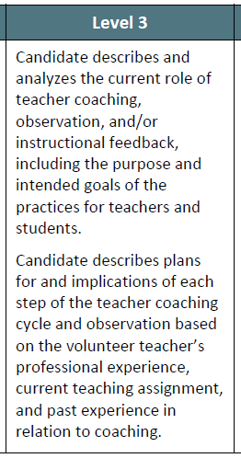
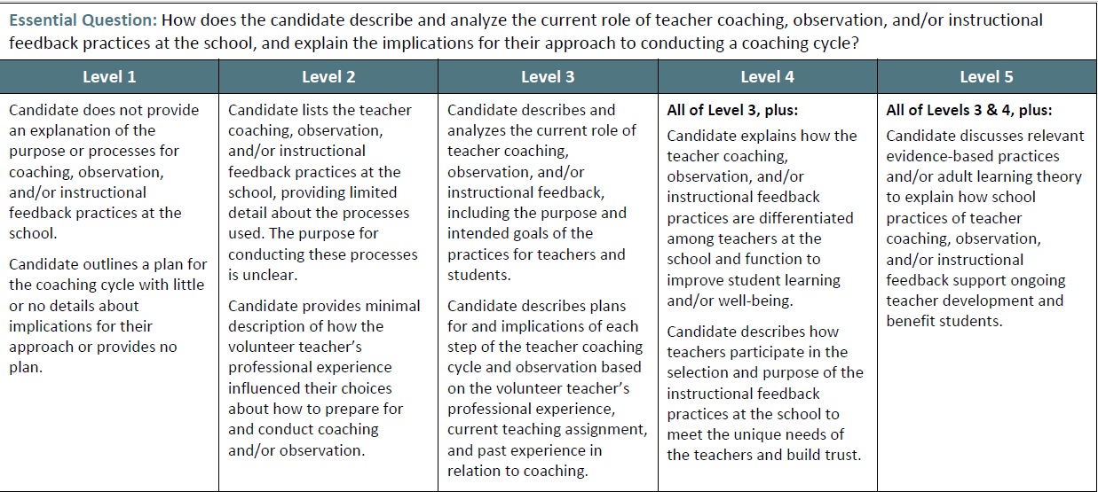
Sample Analytic Rubric
Notes:
This performance assessment is an analytic evaluation of one’s skills. The skills evaluated in each cycle are outlined in a 5-point rubric scale, with Level 3 being the baseline level for MET, echoing the Essential Question that is being asked.

Slide 9
Passing Requirements
Cycle 2
  7 rubrics
  Agendas and minutes
  Video clips of meetings
  Narrative analysis of skills
  14 points to pass
Cycle 1
  8 rubrics
  Quantitative data sets over time
  Qualitative data to illuminate gap
  No video component
  15 points to pass
Cycle 3
  7 rubrics
  Lesson plans, student work
  Video clips of a coaching cycle
  Narrative analysis of skills
  14 points to pass

Slide 10
When Something Goes Amiss: Condition Codes!
A letter/number code (e.g., B3) identifies the submission’s problem; score assignment is suspended. Candidate works with program support to identify and fix the misstep.
Common errors
    Submitted wrong cycle or step
    Uploaded document is illegible or wrong file type
    State indicator not identified
    Evidence (e.g., data sets) were not submitted
    Incorrect file was uploaded
    Not original content (candidate subject to institutional discipline)
Condition Coded submissions require the candidate to fully re-submit

Slide 11
Executive Order/CASC Candidates Differ from PASC Candidates
Ways a CASC Candidate is Different
They hold an administrative position and have admin responsibilities
They are involved in the running of a school
It may be easier to access data
It may be more difficult to find “colleagues” to serve on a COP
It may be challenging to assume a “coaching” vs. evaluative role
Considerations in Supporting a CASC Candidate
The cycle tasks should be embedded in their daily responsibilities whenever possible
Time to work on the tasks of each cycle can be part of their regular workday hours (analyzing data, implementing a change, coaching teachers)
Having a site administrator who understands the tasks and paves the way for the candidate can be very helpful...“our” task, not “their” task attitude
Notes:
Executive Order CalAPA candidates (those allowed to receive their CE or preliminary ASC before passing the three CalAPA cycles are still required to pass them before being recommended for the clear ASC.

Slide 12

Cycle One:
Analyzing Data to Inform School Improvement and Promote Equity

Slide 13
Overview of the Cycle 1 Steps:
Choose a CA state indicator
Conduct quantitative Data Review
Select a student group
Collect & analyze qualitative data
Determine equity gap for student group
Identify potential
contributing factors
Develop a
problem statement
Identify strategies
seek feedback
adjust
Reflect

Slide 14

Cycle 1
Step 1 Investigate

Slide 15
Cycle 1 Step 1:
Assessment Guide (p 5-8)
Part A. Data Tables and Written Narrative: Data Collection and Equity Gap Analysis Template
School Vision, Mission, and/or Goals
  Investigate the vision, mission, and goals of selected school
  Record your findings
Initial Data Collection
  Select CA Indicator topic or well-being issue related to your selected school
  Collect and Analyze Quantitative Data
  Select one student group
Extended Data Collection
  Conduct qualitative data gathering from a range of sources
  Record and analyze the data in table provided
Conduct an Equity Gap Analysis
  Note discrepancies

Slide 16
Glossary Terms define CalAPA Usage
Equity gap analysis. The process of identifying discrepancies between resource allocations and outcomes for previously identified underserved students specified in school site/district improvement plans and actual performance in relation to those measures. Results of an equity gap analysis may show, for example, a lack of monitoring for effectiveness; that data are incomplete or insufficient and require more qualitative data such as student shadowing; or identification of additional underserved student groups.
Page 32

Slide 17
C1 Step 1: Investigate Rubric Essential Questions
(3 Rubrics)
Step 1: Investigate
Rubric 1.1 Based on the chosen California state indicator, how does the candidate select and analyze quantitative data sources across the three most recent years, identify patterns and/or trends related to equity, choose one student group, and relate their analysis to the school’s vision, mission, and/or goals?
Rubric 1.2 How does the candidate collect and analyze a range of at least three qualitative data sources and explain their relation to quantitative data findings and the student group equity issue?
Rubric 1.3 How does the candidate conduct an equity gap analysis based on the chosen California state indicator to inform their understanding of the equity issues for a student group? How does this equity gap link to the school's vision, mission, and/or goals?
Notes:
Corresponds to a. b. and c. from previous slide
Rubric 1.1 analyze data, identify patterns choose a group, relate the analysis to school vision
Rubric 1.2 design, collect, analyze quantitative data
Rubric 1.3 conduct an equity gap

Slide 18
Understanding Language is Key!
Rubric 1.1
Level 1 | Level 2 | Level 3 | Level 4 | Level 5
Does not include Selects...that is not Not identified or irrelevant Does not relate | Selects that is not....but able to identify patterns Not clear Superficially relates | Selects and analyzes identifying chooses | All of level 3 plus explores additional...to support...to further understand | All of levels 3 and 4 plus cites relevant... supports, analysis Clearly explains why...informs understanding
Reflects the Essential Question in statement form
Essential Question plus some additional
Absence of...”NOT”
Parts are evident, parts are missing
Level 3 + Level 4 + even more!

Slide 19
Understanding Language is Key!
Rubric 1.2
Level 1 | Level 2 | Level 3 | Level 4 | Level 5
Provides no or irrelevant info Does not present | Minimally connects Does not provide | Collects Clearly explains | All of level 3 plus Provides a comprehensive analysis Collecting additional qualitative data to deepen understanding | All of levels 3 and 4 plus Is responsive to complex context Demonstrated cultural sensitivity and appreciation of diverse thots

Slide 20
Understanding Language is Key!
Rubric 1.3
Level 1 | Level 2 | Level 3 | Level 4 | Level 5
Identifies issue with no evidence/data analysis Does not identify Provides biased description Does not identify any linkages | Identifies... based on minimal Identifies...not clear Minimal description Minimal description | Identifies Clearly describes Clearly describes Identifies linkages | All of level 3 plus Conducts a thorough Describing a clear Provides a sophisticated understanding | All of levels 3 and 4 plus Cites relevant research to inform and support Clearly explains why.....informs their understanding

Slide 21
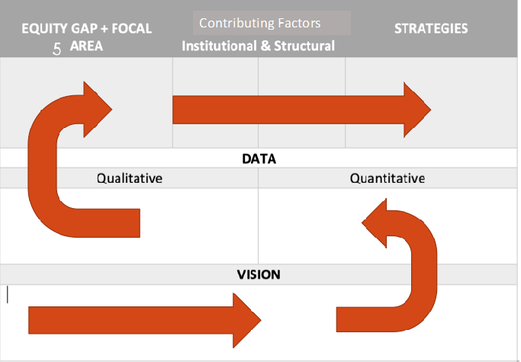
Building a Cycle 1 Submission
The Through Line Concept

Slide 22

22

Slide 23
Possible Data Sources
Quantitative
Site level data
Benchmark Testing Results
Teacher generated tests
Referral Data, Counselor usage
FAFSA completion
College Applications
Qualitative
Virtual Interviews, Observations
Electronic Surveys
Online records reviews
NOTE: Candidates may use the years prior to COVID if their desired data set has gap years.

Slide 24
Overview of Cycle 1 Step 1: Investigate
Choose a CA state indicator
Conduct quantitative Data Review
Select a student group
Collect & analyze qualitative data
Determine equity gap for student group
Identify potential
contributing factors
Develop a
problem statement
Identify strategies
seek feedback
adjust
Reflect

Slide 25

Cycle 1
Step 2:
Plan

Slide 26
Cycle 1 Step 2:
Assessment Guide (p 9-10)
Part B: Written Narrative: Contributing Factors and Problem Statement
Institutional /Structural Factors
  Based on equity-gap analysis AND the quantitative AND the qualitative data –THROUGHLINE!
  Determine institutional and/or structural factors – GLOSSARY!
  Cite evidence, cite research—(Researcher’s name, year of research)
  Identify an education need related to equity gap for 1 group of students--get better at...
Problem Statement to Address Student Group’s Area of Need
Prepare a Problem Statement—call out boxes support the glossary
A problem statement is a clear, concise description of the issue(s) that need(s) to be addressed by a problem-solving team. It is used to center and focus the team at the beginning of the effort, to keep the team on track during the effort, and to validate that the effort delivered an outcome that solves the problem statement.

Slide 27
C1 Step 2: Plan Rubric Essential Questions (2 Rubrics)
Step 2: Plan
Rubric 1.4 How does the candidate determine contributing factors, including institutional and/or structural factors, that created or added to the identified equity gap affecting a student group and cite the research supporting their determination?
Rubric 1.5 How does the candidate use the equity gap analysis and identification of potential contributing factors to develop a feasible problem statement related to student achievement and/or well-being?
Notes:
1.4 Contributing factors—looking behind the gap to identify the need
1.5 Develop a feasible problem statement

Slide 28
Understanding Language is Key!
Rubric 1.4
Level 1 | Level 2 | Level 3 | Level 4 | Level 5
Identifies biased, superficial, irrelevant factors in analysis Does not cite, neglect to draw connections Identifies areas unrelated to analysis | Identifies but minimally describes relation to analysis Attempts to draw connecting not related to gap Identifies areas superficially related to analysis | Used analysis and data to determine factors Cites relevant research to support, add to gap understanding | All of level 3 plus Explains in detail how factors create/add to differences of group | All of levels 3 and 4 plus Demonstrates sophisticated... understanding of causes Identifies relevant areas that would improve conditions

Slide 29
Understanding Language is Key!
Rubric 1.5
Level 1 | Level 2 | Level 3 | Level 4 | Level 5
does not use Is not responsive | Attempt to use....to develop, but is not clear Only partially responsive | Develops... that clearly draws Is responsive | All of level 3 plus is responsive to culture, context...needs | All of levels 3 and 4 plus cites relevant practices or research on how...been addressed

Slide 30
Building a Cycle 1 Submission Review
The Through Line Concept

Slide 31
Overview of Cycle 1 Step 2: Plan
Choose a CA state indicator
Conduct quantitative Data Review
Select a student group
Collect & analyze qualitative data
Determine equity gap for student group
Identify potential
contributing factors
Develop a
problem statement
Identify strategies
seek feedback
adjust
Reflect

Slide 32

Cycle 1
Step 3:
Act

Slide 33
Cycle 1 Step 3:
Assessment Guide (p 11)
Part C: Written Narrative: Planning for School Improvement and Promoting Equity
I. Planning for School Improvement and Promoting Equity
  Based on (THROUGHLINE!) data and equity gap analysis, a develop strategy (research-based) to address your problem statement
  Solicit targeted feedback (not just pat-on-the-back) and alter strategy accordingly
      THROUGHLINE evidence—aligns with school vision/mission/goals, addresses equity gap, takes into account contributing factors, meets students’ needs, incorporated school improvement
  Describe steps you would take to get buy-in from the school community and proactive work to ensure positive reception

Slide 34
Step 3: Act Rubric Essential Questions
(2 Rubrics)
Step 3: Act
Rubric 1.6 Are the strategy(ies) proposed for equitable school improvement for the student group well informed by the findings of the equity gap analysis, including contributing factors, and responsive to the problem statement? Is proposed strategy(ies) aligned to the school’s vision, mission, and/or goals?
Rubric 1.7 How does the candidate apply the feedback received from educational partners familiar with the school culture and context and describe next steps for creating educational partner buy-in and potential implications for the adjusted set of strategy(ies)?
Notes:
1.6 well informed strategies that are linked to school context
1.7 seek and apply feedback

Slide 35
Understanding Language is Key!
Rubric 1.6
Level 1 | Level 2 | Level 3 | Level 4 | Level 5
Does not propose strategies Strategies are not based...and are not aligned | Strategies are minimally informed Strategies proposed are not clearly aligned | Strategies...are well informed by ... are responsive Strategies proposed are clearly aligned | All of level 3 plus provides relevant strategies... represents.. approach to addressing equity | All of levels 3 and 4 plus provides ...evidence of....and their implementation

Slide 36
Understanding Language is Key!
Rubric 1.7
Level 1 | Level 2 | Level 3 | Level 4 | Level 5
Does not apply States plans with little or no explanation Does not identify | Vaguely describes feedback and makes minimal or irrelevant.... Briefly describes proposed strategies to address...it is not clear | Applies feedback received to adjust or strengthen Provides relevant and appropriate next steps...to address Describes | All of level 3 plus seeks additional...feedback to ensure they are proposing strategically plans and shares | All of levels 3 and 4 plus Plans to coach stakeholders to examine and address...is transparent

Slide 37
Building a Cycle 1 Submis 3sion

Slide 38
Overview of Cycle 1 Step 3: Act
Choose a CA state indicator
Conduct quantitative Data Review
Select a student group
Collect & analyze qualitative data
Determine equity gap for student group
Identify potential
contributing factors
Develop a
problem statement
Identify strategies
seek feedback
adjust
Reflect

Slide 39

Cycle 1
Step 4 Reflect

Slide 40
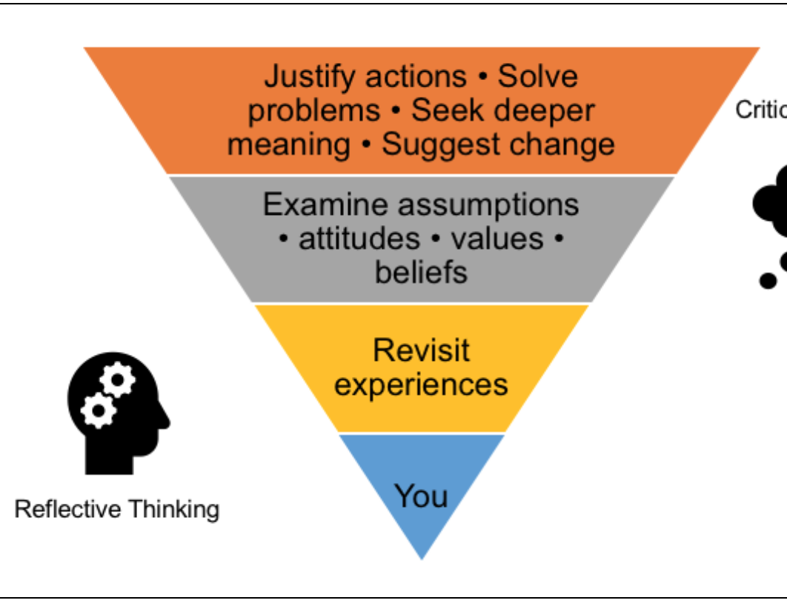
Reflective Writing (1.8)
Reflective writing is a processing phase in which candidates can communicate their learning in light of their experiences.

Slide 41
Cycle 1 Step 4: Reflect
Assessment Guide (p 12)
Part D: Reflective Narrative (no more than 5 pages of written or no more than 5 minutes of video explanation)
I. Reflecting Narrative
  Reflect on what you have learned...focus on your leadership capacity
  Learnings specific to contributing factors
  Learnings specific to equity-driven leadership
  Reflect on what you have learned from all the activities of Cycle 1 (THROUGH-LINE)
    Rationale for selecting feedback provider (why them?)
    Growth as an equity-driven leader
    Your next steps for professional learning

Slide 42
C1 Step 4: Reflect Rubric Essential Question
(1 Rubric)
Step 4: Reflect
Rubric 1.8 How does the candidate reflect on and analyze what they have learned about equity-driven leadership in Cycle 1 (citing from Steps 1, 2, and/or 3) and how, based on the school contexts, they might address a single equity gap for a group of students at the school? How does the candidate use reflection on their own strengths and areas for growth as an equity-driven leader to address equity needs for the identified group(s) of students at their chosen school?
Notes:
What they have learned about leadership and how to address an equity gap for a group of students? How to use this learning?
NOT summarize what they did!!!!

Slide 43
Understanding Language is Key!
Rubric 1.8
Level 1 | Level 2 | Level 3 | Level 4 | Level 5
Is irrelevant ....are not discussed or present bias Are not aligned...buy-in is not discussed Does not discuss strengths and/or growth | Demonstrates limited understanding ...to address Limited insight into...in developing Are provided but are loosely related | Reflects on and analyzes...to address Provides a clear ..and how impacted...to build Assesses ...draws from...to identify strengths/growth | All of level 3 plus Demonstrates how...to providing equity-driven leadership Develops steps to address...to improve learning/well-being | All of levels 3 and 4 plus Reflection... influences.... analyzes challenges...to address and to act on

Slide 44
Overview of Cycle 1 Steps: Reflect
Choose a CA state indicator
Conduct quantitative Data Review
Select a student group
Collect & analyze qualitative data
Determine equity gap for student group
Identify potential
contributing factors
Develop a
problem statement
Identify strategies
seek feedback
adjust
Reflect

Slide 45


Technical questions: es-calapa@pearson.com
Policy questions: CalAPA@ctc.ca.gov
Website: www.ctcexams.nesinc.com

