Slide 1
New Options for Candidates to Meet the Basic Skills Requirement
August 2021

Slide 2
Why the Change
Severe and persistent teacher shortage required a reevaluation of testing requirements and desire to “right size” testing for future educators
Recognition that there are multiple valid ways to demonstrate basic skills competence
Recognition that successful completion of coursework at the collegiate level has meaning

Slide 3
Why the change?
Recognition of the imperative to expand and diversify the teaching workforce in California
To reduce the financial hardship experienced by individuals as they prepare to become members of the education profession.

Slide 4
AB 130 (Chap. 44, Stats 2021)
The bottom line:
The 2021-2022 Budget Trailer Bill expanded the list of options available to candidates to meet the Basic Skills Requirement to include coursework and a mix and match option of coursework and exam subtests.

Slide 5
Previous Options for Meeting BSR
1. Pass CBEST
2. Pass CSET: MS + Writing Skills Exam
3. Pass CSU Early Assessment or CSU Placement Exams
4. Qualifying score on SAT/ACT
5. 3 or Higher on AP Exam
6. Basic Skills Exam from Another State

Slide 6
Two New Options:
7. Coursework Option
8. Combination Coursework and Exams Option

Slide 7
New Options for Meeting BSR
Coursework option conditions:
Must have been taken at a regionally accredited institution of higher education
Can include community college coursework (whether used for transfer or not)
Candidate must have achieved a grade of B- or better, Pass, or Credit
Course must have been the equivalent of 3 semester units or 4.5 quarter units
Course must be degree applicable

Slide 8
New Options for Meeting BSR
Coursework option conditions:
Cannot be professional development classes
Cannot be continuing education units
Cannot be in-service training or workshops

Slide 9
What courses are allowed?
Reading: critical thinking, literature, philosophy, rhetoric, textual analysis
Writing: composition, English, rhetoric, written communication, writing
Mathematics: algebra, geometry, mathematics, quantitative reasoning, statistics.

Slide 10
Allowing a Single Course for Both Reading and Writing
Yes, it is allowable
Rhetoric is listed in the law under both Reading and Writing and may be automatically counted for both
Other courses may be accepted if the application is accompanied by a letter from the registrar or department chair of the institution where the candidate has taken the course attesting that it covers both areas.

Slide 11
Support Letters
A course which does not fit the guidance can still be accepted if a letter from the registrar or appropriate department chair verifies the content.
Example: course from the Computer Science department used to clear Mathematics.

Slide 12
New Options for Meeting BSR
Combination Coursework/Exam:
Only available through Commission approved programs.
All conditions on coursework apply
May use any of the available exam options

Slide 13
Examples of Combination Option
Example 1
Candidate passed CBEST Reading and Writing
Candidate has not taken or not passed CBEST Mathematics
Candidate has taken Math 31: Introduction to Linear Algebra at CSUS, earned B+
Program may determine this candidate meets BSR through the Combination option.

Slide 14
Examples of Combination Option
Example 2
Candidate has passed CBEST Mathematics
Candidate has not taken CBEST Reading or Writing
Candidate scored 3 on AP English test (which may count for English and Writing)
Program may determine this person meets BSR through Combination option.

Slide 15
Process for Online Recommendations
Form 41-BSR (or other written verification) must accompany online recommendations from a Commission approved preparation program for:
Coursework option, or
Combination option
Form 41-BSR not necessary if using CBEST or CSET scores to meet the requirement

Slide 16
Process for Paper Applications
Commission-approved preparation programs: Form 41-BSR must accompany submissions for:
Coursework option, or
Combination option
All other agencies: 41-BSR is encouraged but not required as Commission staff must verify the requirement with official transcripts.
The Commission is not able to verify the Combination option

Slide 17
What does all this mean?
Many candidates/applicants should be able to meet BSR with existing coursework used to fulfill general education requirements, AA or BA/BS degrees as long as conditions are met.
There is no need for institutions to build new “courses” for these new options.
Yes, a review of a candidate’s coursework/transcripts/examinations will be necessary.

Slide 18
What does all this mean?
These new options may be implemented today.
These new options are available for any candidate or individual who needs to demonstrate basic skills for a credential or certificate.

Slide 19
What does all this mean?
Commission approved programs:
Document your process.
Keep appropriate records for each candidate as to how they met BSR.
Verification of implementation of appropriate processes will be built into the regular accreditation process (Common Standard 1).

Slide 20
FAQs
Can we use this with former students who were stopped from continuing to progress? Yes, these options are available to all individuals who need to meet BSR.
Is there are recency requirement on the coursework? No.

Slide 21
FAQs
Who needs to submit the documentation for the candidate to CTC? Only the authorized submitters from a Commission approved program may submit the necessary documentation to CTC.
Can we accept coursework from out of state institutions? Yes, if the coursework meets the required conditions.

Slide 22
FAQs
Will courses where the student earned “credit” or “pass” in place of a letter grade be acceptable? Yes. If no letter grade is earned, a course designated with “credit” or “pass” would be acceptable.
Can all programs verify BSR, or is this only available to preliminary preparations programs? All Commission-approved programs, including Intern, Induction, CTEL, and CTE programs have the authority in statute to verify the BSR.

Slide 23
FAQs
What does “degree applicable” mean? Does that mean the course must have been a part of the required coursework for the candidate’s degree program? No. Degree applicable means that the course is non-remedial and could be applied towards the undergraduate requirements of a Bachelor’s degree or for an Associates degree, or is transferred to a four-year institution.

Slide 24
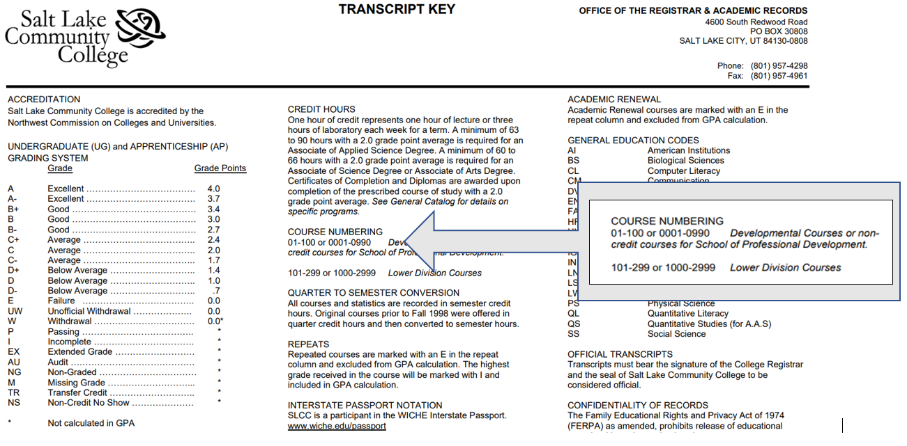

Slide 25
Questions?

Slide 26
Thank you for your attendance

