Slide 1
How Preparation Predicts Teaching Performance Assessment Results in California
California Commission on Teacher Credentialing
Susan Kemper Patrick
June 21, 2024

Slide 2
Objectives
What predicts success on TPAs for California candidates?
How do TPA results vary across preparation pathways, programs, and preparation experiences?
The CTC provided statewide data on:
Teaching credentials
TPA records
Program completer surveys

Slide 3
Who is included in this performance assessment analysis?
California teaching candidates who took the CalTPA or edTPA in 2021-22 or 2022-23 (N=18,455 candidates)
Excluded anyone who received a pandemic-related deferral to take their TPA during induction
Program-level passing rates for all CA-based preparation programs with at least 5 tested candidates (N=263 programs)
Programs defined based on institution, credential area, preparation pathway (ex: San Diego State’s preservice single subject program)

Slide 4
How are we measuring TPA performance?
CalTPA (N=11,092 candidates)
Initial passing: Passed both cycles on their first attempt
Eventual passing: Passed both cycles across all attempts
edTPA (N=7,363 candidates)
Initial passing: Passed on their first attempt
Eventual passing: Passed across all attempts
Includes all teaching candidates with at least one scored attempt except CalTPA candidates who took cycle 1 after January 1, 2023 but never attempted cycle 2.

Slide 5
Differences across candidate characteristics

Slide 6
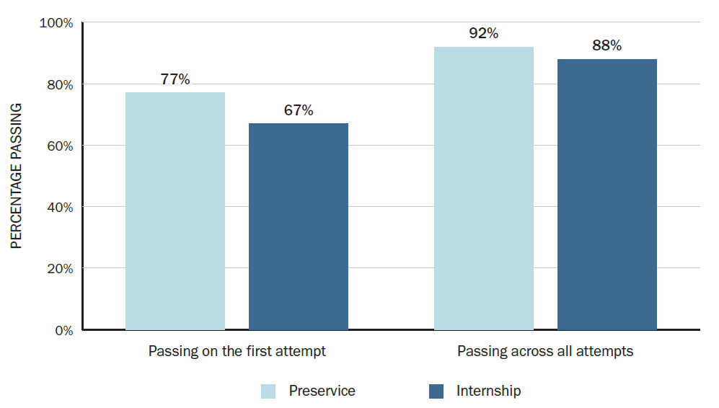
Preservice candidates were more likely to be successful on a TPA.
Credential data captures differences in pathway:
Preservice programs include student teaching or residency placement before becoming teacher of record
Intern programs occur while serving as teacher of record
Source: Learning Policy Institute analysis of Commission on Teacher Credentialing data (2024).

Slide 7
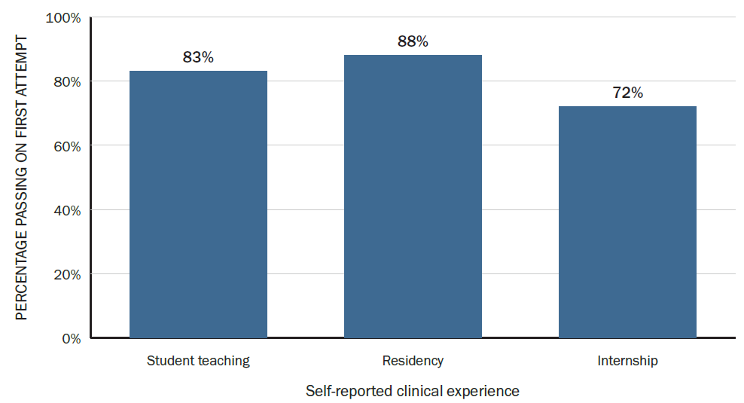
Completers known to be residents had higher initial passing rates.
Notes: This analysis includes 2,378 student teachers, 325 residents, and 780 interns and it does not include candidates from the California State University system.
Source: Learning Policy Institute analysis of Commission on Teacher Credentialing data (2024).

Slide 8
Program passing rates are associated with racial/ethnic disparities in TPA success.
Among candidates for whom TPA results can be connected to self-reported race/ethnicity (N=4,323 candidates, excluding CSU completers):
Programs with lower passing rates tend to have larger racial and ethnic disparities among their candidates
There are not statistically significant differences in passing rates among programs with eventual passing rates above 90%.
These patterns suggest that statewide disparities may reflect differential access to supportive preparation.

Slide 9
What about candidates who don’t pass on their first attempt?

Slide 10
CalTPA candidates
CalTPA Cycle 1 | N | %
Passed on 1st attempt | 11,795 | 74%
2nd attempt | 2,188 | 14%
3rd attempt | 408 | 3%
4th attempt or more | 110 | 1%
Never passed | 1,349 | 9%
CalTPA Cycle 2 | N | %
Passed on 1st attempt | 10,541 | 85%
2nd attempt | 1,006 | 8%
3rd attempt | 176 | 1%
4th attempt or more | 42 | <1%
Never passed | 583 | 5%
Note: This analysis includes all candidates whose last attempt on the CalTPA occurred between September 1, 2021 and August 31, 2023.
Source: Learning Policy Institute analysis of Commission on Teacher Credentialing data (2024).

Slide 11
edTPA candidates
edTPA candidates | N | %
Passed on 1st attempt | 6,476 | 82%
2nd attempt | 549 | 7%
3rd attempt | 178 | 2%
4th attempt or more | 97 | 1%
Never passed | 607 | 8%
Note: This analysis includes all candidates whose last attempt on the edTPA occurred between September 1, 2021 and August 31, 2023.
Source: Learning Policy Institute analysis of Commission on Teacher Credentialing data (2024).

Slide 12
Perceptions of retakers
Source: Learning Policy Institute analysis of Commission on Teacher Credentialing data (2024).

Slide 13
Differences across programs

Slide 14
Passing rates varied considerably across preparation programs.
Among all the CA preparation programs in this analysis (N=263):
167 programs (63%) had eventual passing rates above 90%
101 programs (38%) had eventual passing rates above 95%
61 programs (23%) had all of their candidates pass a TPA
35 programs (13%) had eventual passing rates under 80%
14 programs (5%) had eventual passing rates under 70%

Slide 15
Initial passing rates for multiple subject programs for 2021-22/2022-23
Initial Passing Rate | Number of programs
<60% | 45
60-69.9% | 22
70-79.9% | 23
80-89.9% | 14
90-100% | 15
Source: Learning Policy Institute analysis of Commission on Teacher Credentialing data (2024).

Slide 16
Eventual passing rates for multiple subject programs for 2021-22/2022-23
Eventual Passing Rate | Number of programs
<70% | 8
70-79.9% | 16
80-89.9% | 37
90-99.9% | 41
100% | 17
Source: Learning Policy Institute analysis of Commission on Teacher Credentialing data (2024).

Slide 17
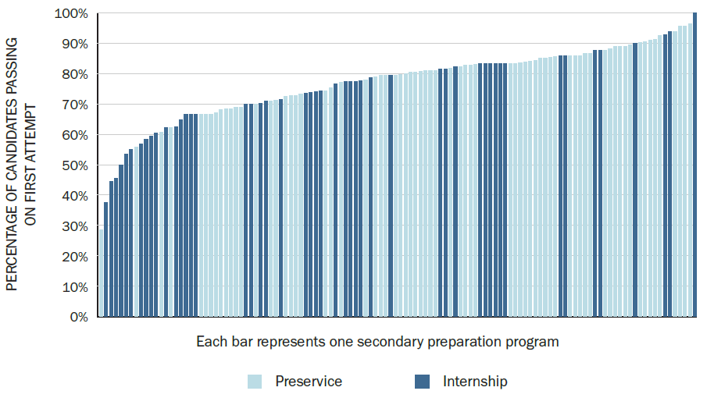
Initial passing rates for single subject programs for 2021-22/2022-23
Initial Passing Rate | Number of programs
<60% | 11
60-69.9% | 21
70-79.9% | 29
80-89.9% | 47
90-100% | 12
Source: Learning Policy Institute analysis of Commission on Teacher Credentialing data (2024).

Slide 18
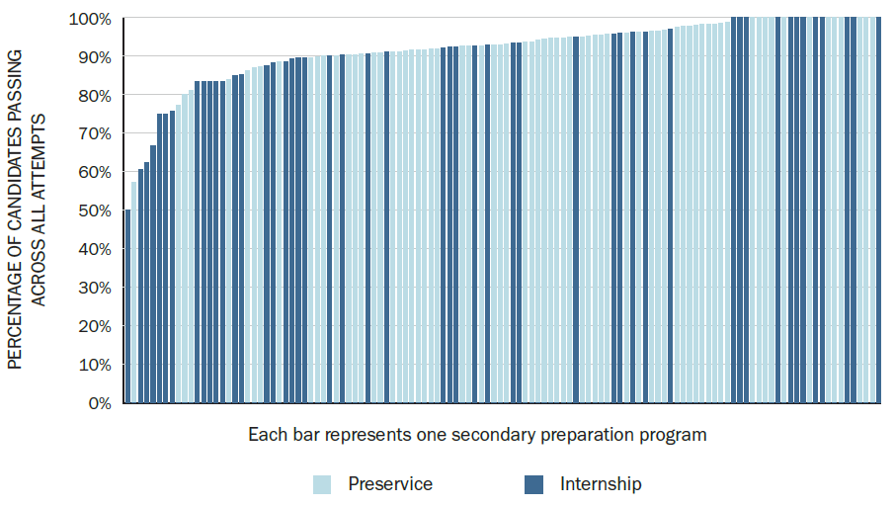
Eventual passing rates for single subject programs for 2021-22/2022-23
Eventual Passing Rate | Number of programs
<70% | 5
70-79.9% | 4
80-89.9% | 24
90-99.9% | 63
100% | 24
Source: Learning Policy Institute analysis of Commission on Teacher Credentialing data (2024).

Slide 19
Passing rates for education specialist programs for 2021-22/2022-23
Source: Learning Policy Institute analysis of Commission on Teacher Credentialing data (2024).

Slide 20
Characteristics of programs with the highest and lowest passing rates
Programs with lowest initial passing rates were more likely to be:
District intern programs
Small programs at private IHEs
Performance varied more among CSUs and larger private IHEs
UC programs had higher average passing rates
See tables at the end of the slide deck for more detailed information
on programs with different passing rates

Slide 21
Differences by preparation experiences

Slide 22
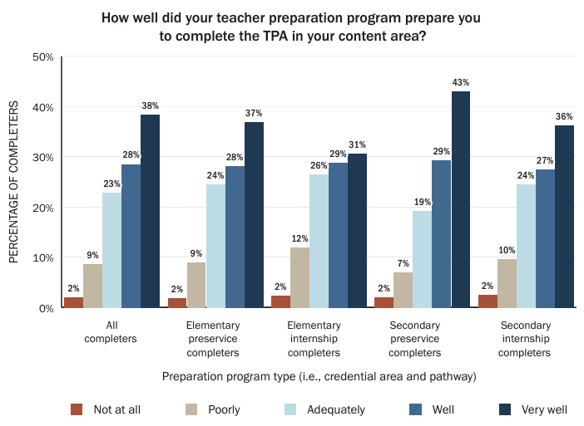
Two-thirds of preparation completers reported being well supported by their program to take the TPA.
Program completer survey asks about:
TPA preparation
TPA purpose
TPA tasks
TPA scoring rubrics
TPA submission & scoring process
TPA remediation
Source: Learning Policy Institute analysis of Commission on Teacher Credentialing data (2024).

Slide 23
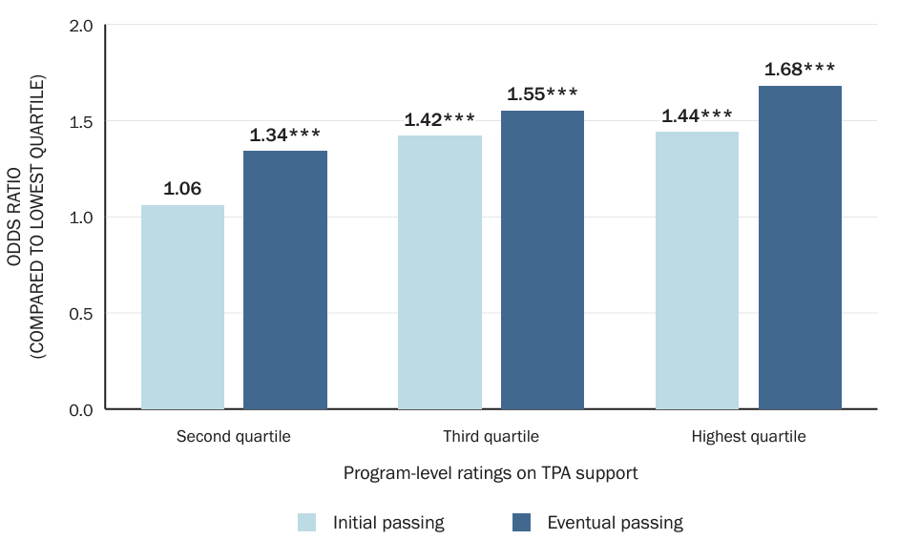
Candidates who attended programs with higher ratings on TPA support were more likely to pass a TPA, on average, than those attending the lowest-rated programs.
Asterisks illustrate statistical significance, with * indicating p < .05, ** indicating p < .01, and *** indicating p < .001.
Source: Learning Policy Institute analysis of Commission on Teacher Credentialing data (2024).

Slide 24
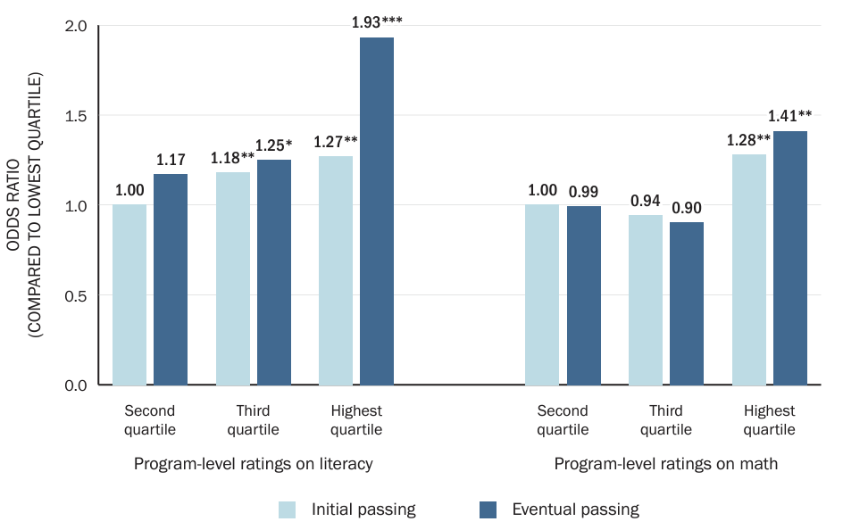
Multiple subject and education specialist candidates from the highest-rated programs for preparation in literacy and math were more likely to pass the TPA, on average, than completers from the lowest-rated programs.
Asterisks illustrate statistical significance, with * indicating p < .05, ** indicating p < .01, and *** indicating p < .001.
Source: Learning Policy Institute analysis of Commission on Teacher Credentialing data (2024).

Slide 25
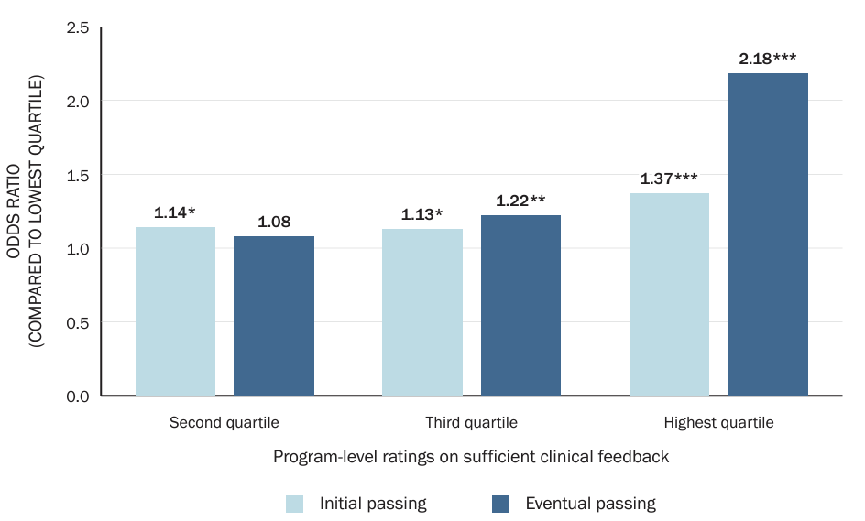
Preservice candidates from the highest-rated programs for providing sufficient clinical feedback were more likely to pass the TPA, on average, than completers from the lowest-rated programs.
Asterisks illustrate statistical significance, with * indicating p < .05, ** indicating p < .01, and *** indicating p < .001.
Source: Learning Policy Institute analysis of Commission on Teacher Credentialing data (2024).

Slide 26
Summary of Findings
During the 2021-22 and 2022-23 years, more than 90% of California candidates are passing a TPA across all their attempts.
More than 85% of candidates passing on first two attempts
Higher passing rates among preservice candidates
Preparation experiences matter for TPA performance, including:
Programmatic support around TPAs
Content-specific training in literacy and math
Sufficient clinical feedback (i.e., receiving feedback on instruction at least 5 times)
While many programs are very successful in ensuring their candidates pass TPAs, there is a subset of programs that may need further support.
Nearly one-quarter of programs have all tested candidates pass while about one-tenth of programs have less than 80% of candidates pass across all attempts.
Multiple subject and internship programs have lower passing rates, on average, but there is wide variation in passing rates across programs

Slide 27
Implications for Policy
The California Commission on Teacher Credentialing is well positioned to target supports for programs with low pass rates and ensure that program standards are being met as well as create opportunities to learn from programs with demonstrated success with TPAs.
Certain recent state investments reduce barriers to successful TPA performance and completion of licensure requirements:
Golden State Teacher Grant Program and Teacher Residency Grant Program offset the cost of preservice preparation
State funding to waive assessment fees for all candidates

Slide 28
Follow-up and Questions:
Susan K. Patrick
spatrick@learningpolicyinstitute.org

Slide 29
Appendix Slides

Slide 30
Defining initial and eventual passing from the CalTPA and edTPA records
Candidate ID | TPA Model | Example Record |  |  | Initial passing | Eventual passing
 |  | Cycle | Attempt | Status
A | CalTPA | 1 | 1 | Pass | No | Yes
 |  | 2 | 1 | Not Pass
 |  | 2 | 2 | Pass
B | CalTPA | 1 | 1 | Not scoreable | Yes | Yes
 |  | 1 | 2 | Pass
 |  | 2 | 1 | Pass
C | CalTPA | 1 | 1 | Pass | Yes | Yes
 |  | 2 | 1 | Pass
D | CalTPA | 1 | 1 | Not Pass | No | No
 |  | 1 | 2 | Not Scoreable
 |  | 1 | 3 | Not Pass
E | EdTPA | N/A | 1 | Not Pass | No | Yes
 |  | N/A | 2 | Pass
F | EdTPA | N/A | 1 | Pass | Yes | Yes
G | EdTPA | N/A | 1 | Not scoreable | Yes | Yes
 |  | N/A | 2 | Pass
H | EdTPA | N/A | 1 | Not Pass | No | No

Slide 31
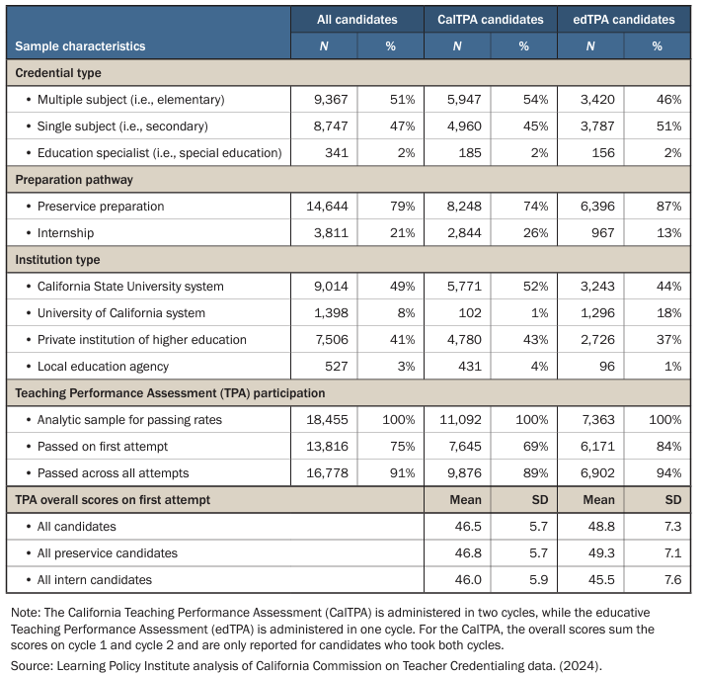
Characteristics of the Teaching Candidates in the Analytic Sample

Slide 32
Initial passing rates for multiple subject programs
Program characteristics | Multiple Subject Programs by Initial Passing Rates
 | All (N=119) |  | <60% (N=45) |  | 60-69.9% (N=22) |  | 70-79.9% (N=23) |  | 80-89.9% (N=14) |  | 90-100% (N=15)
Pathway | N | % | N | % | N | % | N | % | N | % | N | %
Preservice | 75 | 63% | 22 | 49% | 16 | 73% | 19 | 83% | 7 | 50% | 11 | 73%
Internship | 44 | 37% | 23 | 51% | 6 | 27% | 4 | 17% | 7 | 50% | 4 | 27%
Institution Type
CSU | 39 | 33% | 10 | 22% | 8 | 36% | 10 | 43% | 8 | 57% | 3 | 20%
UC | 9 | 8% | 0 | 0% | 1 | 5% | 1 | 4% | 1 | 7% | 6 | 40%
Private IHE | 62 | 52% | 28 | 62% | 13 | 59% | 12 | 52% | 4 | 29% | 5 | 33%
LEA | 9 | 8% | 7 | 16% | 0 | 0% | 0 | 0% | 1 | 7% | 1 | 7%
Note: Percentages are column percentages (e.g., 63% of all programs in the analysis are preservice programs while 49% of programs with initial passing rates under 60% are preservice programs). This analysis includes 120 secondary preparation programs that had at least five candidates take the CalTPA or edTPA between September 1, 2021, and August 31, 2023, excluding candidates who received a deferral to take the TPA after receiving their preliminary credential. Candidates taking CalTPA must have either taken both cycles of the TPA or taken the first cycle before January 1, 2023, to be included. Program size varies, with between 6 and 593 test-taking candidates in each program.
Source: Learning Policy Institute analysis of California Commission on Teacher Credentialing data. (2024).

Slide 33
Eventual passing rates for multiple subject programs
Program characteristics | Multiple Subject Programs by Eventual Passing Rates
 | All (N=119) |  | <70% (N=8) |  | 70-79.9% (N=16) |  | 80-89.9% (N=37) |  | 90-99.9% (N=41) |  | 100% (N=17)
Pathway | N | % | N | % | N | % | N | % | N | % | N | %
Preservice | 75 | 63% | 5 | 63% | 9 | 56% | 26 | 70% | 27 | 66% | 8 | 47%
Internship | 44 | 37% | 3 | 38% | 7 | 44% | 11 | 30% | 14 | 34% | 9 | 53%
Institution Type
CSU | 39 | 33% | 1 | 13% | 6 | 38% | 12 | 32% | 16 | 39% | 4 | 24%
UC | 9 | 8% | 1 | 13% | 0 | 0% | 0 | 0% | 4 | 10% | 4 | 24%
Private IHE | 62 | 52% | 5 | 63% | 8 | 50% | 23 | 62% | 19 | 46% | 7 | 41%
LEA | 9 | 8% | 1 | 13% | 2 | 13% | 2 | 5% | 2 | 5% | 2 | 12%
Note: Percentages are column percentages (e.g., 33% of all programs in the analysis are CSU programs while 13% of programs with eventual passing rates under 70% are CSU programs). This analysis includes 120 secondary preparation programs that had at least five candidates take the CalTPA or edTPA between September 1, 2021, and August 31, 2023, excluding candidates who received a deferral to take the TPA after receiving their preliminary credential. Candidates taking CalTPA must have either taken both cycles of the TPA or taken the first cycle before January 1, 2023, to be included. Program size varies, with between 6 and 593 test-taking candidates in each program.
Source: Learning Policy Institute analysis of California Commission on Teacher Credentialing data. (2024).

Slide 34
Initial passing rates for single subject programs
Program characteristics | Single Subject Programs by Initial Passing Rates
 | All (N=120) |  | <60% (N=11) |  | 60-69.9% (N=21) |  | 70-79.9% (N=29) |  | 80-89.9% (N=47) |  | 90-100% (N=12)
Pathway | N | % | N | % | N | % | N | % | N | % | N | %
Preservice | 71 | 59% | 2 | 18% | 12 | 57% | 15 | 52% | 33 | 70% | 9 | 75%
Internship | 49 | 41% | 9 | 82% | 9 | 43% | 14 | 48% | 14 | 30% | 3 | 25%
Institution Type
CSU | 38 | 32% | 1 | 9% | 2 | 10% | 12 | 41% | 20 | 43% | 3 | 25%
UC | 11 | 9% | 0 | 0% | 0 | 0% | 0 | 0% | 6 | 13% | 5 | 42%
Private IHE | 62 | 52% | 7 | 64% | 19 | 90% | 13 | 45% | 20 | 43% | 3 | 25%
LEA | 9 | 8% | 3 | 27% | 0 | 0% | 4 | 14% | 1 | 2% | 1 | 8%
Note: Percentages are column percentages (e.g., 59% of all programs in the analysis are preservice programs while 18% of programs with initial passing rates under 60% are preservice programs). This analysis includes 120 secondary preparation programs that had at least five candidates take the CalTPA or edTPA between September 1, 2021, and August 31, 2023, excluding candidates who received a deferral to take the TPA after receiving their preliminary credential. Candidates taking CalTPA must have either taken both cycles of the TPA or taken the first cycle before January 1, 2023, to be included. Program size varies, with between 6 and 593 test-taking candidates in each program.
Source: Learning Policy Institute analysis of California Commission on Teacher Credentialing data. (2024).

Slide 35
Eventual passing rates for single subject programs
Program characteristics | Single Subject Programs by Eventual Passing Rates
 | All (N=120) |  | <70% (N=5) |  | 70-79.9% (N=4) |  | 80-89.9% (N=24) |  | 90-99.9% (N=63) |  | 100% (N=24)
Pathway | N | % | N | % | N | % | N | % | N | % | N | %
Preservice | 71 | 59% | 1 | 20% | 1 | 25% | 10 | 42% | 47 | 75% | 12 | 50%
Internship | 49 | 41% | 4 | 80% | 3 | 75% | 14 | 58% | 16 | 25% | 12 | 50%
Institution Type
CSU | 38 | 32% | 0 | 0% | 0 | 0% | 7 | 29% | 25 | 40% | 6 | 25%
UC | 11 | 9% | 0 | 0% | 0 | 0% | 0 | 0% | 7 | 11% | 4 | 17%
Private IHE | 62 | 52% | 5 | 100% | 2 | 50% | 17 | 71% | 25 | 40% | 13 | 54%
LEA | 9 | 8% | 0 | 0% | 2 | 50% | 0 | 0% | 6 | 10% | 1 | 4%
Note: Percentages are column percentages (e.g., 59% of all programs in the analysis are preservice programs while 20% of programs with eventual passing rates under 70% are preservice programs). This analysis includes 120 secondary preparation programs that had at least five candidates take the CalTPA or edTPA between September 1, 2021, and August 31, 2023, excluding candidates who received a deferral to take the TPA after receiving their preliminary credential. Candidates taking CalTPA must have either taken both cycles of the TPA or taken the first cycle before January 1, 2023, to be included. Program size varies, with between 6 and 593 test-taking candidates in each program.
Source: Learning Policy Institute analysis of California Commission on Teacher Credentialing data. (2024).

