Slide 1
Update from WestEd’s Evaluation of the Teacher Residency Grant Program
CTC Commission Meeting
April 2024
Andrew Brannegan

Slide 2
TRGP contextual developments
Increased grant funds:
Originally $50 million in funding in 2018 appropriated to teacher residencies
An additional $350 million in 2021 and $184 million in 2022 appropriated
Increased per-resident funding & qualifying credential area:
Resident funding increased to $40k
Added “diversifying the workforce” criteria
Increased # of programs:
37 residency partnerships in 2018
98 residency partnerships funded to date from 2021 grant, just reporting on first 18 funded today
Funding and launch of the new statewide residency technical assistance center (SRTAC)

Slide 3
Residency Program Enrollment
How has resident enrollment changed over the 4 cohorts of 2018 grantees and the first cohort of 2021 grantees?

Slide 4
RESIDENCY ENROLLMENT: The number of TRGP residents increased during the 21-22 and 22-23 school years

Slide 5
RESIDENCY ENROLLMENT: The majority of programs across all cohorts had fewer than 15 residents, but median program size increased during the first cohort of 2021 grantees

Slide 6
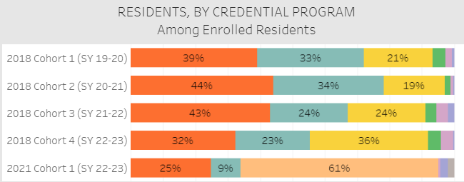
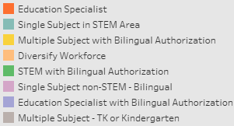
RESIDENCY ENROLLMENT: The majority of residents in the first cohort of 2021 funding qualified under the “diversifying the workforce” criteria
126 “diversifying workforce” residents:
45% Elementary multiple subject
27% Secondary single subject
11% STEM
8% Special education

Slide 7
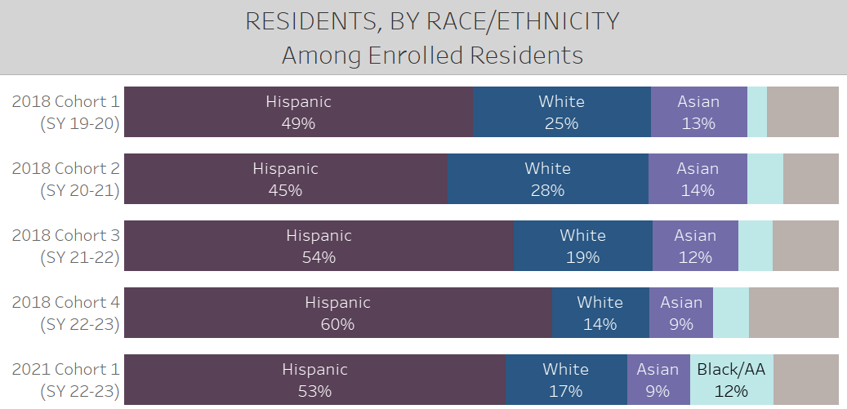
RESIDENCY ENROLLMENT: Across all waves, TRGP residents continue to diversify California’s teacher workforce

Slide 8
How are residents distributed across California?

Slide 9
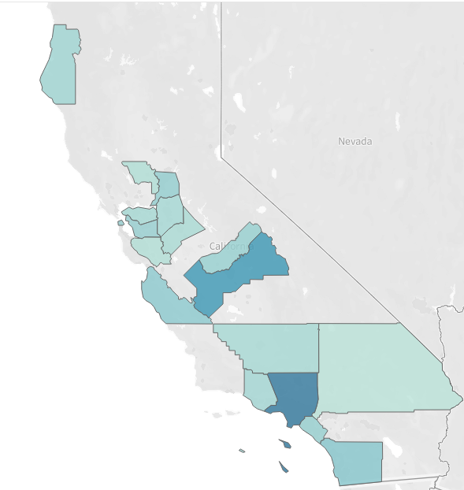
Distribution of residents by county: 2018 grantees
Through the first four cohorts of the 2018 grant, residents were spread across 18 counties in the state
Los Angeles and Fresno had the largest number of residents

Slide 10
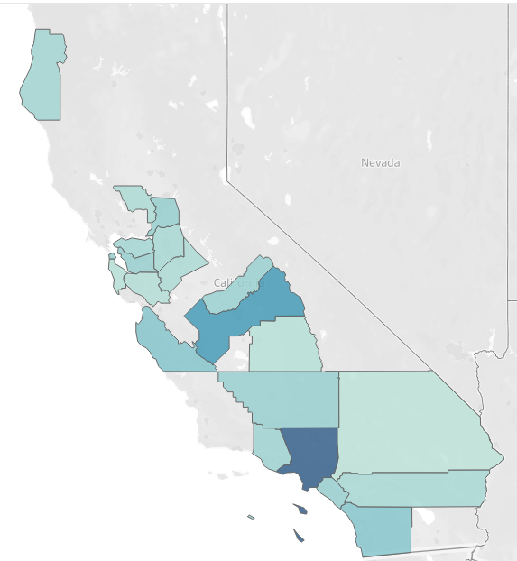
Distribution of residents by county: 2018 grantees & first cohort of 2021 grantees
In the first cohort of 2021 grantees, 3 additional counties added residents - Riverside, San Mateo & Tulare.
37 counties in the state haven’t had any TRGP residents to date

Slide 11
Residency program enrollment findings
Program enrollment has increased modestly over the first 4 school years of funding, from 297 residents in the 19-20 school year, to 428 residents in the 22-23 school year.
Programs tend to be small, but there was a slight increase in program size in the first cohort of 2021 grantees.
Residents coming through 2018 funding were qualifying through education specialist, STEM and bilingual credential programs. The majority of 2021 cohort 1 residents were qualifying through the “diversifying the workforce” criteria.
Residency programs across all cohorts diversified the teacher workforce in California.
Residency programs have been concentrated in 21 counties in the state.

Slide 12
Future WestEd Investigations
Building on the enrollment data, we will be looking at how residency programs are scaling in California and within districts/counties, specifically:
How widespread are residency programs?
How significant of a pathway are residencies compared to other teacher pathways?
How have residency programs addressed teacher shortages in specific content areas?

Slide 13
Resident Hiring & Retention
Are residents being hired and retained? In their district of training?

Slide 14
RESIDENT HIRING: Around 90% of residents were hired, and 74% were hired in the same LEA

Slide 15
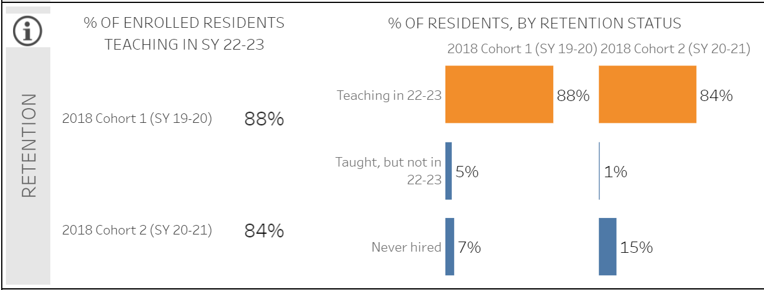
RESIDENT RETENTION: Nearly 90% of residents enrolled in Cohort 1 were teaching in the 2nd year after their residency training

Slide 16
Residency Hiring & Retention findings & Future WestEd Investigations
Across the first 3 cohorts of residents, around 90% were hired after their residency year, and 75% were hired in the same district in which they trained
Across the first 2 cohorts of residents, nearly 90% of residents were still teaching in the 22-23 school year
Building on the placement and retention data, we will be investigating how resident retention compares to retention rates for other pathways, specifically:
How do TRGP resident retention rates compare to those of similar teachers from other preparation pathways?
How do these retention rates vary by teacher demographic characteristic (e.g., race, gender) and characteristics of their placement school and district?

