Slide 1
Teacher Supply in California, 2022-23 A Report to the Legislature
phi phi lau, Research data specialist
Jack Boss, Research Data Analyst
Kristin Calderone, Harvard Data Fellow
Professional Services Division
april 2023

Slide 2
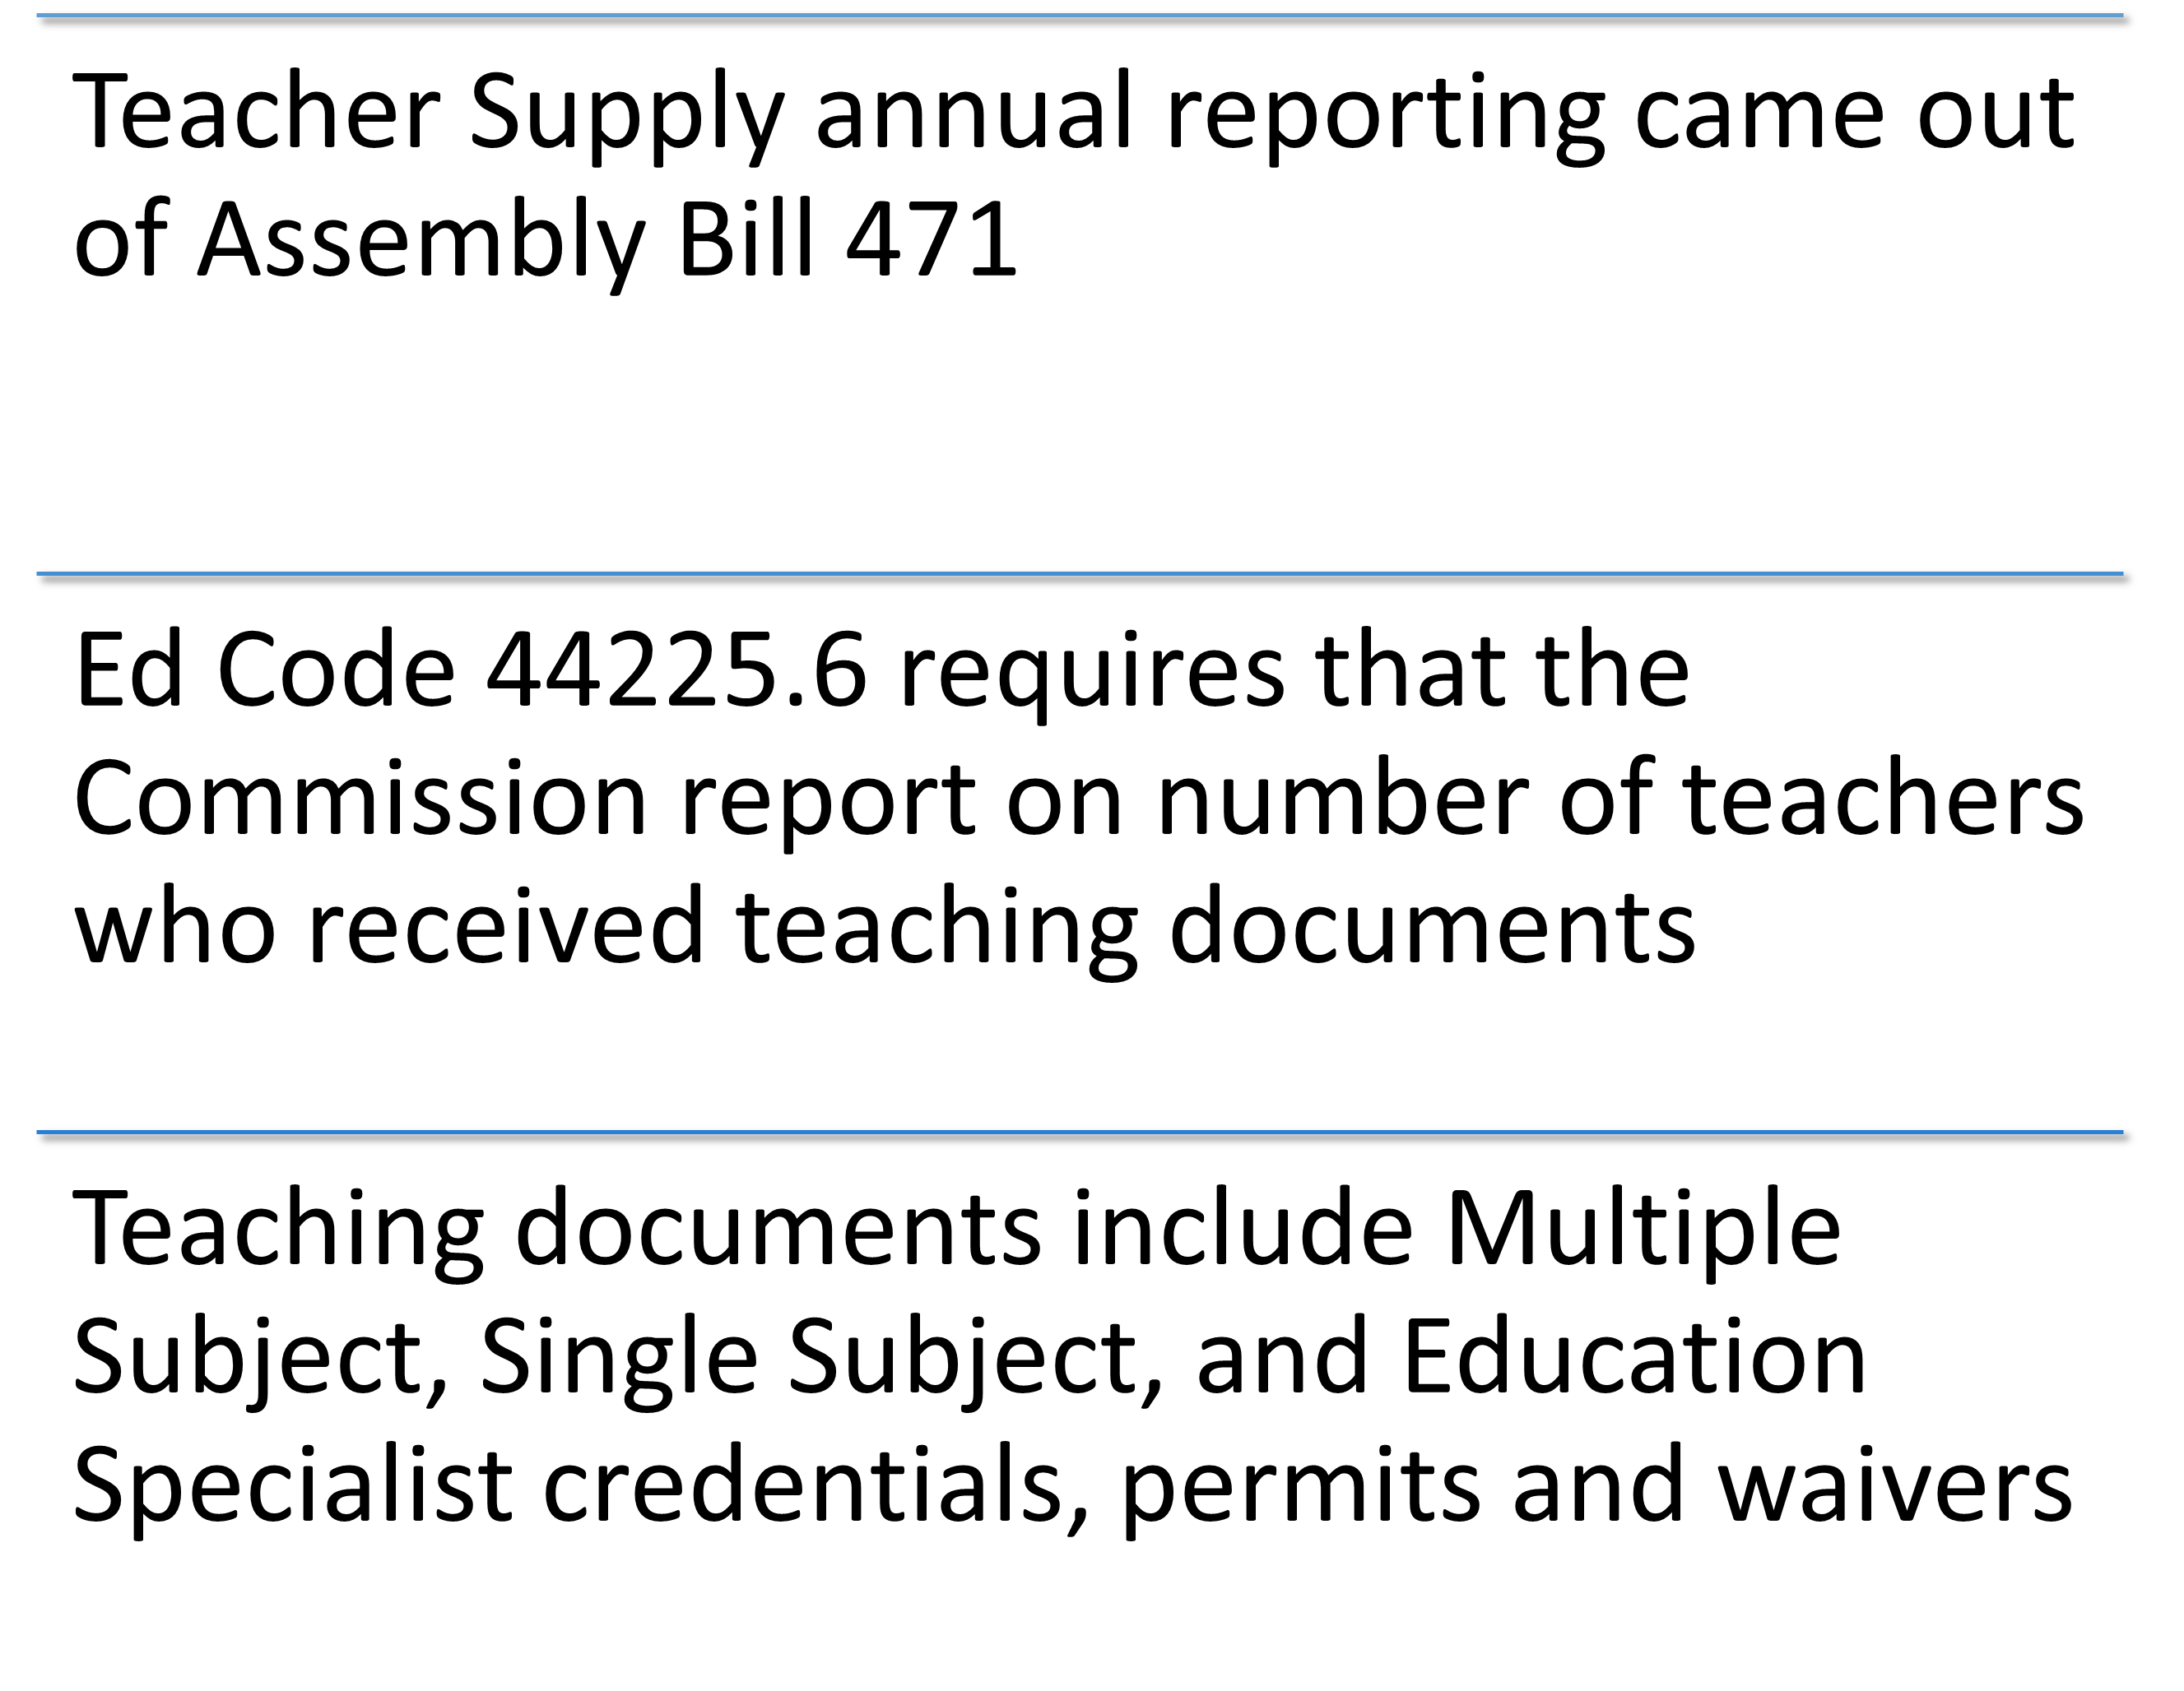
Background – Why do we submit the report every April?

Slide 3
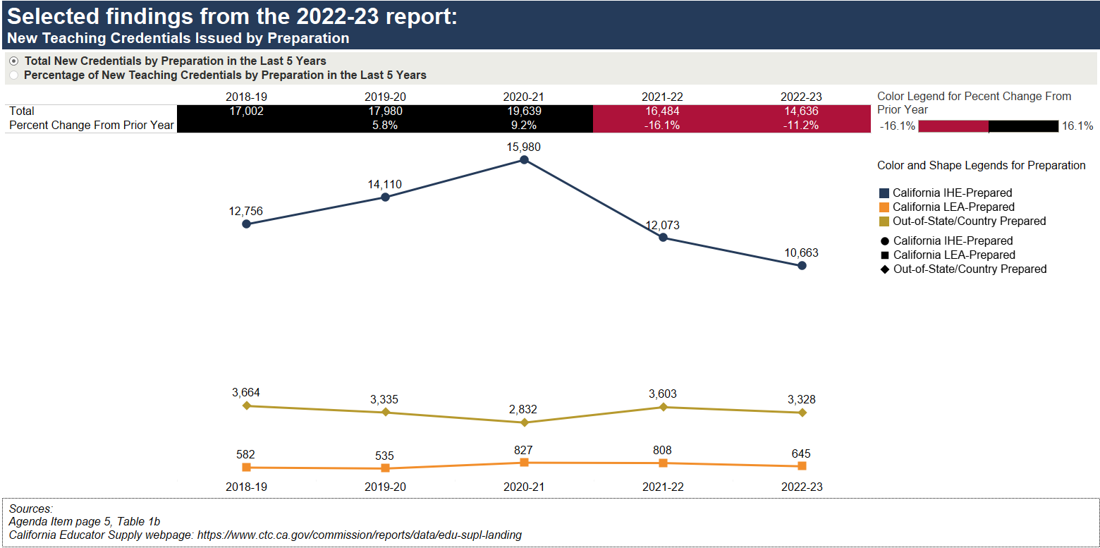
Selected findings from the 2022-23 report: New Teaching Credentials Issued by Preparation
Sources
April 2024 Commission Agenda item 3D– page 5, Table 1b
California Educator Supply

Slide 4
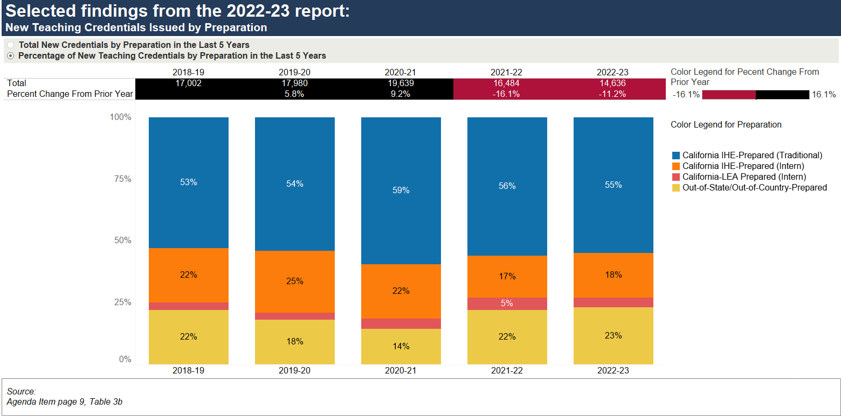
Selected findings from the 2022-23 report: New Teaching Credentials Issued by Preparation
Source
April 2024 Commission Agenda item 3D– page 9, Table 3b

Slide 5
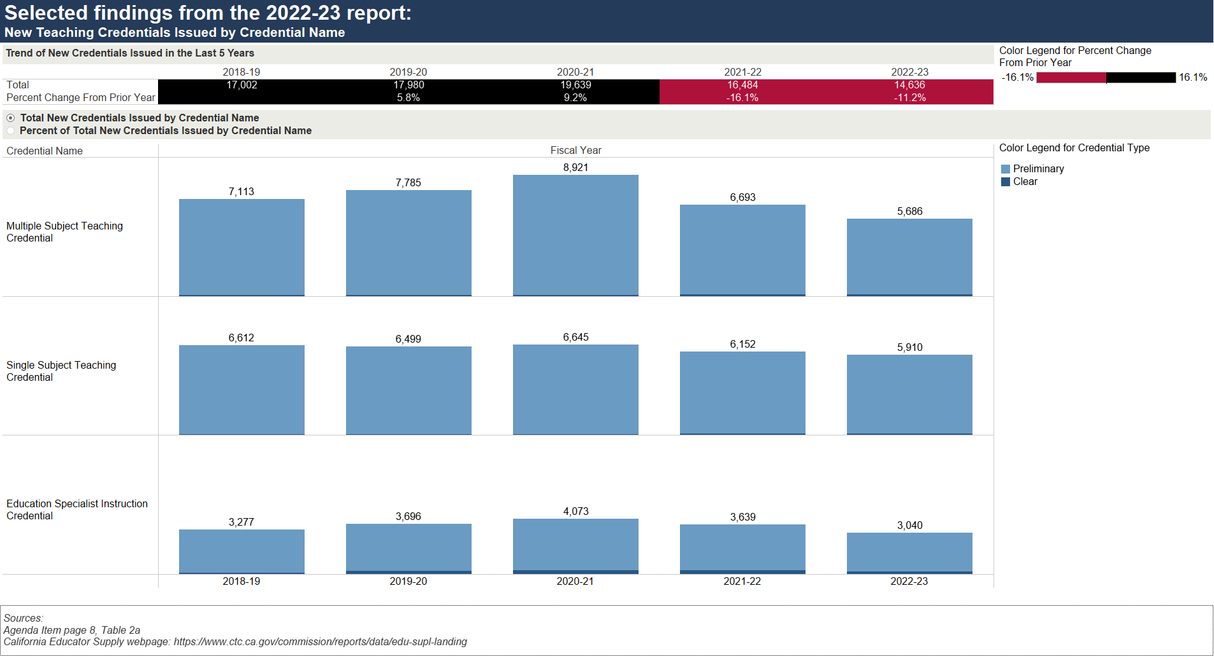
Selected findings from the 2022-23 report: New Teaching Credentials Issued by Credential Name
Sources
April 2024 Commission Agenda item 3D – page 8, Table 2a
Teacher Supply: Credentials

Slide 6
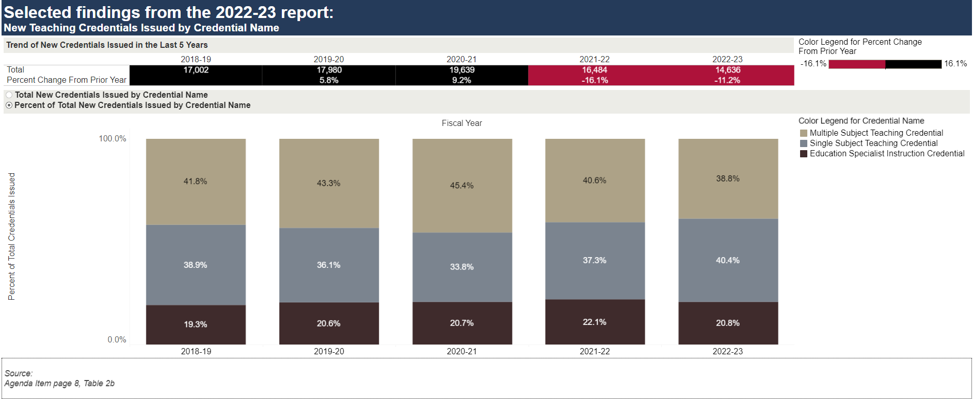
Selected findings from the 2022-23 report: New Teaching Credentials Issued by Credential Name
Source
April 2024 Commission Agenda item 3D – page 8, Table 2b

Slide 7
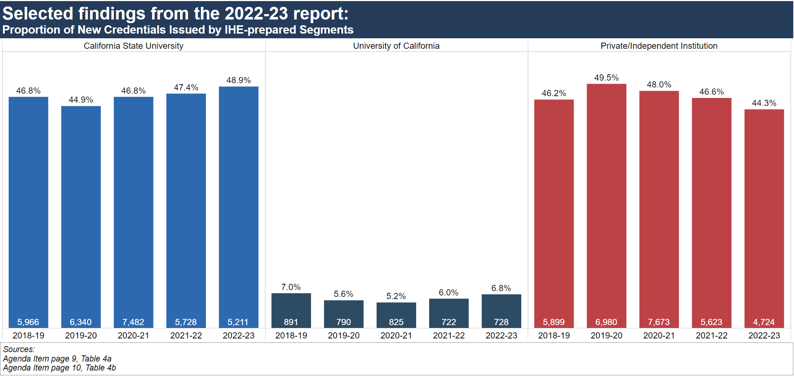
Selected findings from the 2022-23 report: Proportion of New Credentials Issued by IHE-prepared Segments
Source
April 2024 Commission Agenda item 3D – page 9, Table 4a; page 10, Table 4b

Slide 8
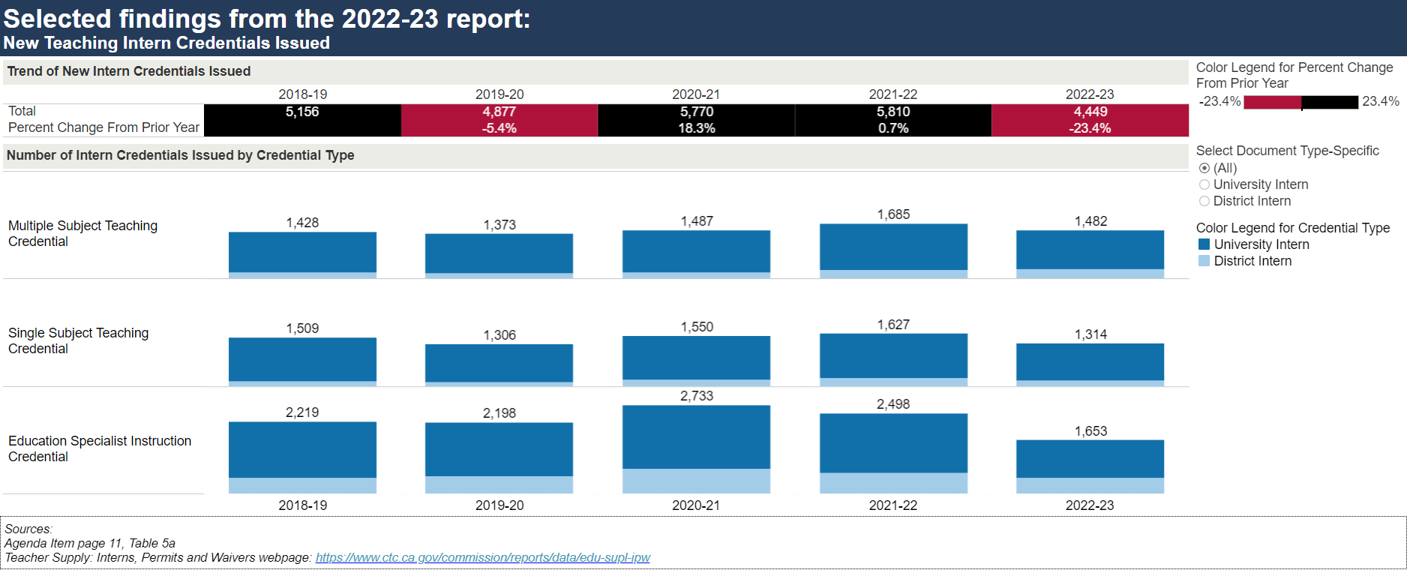
Selected findings from the 2022-23 report: New Intern Credentials Issued
Sources
April 2024 Commission Agenda item 3D – page 11, Table 5a
Teacher Supply: Interns, Permits and Waivers

Slide 9
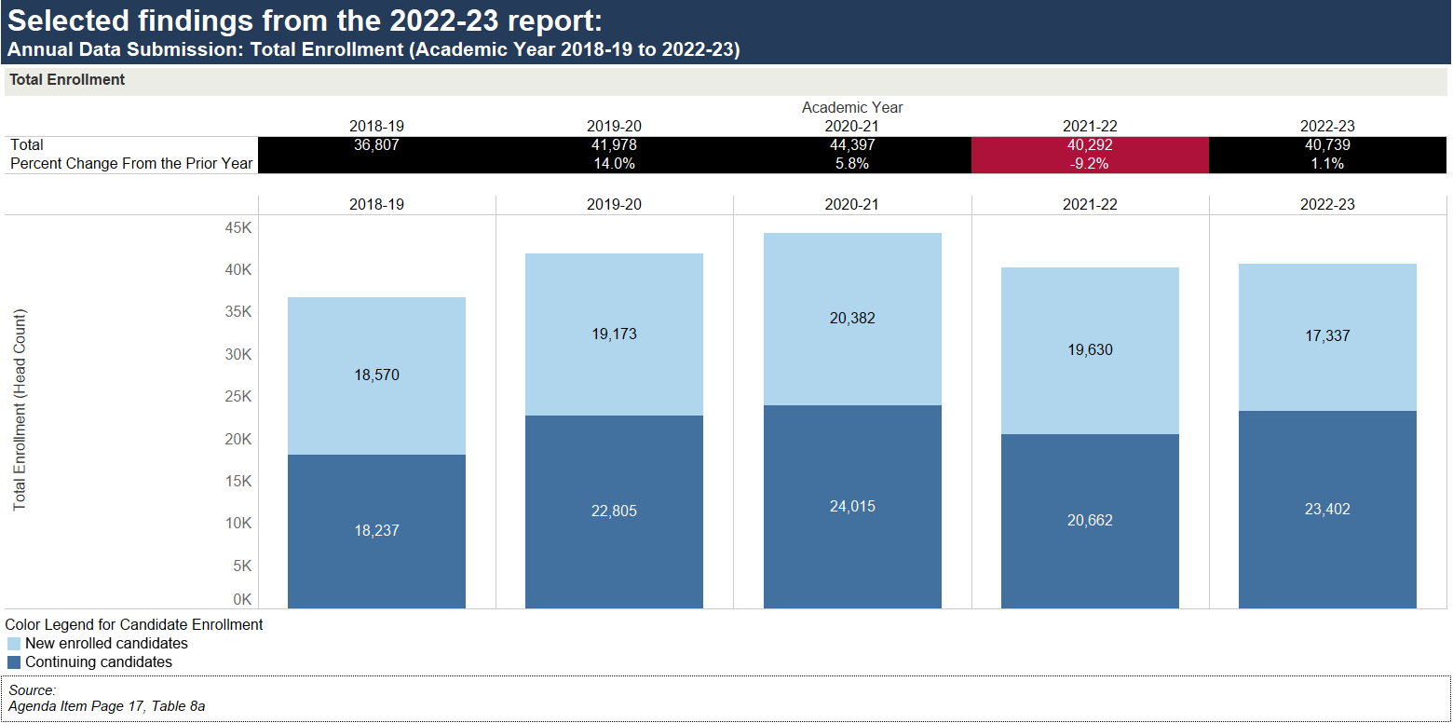
Selected findings from the 2022-23 report: Annual Data Submission: Total Enrollment
Source
April 2024 Commission Agenda item 3D – page 17, Table 8a

Slide 10
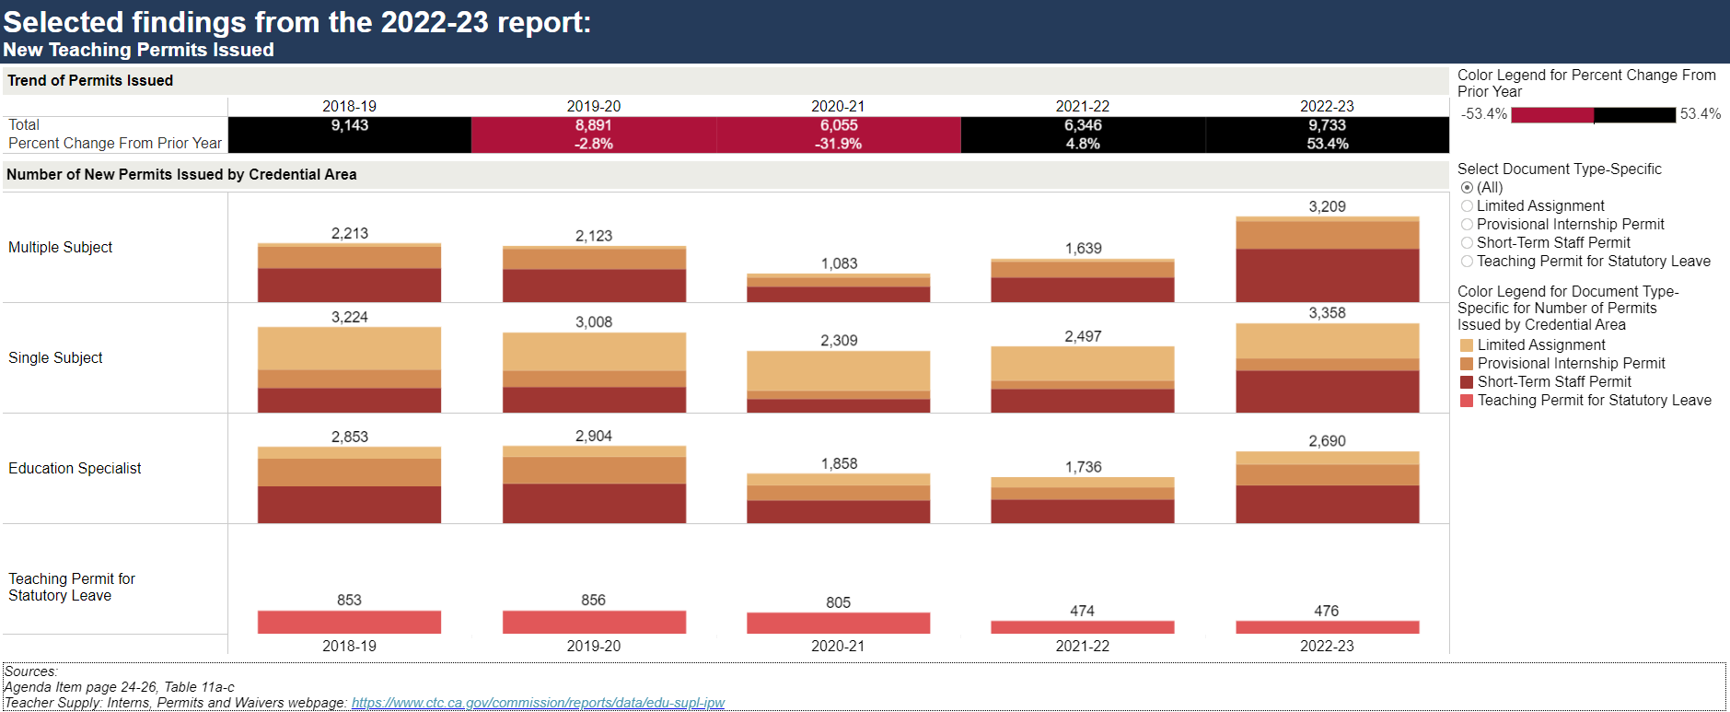
Selected findings from the 2022-23 report: New Teaching Permits Issued
Sources
April 2024 Commission Agenda item 3D – page 24-26, Table 11a-11c
Teacher Supply: Interns, Permits and Waivers

Slide 11
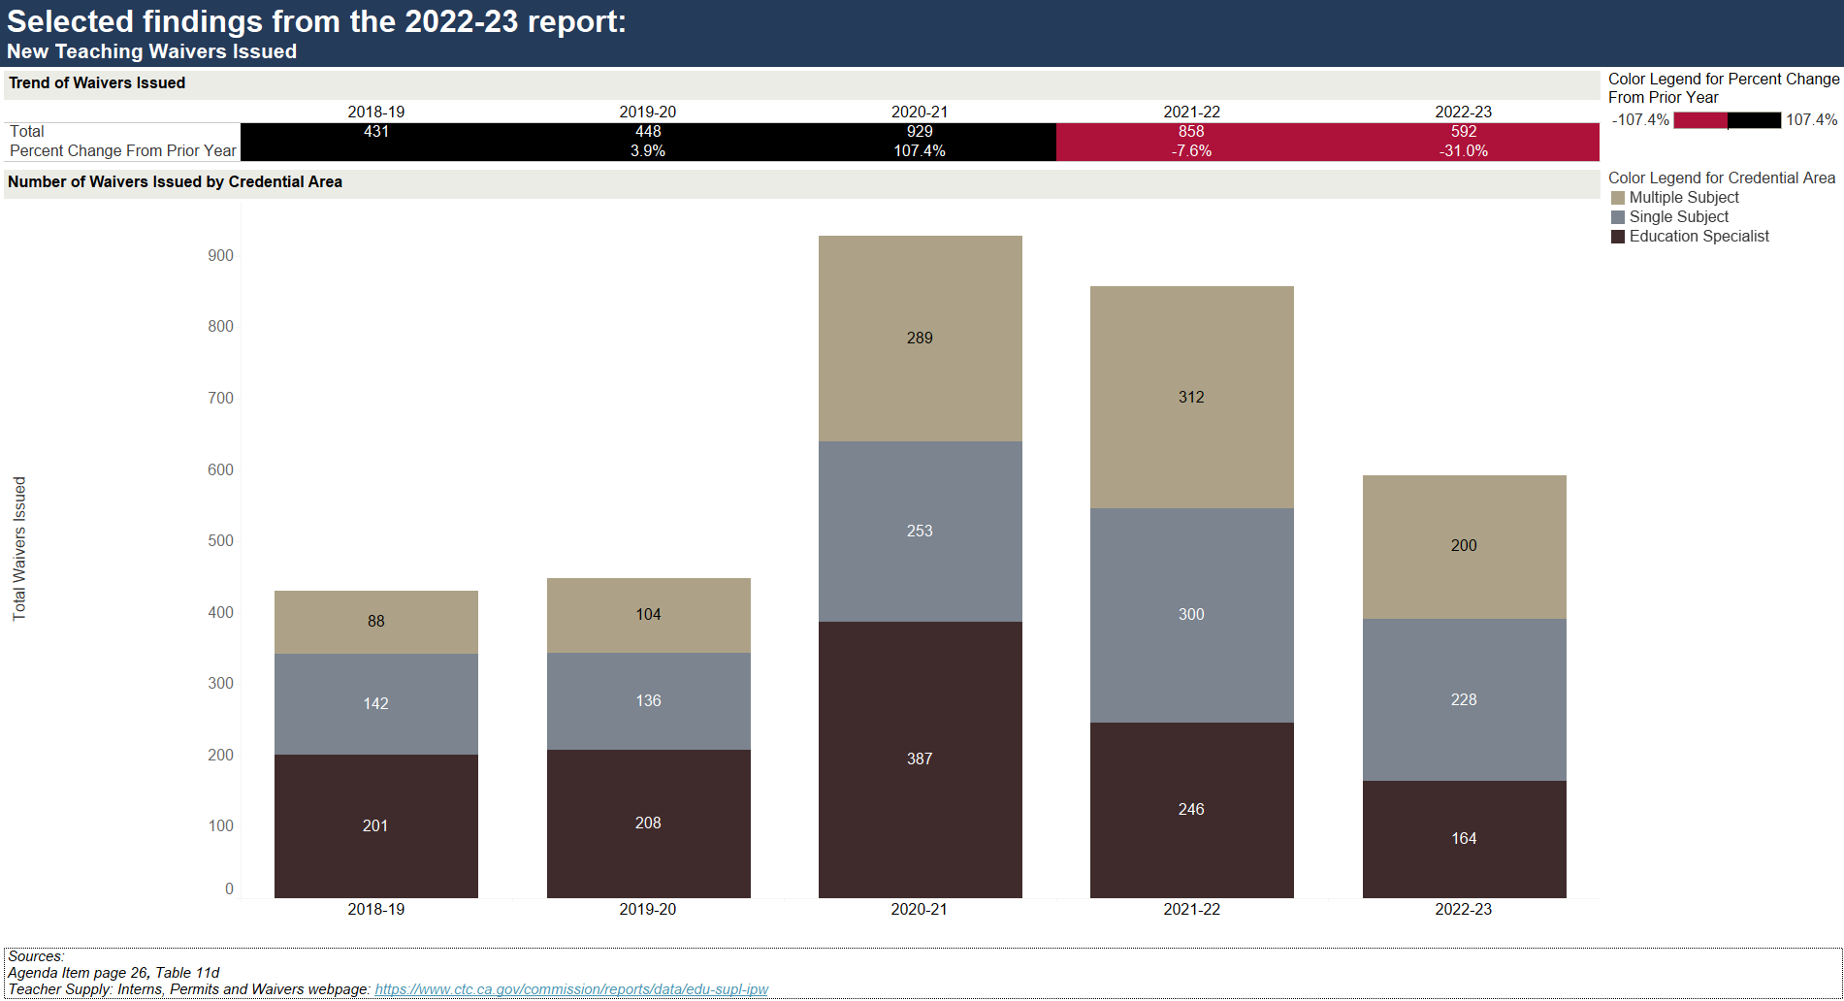
Selected findings from 2022-23 report: New Teaching Waivers Issued
Sources
April 2024 Commission Agenda item 3D – page 26, Table 11d
Teacher Supply: Interns, Permits and Waivers

Slide 12
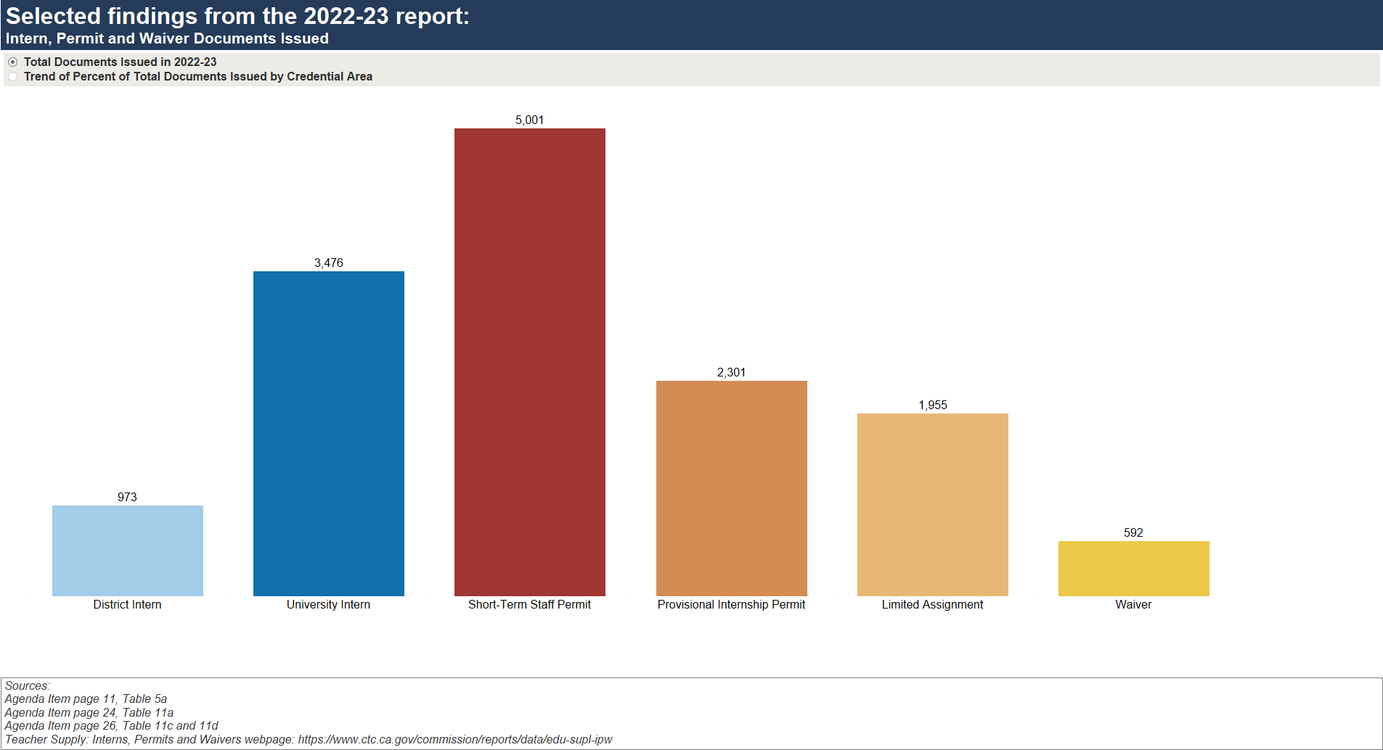
Selected findings from the 2022-23 report: Intern, Permit and Waiver Documents Issued
Sources
April 2024 Commission Agenda item 3D – page 11, Table 5a; page 24, Table 11a, 26, Table 11c and 11d
Teacher Supply: Interns, Permits and Waivers

Slide 13
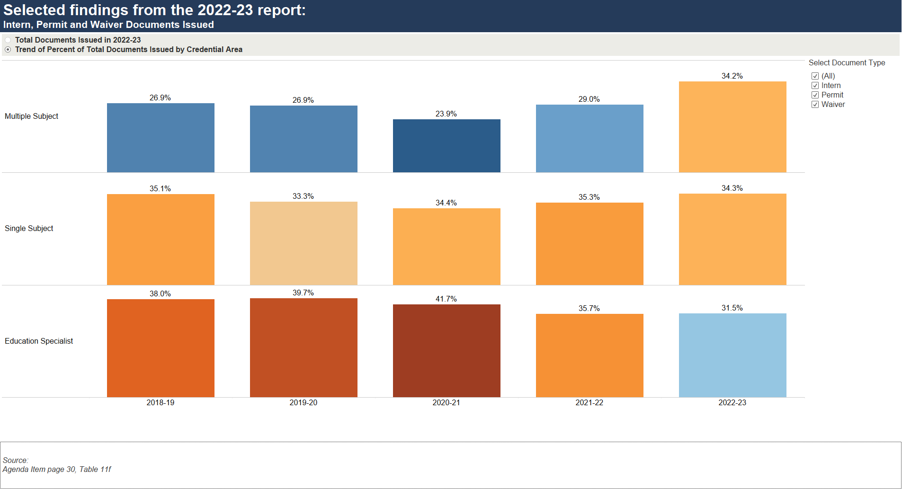
Selected findings from the 2022-23 report: Intern, Permit and Waiver Documents Issued
Source
April 2024 Commission Agenda item 3D – page 30, Table 11f

Slide 14
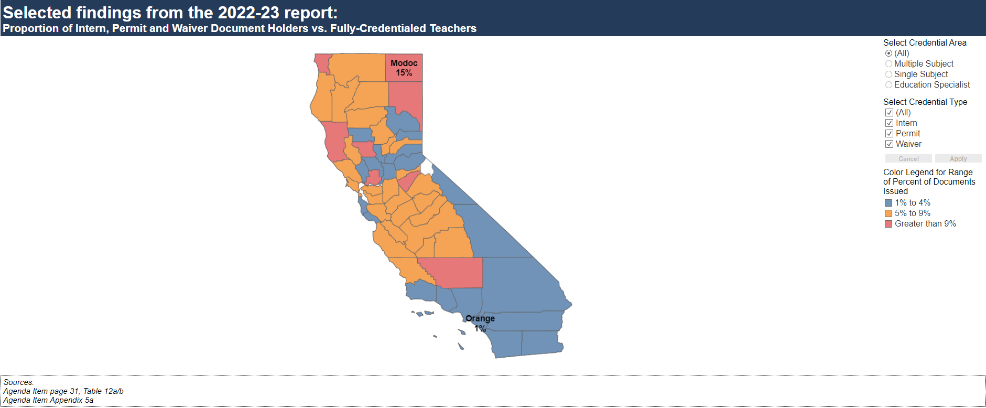
Selected findings from the 2022-23 report: Intern, Permit and Waiver Documents Holders vs. Fully-Credentialed Teachers
Source
April 2024 Commission Agenda item 3D – Appendix Table 5a

Slide 15
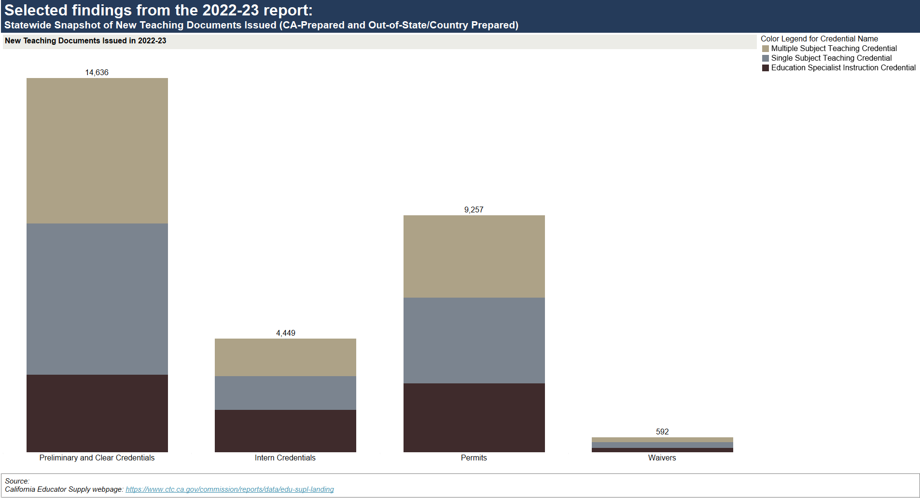
Selected findings from the 2022-23 report: Statewide Snapshot of New Teaching Documents Issued (CA-prepared and Out-of-State/Country Prepared)
Source
California Educator Supply

Slide 16
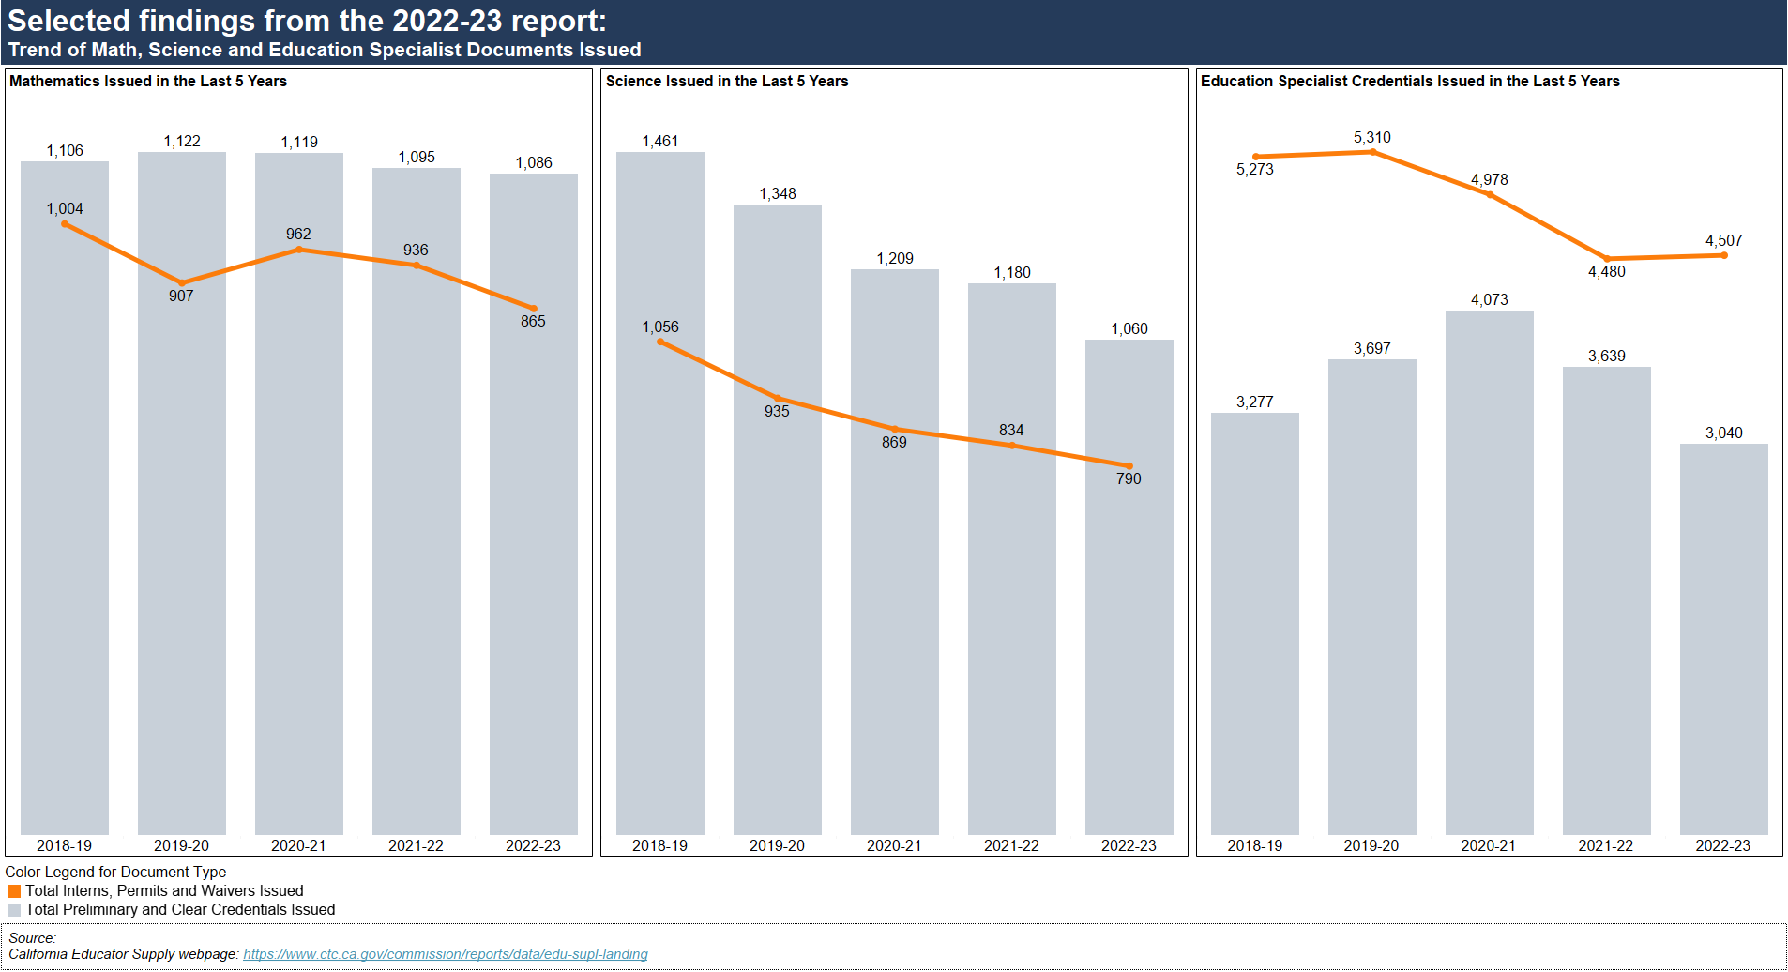
Selected findings from the 2022-23 report: Trend of Math, Science and Education Specialist Documents Issued
Source
California Educator Supply

Slide 17
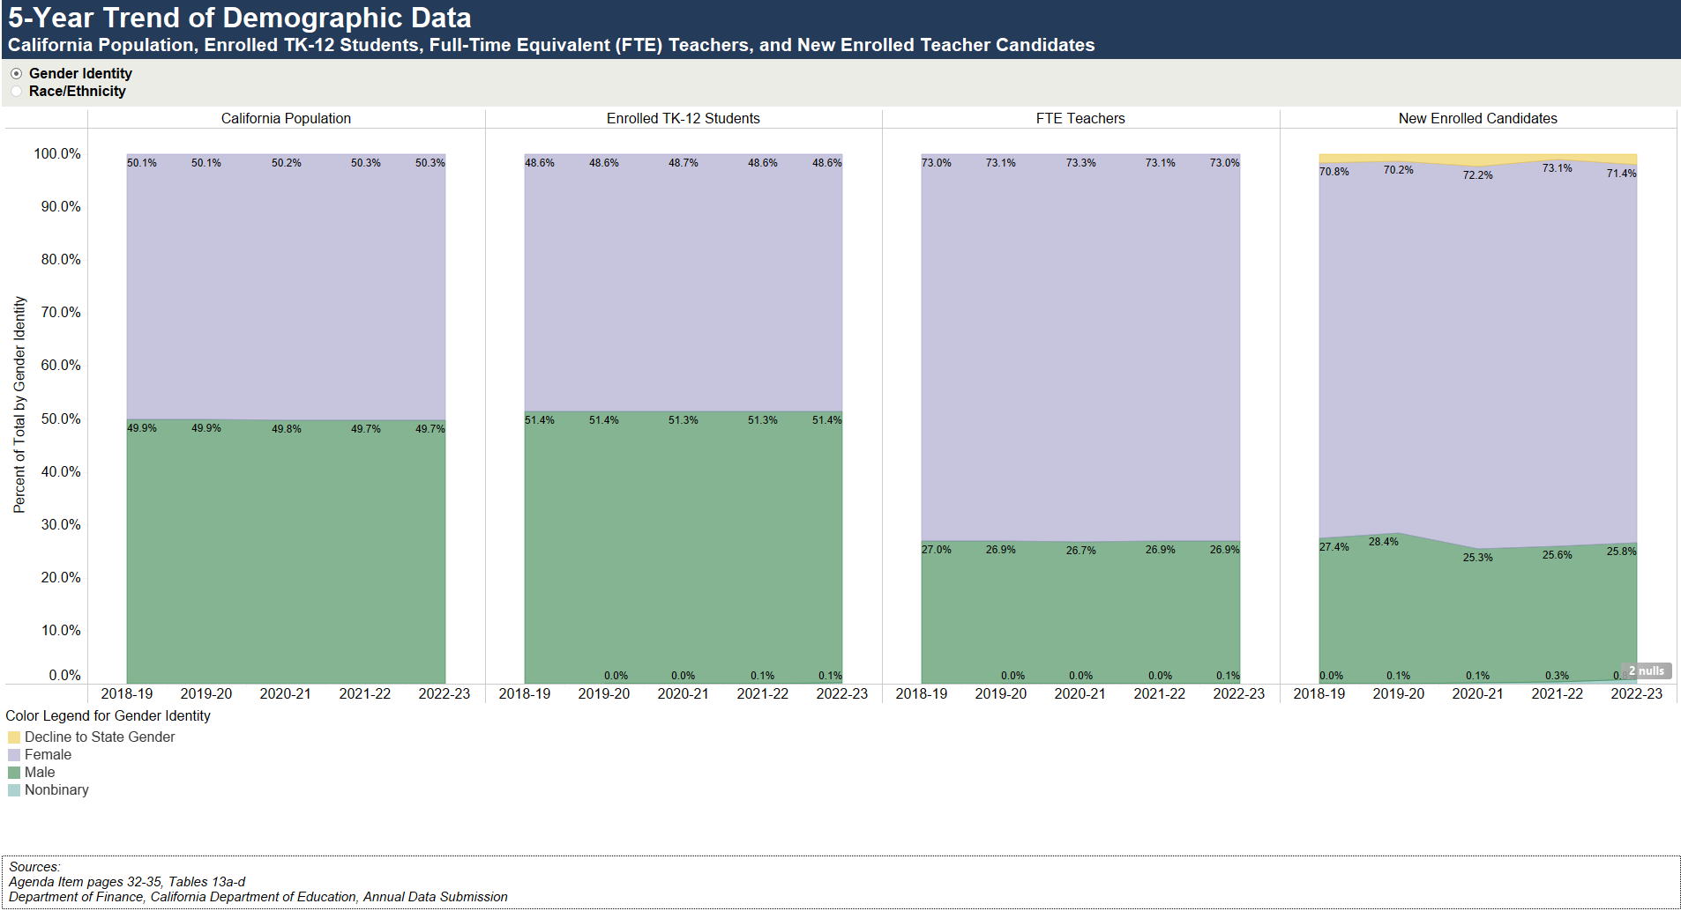
5-Year Trend of Demographic Data: State Population, Enrolled TK-12 Students, Full-Time Equivalent (FTE) Teachers, and New Enrolled Teacher Candidates by Gender Identity
Sources
April 2024 Commission Agenda item 3D – pages 32-35, Table 13a-13d
California Population: : Department of Finance: Report P-2D: Total Population by Total Hispanic and Non-Hispanic Race
TK-12 Student Enrollment: CDE Annual Enrollment
FTE Teachers: CDE Staff Demographic Data
New Enrolled Candidates: Commission on Teacher Credentialing Annual Data Submission

Slide 18
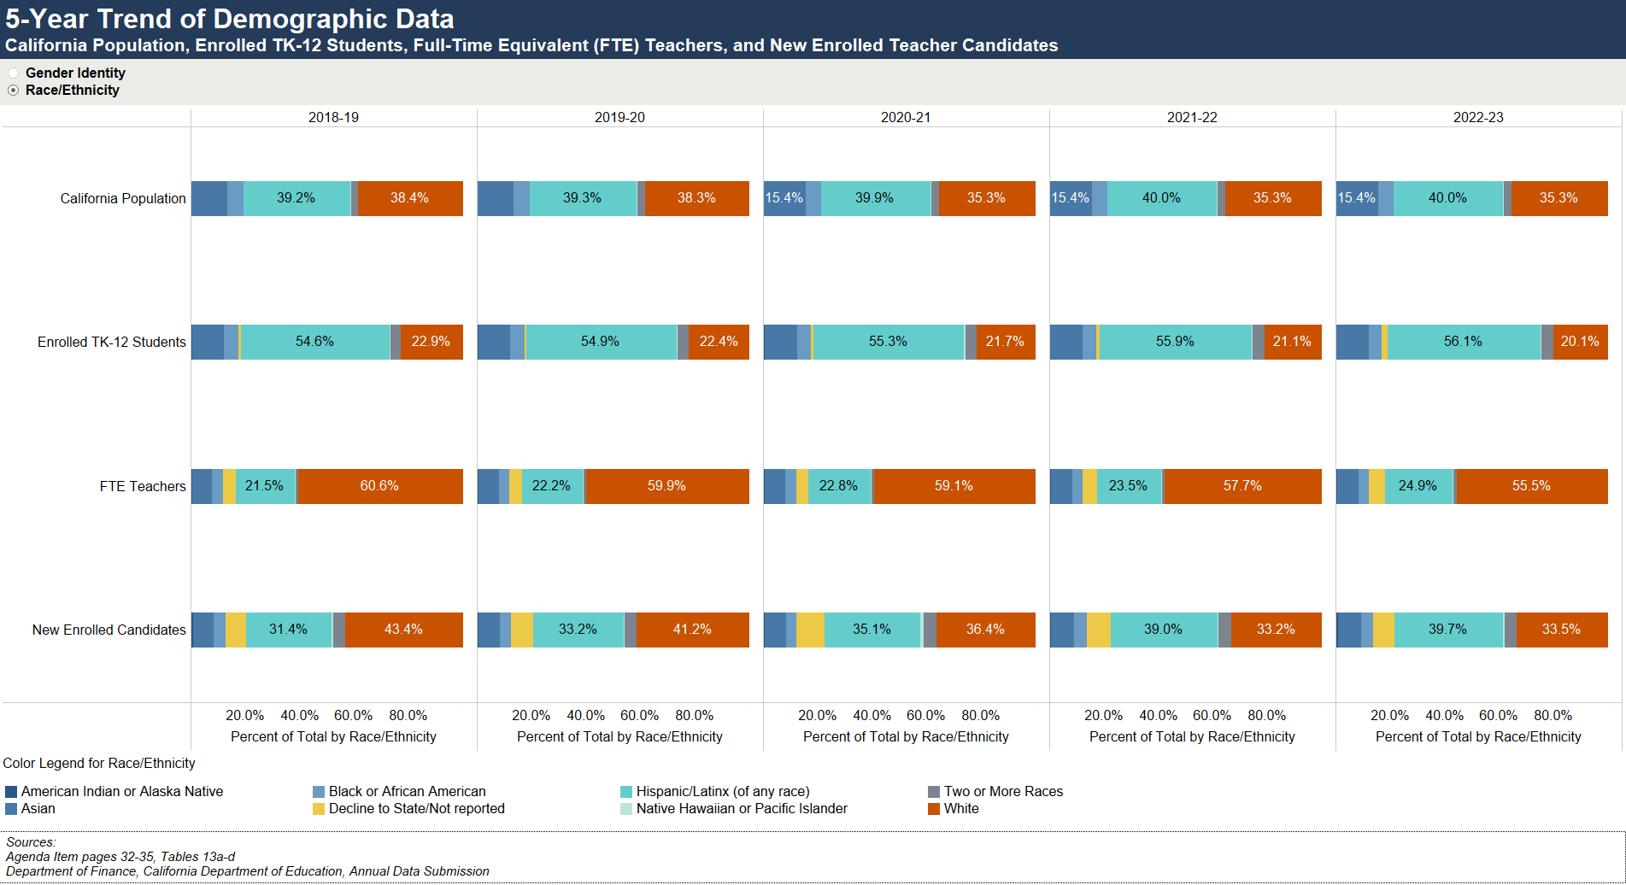
5-Year Trend of Demographic Data: State Population, Enrolled TK-12 Students, Full-Time Equivalent (FTE) Teachers, and New Enrolled Teacher Candidates by Race/Ethnicity
Sources
April 2024 Commission Agenda item 3D – pages 32-35, Table 13a-13d
California Population: : Department of Finance: Report P-2D: Total Population by Total Hispanic and Non-Hispanic Race
TK-12 Student Enrollment: CDE Annual Enrollment
FTE Teachers: CDE Staff Demographic Data
New Enrolled Candidates: Commission on Teacher Credentialing Annual Data Submission

Slide 19
Summary
State mandate
Commission transmitted the Teacher Supply Report to the Governor and Legislature by April 15, 2024
2022-23 report highlights:
Decrease of new teaching credentials issued by all preparation and credential types
Proportion of credentials recommended by IHE shifted slightly with an increase from CSU and UC, and a decrease from the Private/Independent and UC systems in the last five years
Decrease of intern credentials and waivers issued
Increase of all permits (STSP, PIP, LA, TPSL) issued
Intern, permit, and waiver holders represented about 4.4% of statewide certificated teachers

