Slide 1
Annual Report Card on California Teacher Preparation Programs for the Academic Year 2021-22 as required by Title II of Higher Education Act
Cara Mendoza, Administrator
phi phi lau, Research Data specialist
Professional Services Division
December 2023

Slide 2
Background: What is the Title II report? Why do we have to submit the report?

Slide 3
When do we submit the report?
Three reports are developed for each Title II data collection and reporting cycle:

Slide 4
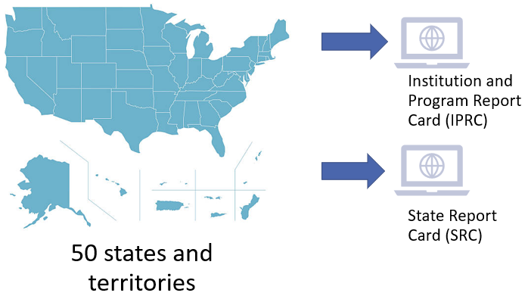
How do we submit the report?

Slide 5
What is required in the Title II report?
Title II report includes data on Multiple Subject, Single Subject, and Education Specialist credential preparation only
The report does not include Designated Subjects or Services credential preparation
Data are reported for candidates earning initial teacher credentials only; do not report candidate data on added authorizations or subsequent authorizations

Slide 6
What types of reports are Teacher Preparation Programs required to submit?
Traditional Route (Student teaching programs)
Alternative route, IHE-based (University Intern Programs)
Alternative route, not-IHE-based (District/County Intern Programs)

Slide 7
What assessment data are reported?
Basic Skills
CSET
RICA
TPA

Slide 8
How are candidates being reported?
Pass rates data are submitted for 5 groups:
Enrolled candidates who completed all Nonclinical coursework (Group 1)
Other Enrolled candidates (Group 2)
Program Completers for current year, 2021-22 (Group 3)
Program Completers for prior year, 2020-21 (Group 4)
Program Completers for second prior year, 2019-20 (Group 5)

Slide 9
What data elements are reported?
Sections | Institution and Program Report Card (IPRC) | State Report Card (SRC)
Program Information | X | X
Assurances; Annual Goals for Math, Science, Special Education | X
Assessment Data | X | X
Low-Performing Teacher Preparation Programs | X | X
Use of Technology | X
Teacher Training | X
Credential Requirements |  | X
Standards and Criteria |  | X
Improvement Efforts |  | X

Slide 10
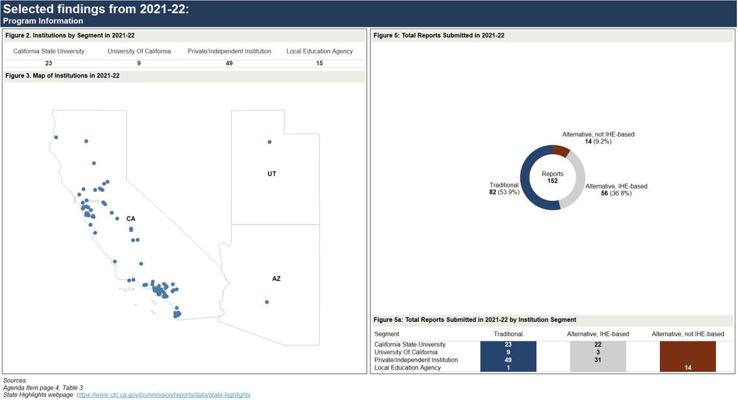
Sources
State Highlights
December 2023 Commission agenda item 2C – page 4, table 3

Slide 11
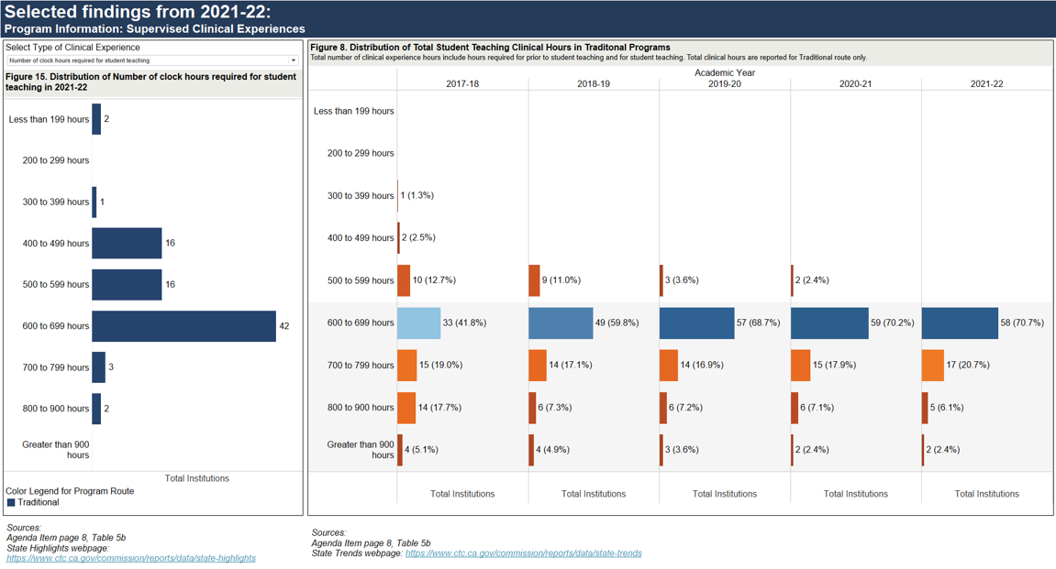
Sources
State Highlights
State Trends
December 2023 Commission agenda item 2C – page 8, table 5b

Slide 12
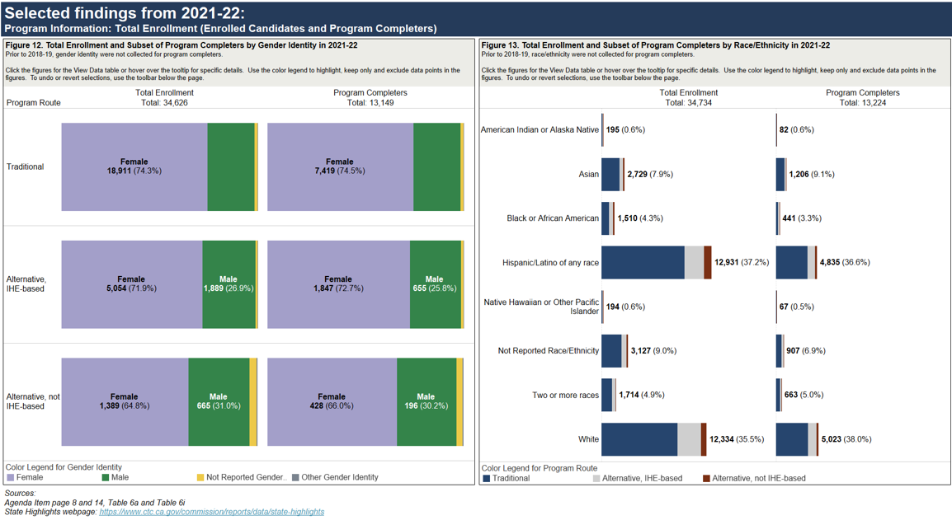
Sources
State Highlights
December 2023 Commission agenda item 2C – page 8 and 14, table 6a and table 6i

Slide 13
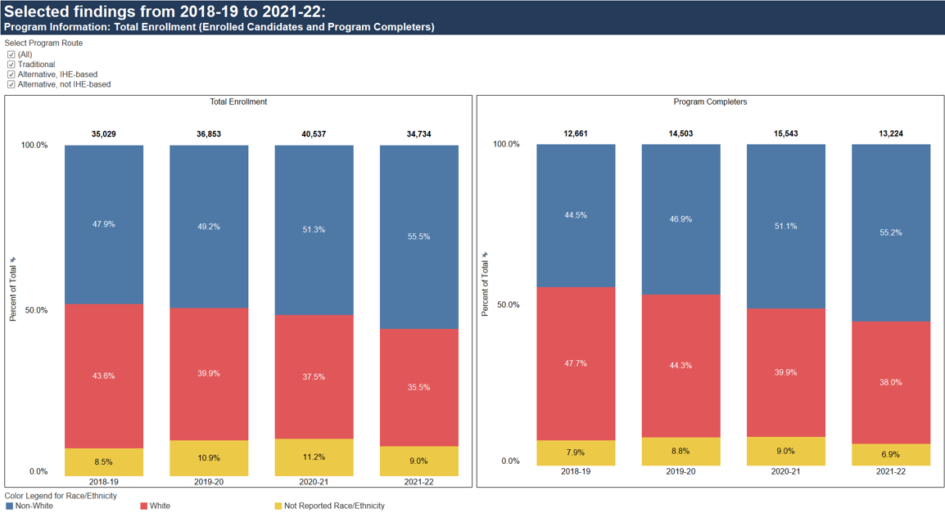

Slide 14
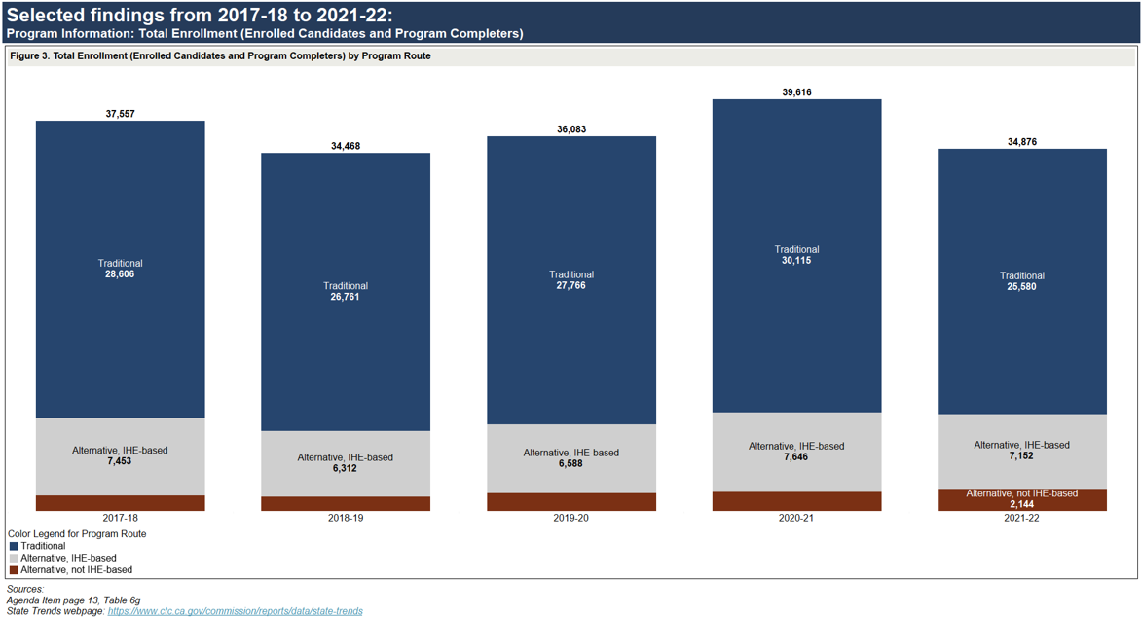
Sources
State Trends
December 2023 Commission agenda item 2C – page 13, table 6g

Slide 15
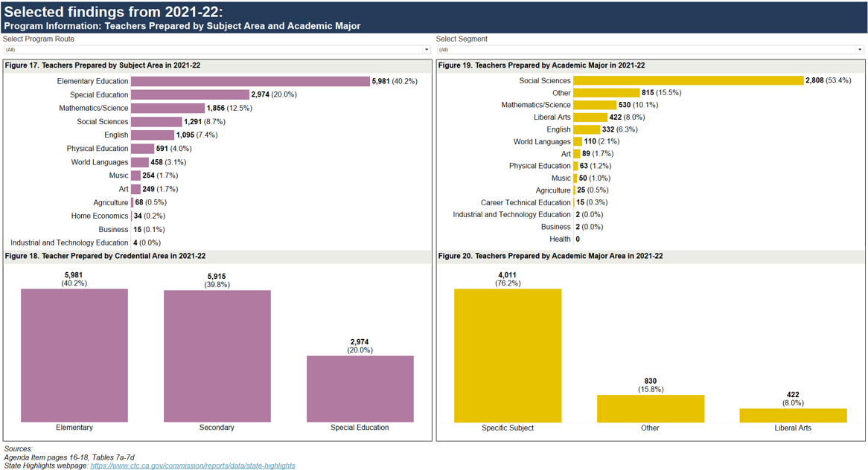
Sources
State Highlights
December 2023 Commission agenda item 2C – pages 16-18, tables 7a-7d

Slide 16
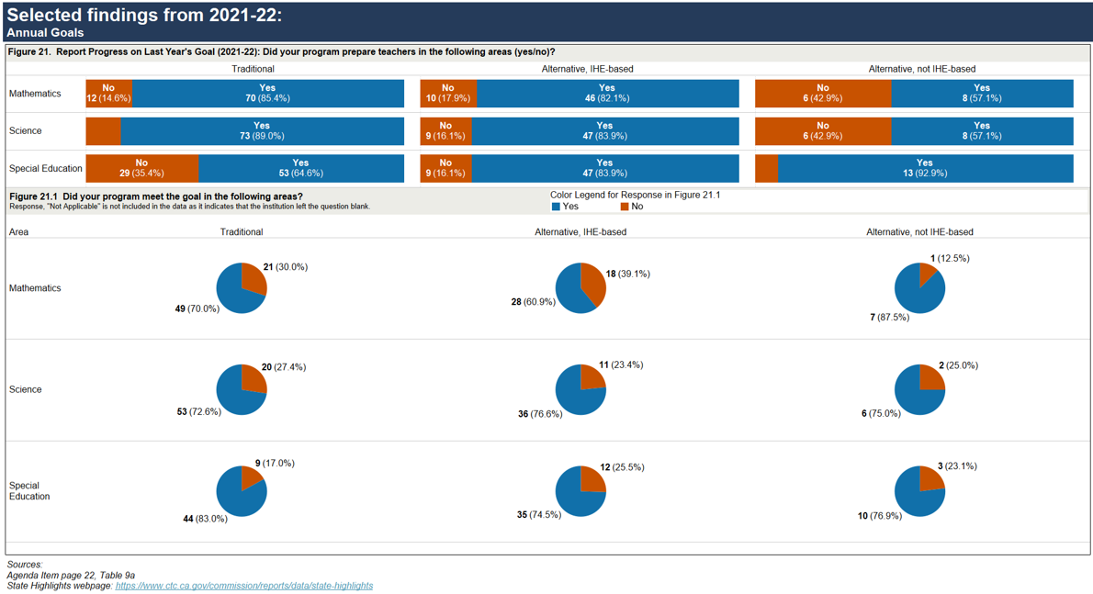
Sources
State Highlights
December 2023 Commission agenda item 2C – pages 21, table 9a

Slide 17
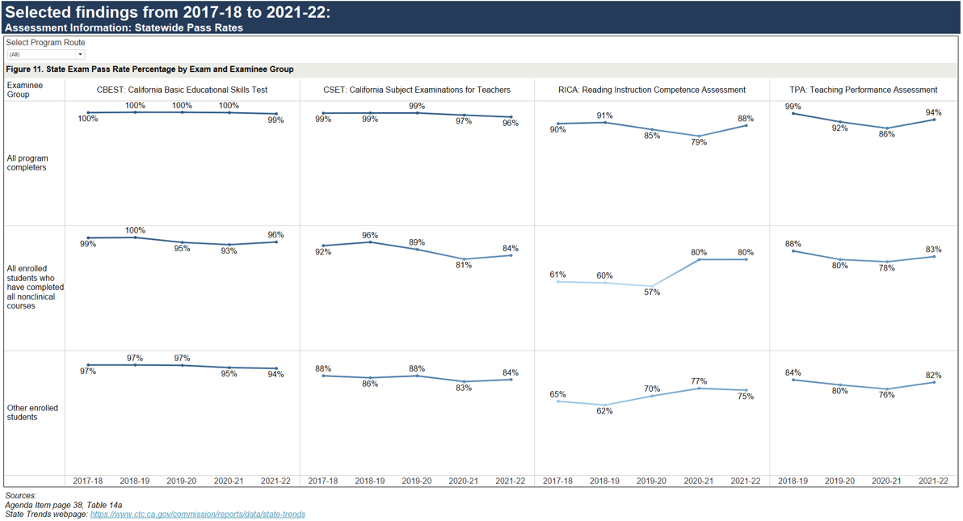
Selected Findings from 2017-18 to 2021-22: Assessment Information: Statewide Pass Rates
Sources
State Trends
December 2023 Commission agenda item 2C – page 38, table 14a

Slide 18
Summary
Federal mandate
Teacher Preparation programs submitted their IPRCs (May 19, 2023)
State report is due to the U.S. Department of Education (October 31, 2023)
2021-22 report highlights:
Decrease in total candidate enrollment in the Traditional and Alternative, IHE-based routes from the prior year
Increase in total candidate enrollment in the Alternative, LEA-based route from the prior year
More than half of total candidates identified themselves as non-White in all program routes
Higher percentage of male candidates enrolled in Alternative route programs
Higher percentage of teachers in the Alternative routes were prepared in special education
More than half of teachers were prepared with the Social Sciences academic major
Assessment rates varied by route and segment

