Slide 1
Teacher Supply in California, 2021-22 A Report to the Legislature
David Deguire, Director
Cara Mendoza, administrator
phi phi lau, Research data specialist
Professional Services Division
april 2023

Slide 2
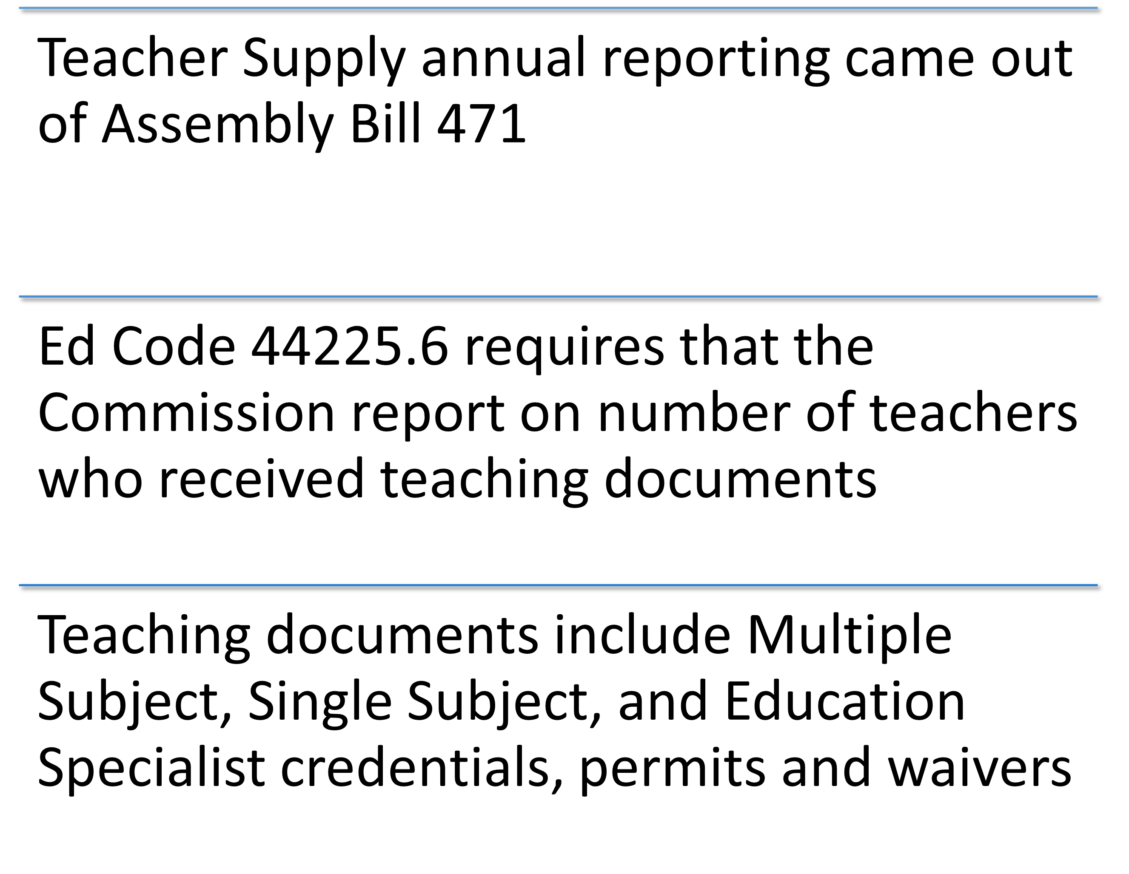
Background – Why do we submit the report every April?

Slide 3
Selected findings from the 2021-22 report: New Teaching Credentials Issued
Sources
April 2023 Commission Agenda item 5C – page 5, Table 1a
California Educator Supply

Slide 4
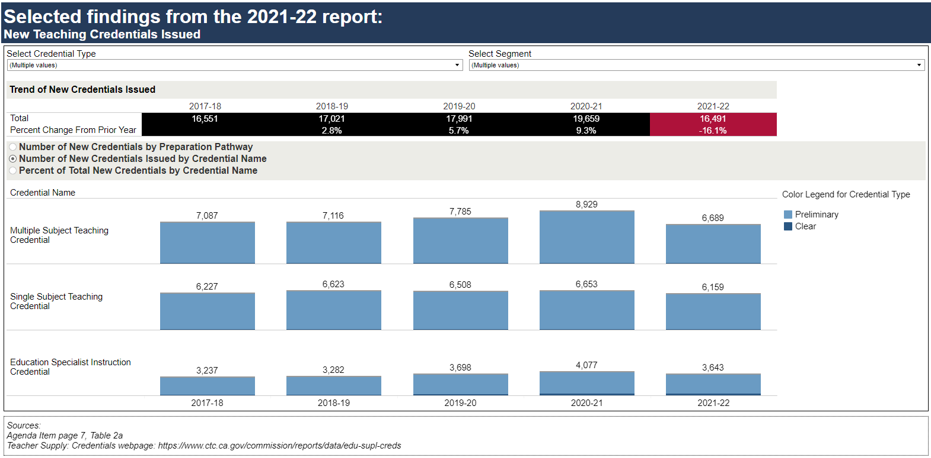
Selected findings from the 2021-22 report: New Teaching Credentials Issued
Sources
April 2023 Commission Agenda item 5C – page 7, Table 2a
Teacher Supply: Credentials

Slide 5
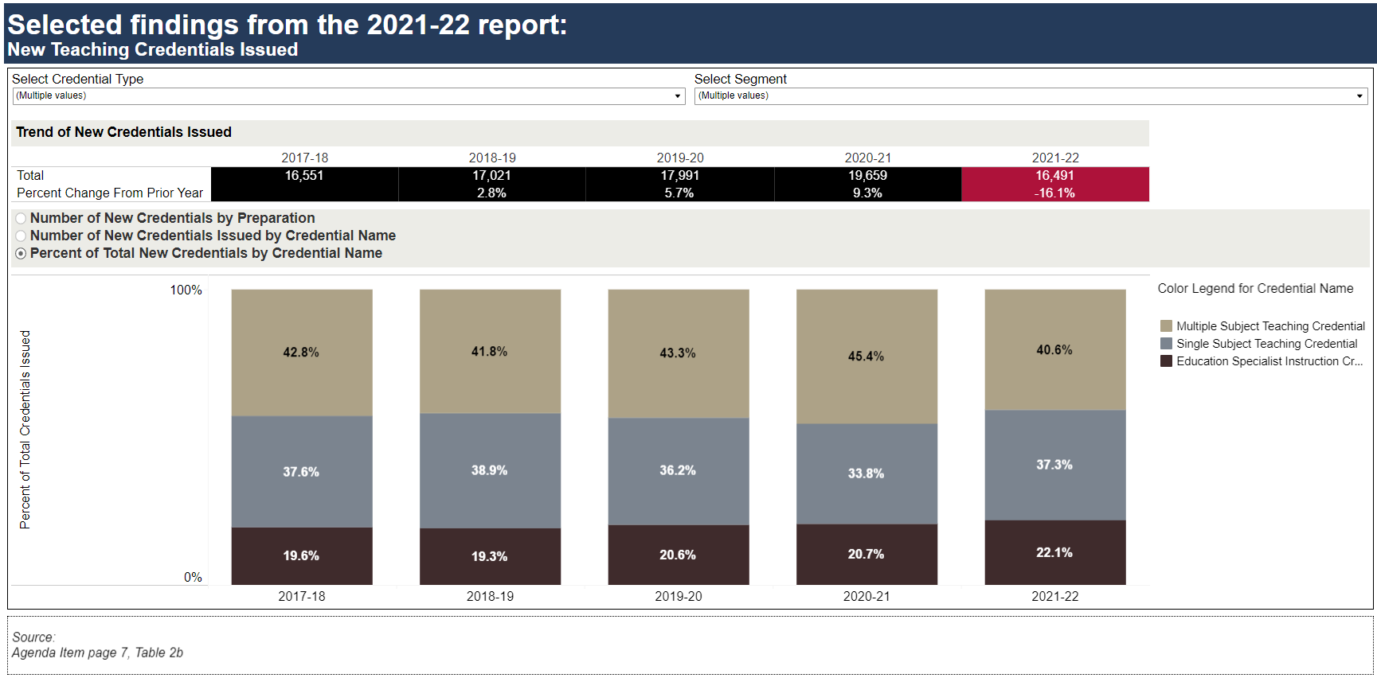
Selected findings from the 2021-22 report: New Teaching Credentials Issued
Source
April 2023 Commission Agenda item 5C – page 7, Table 2b

Slide 6
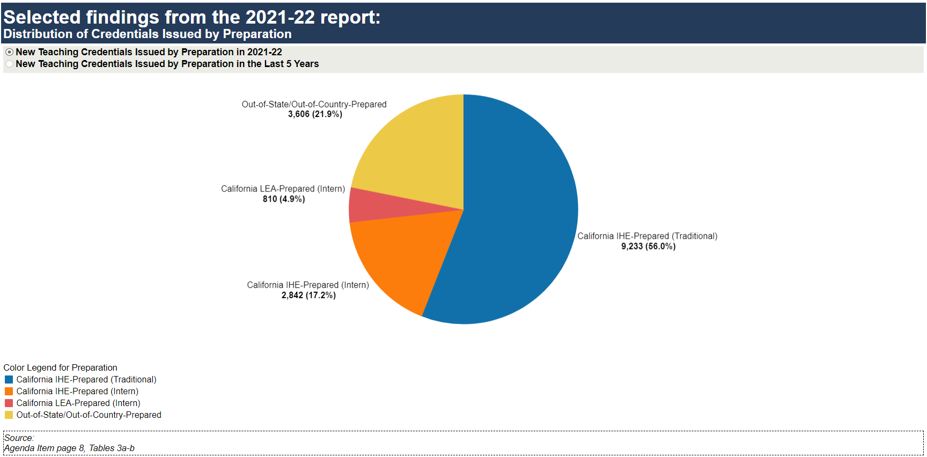
Selected findings from the 2021-22 report: Distribution of Credentials Issued by Preparation
Source
April 2023 Commission Agenda item 5C – page 8, Table 3a and 3b

Slide 7
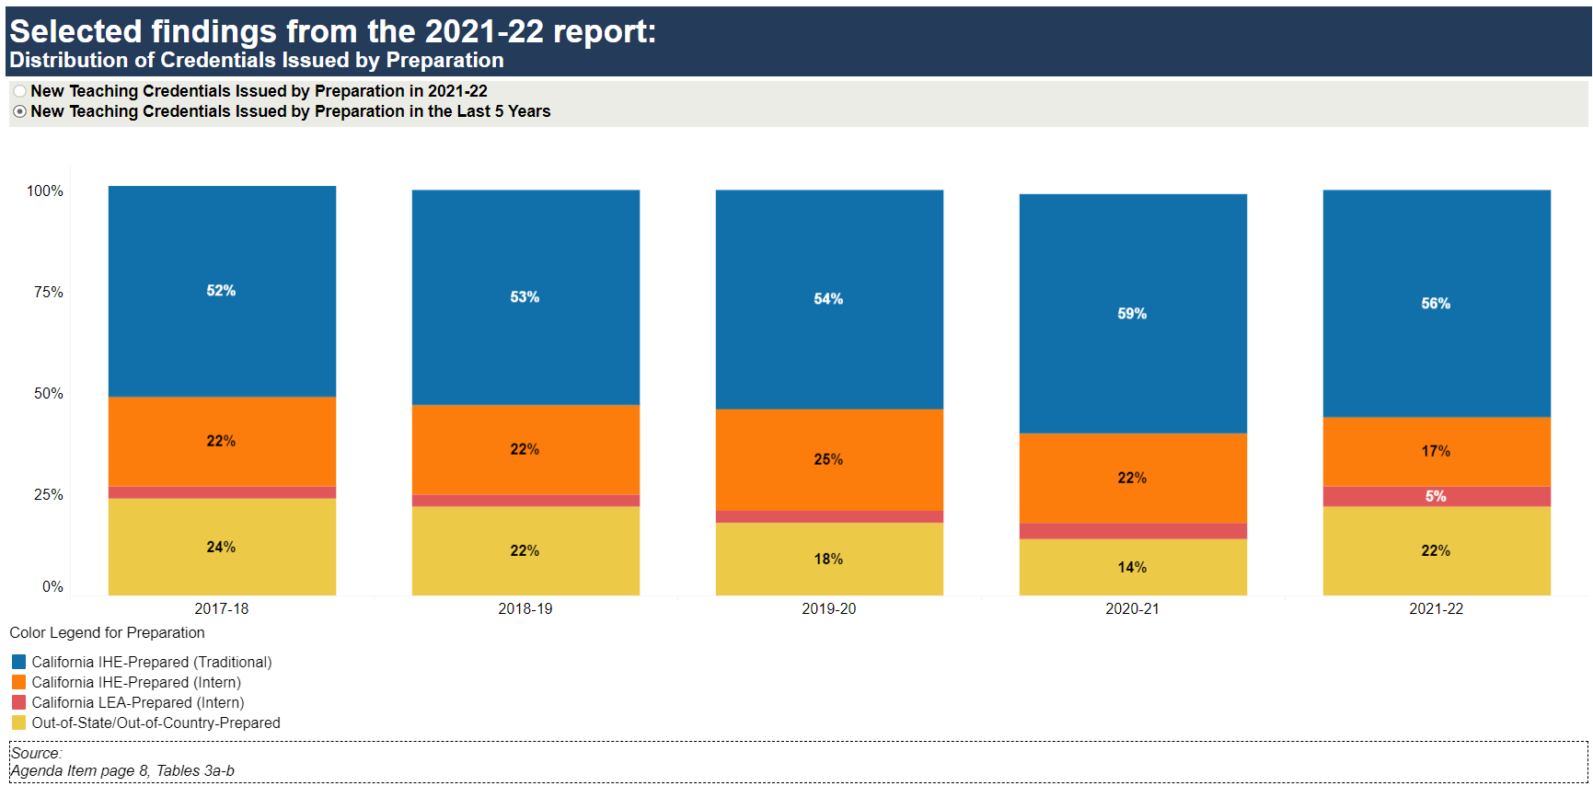
Selected findings from the 2021-22 report: Distribution of Credentials by Preparation
Source
April 2023 Commission Agenda item 5C – page 8, Table 3a and 3b

Slide 8
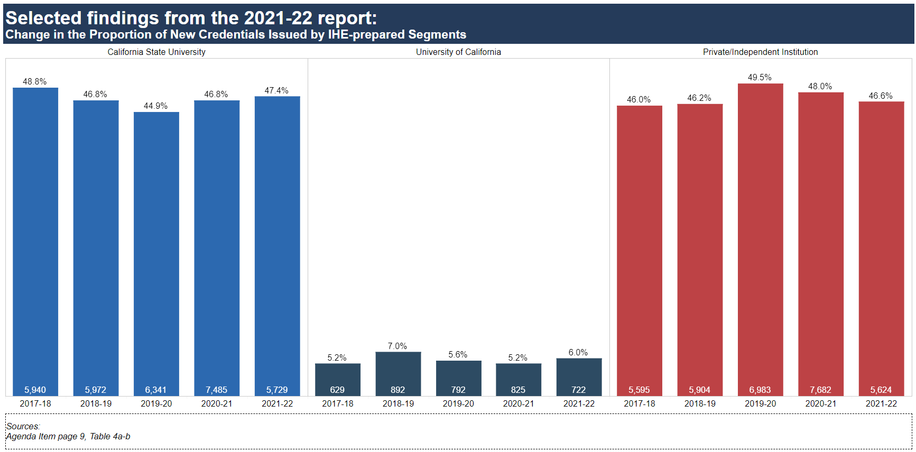
Selected findings from the 2021-22 report: Change in the Proportion of New Credentials Issued by IHE-prepared Segments
Source
April 2023 Commission Agenda item 5C – page 9, Table 4a and 4b

Slide 9
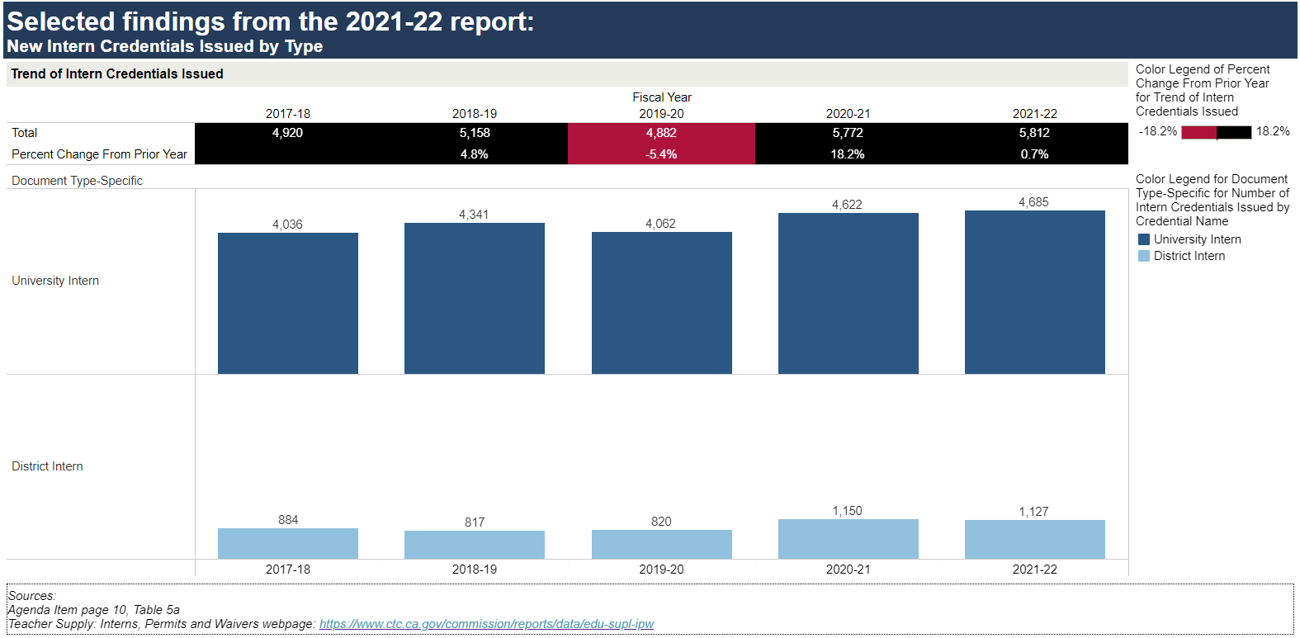
Selected findings from the 2021-22 report: New Intern Credentials Issued by Type
Sources
April 2023 Commission Agenda item 5C – page 10, Table 5a
Teacher Supply: Interns, Permits and Waivers

Slide 10
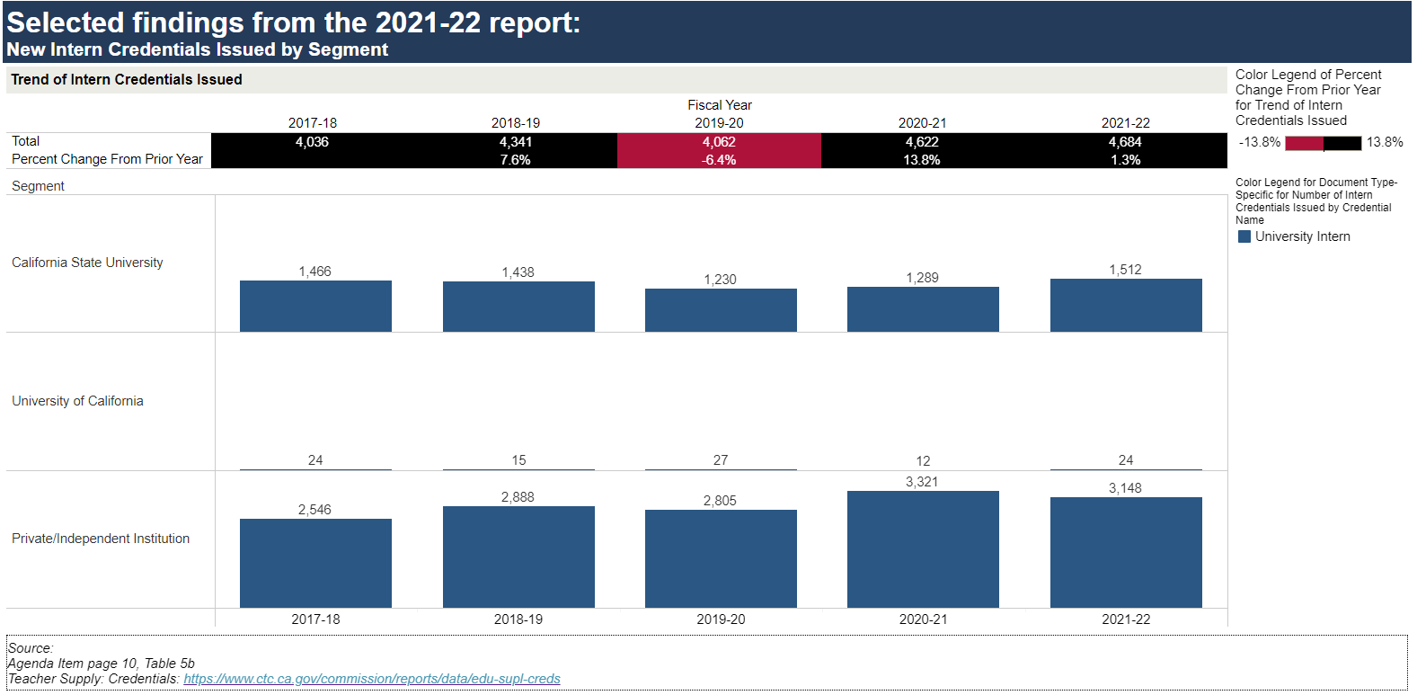
Selected findings from the 2021-22 report: New Intern Credentials Issued by Segment
Sources
April 2023 Commission Agenda item 5C – page 10, Table 5b
Teacher Supply: Credentials

Slide 11
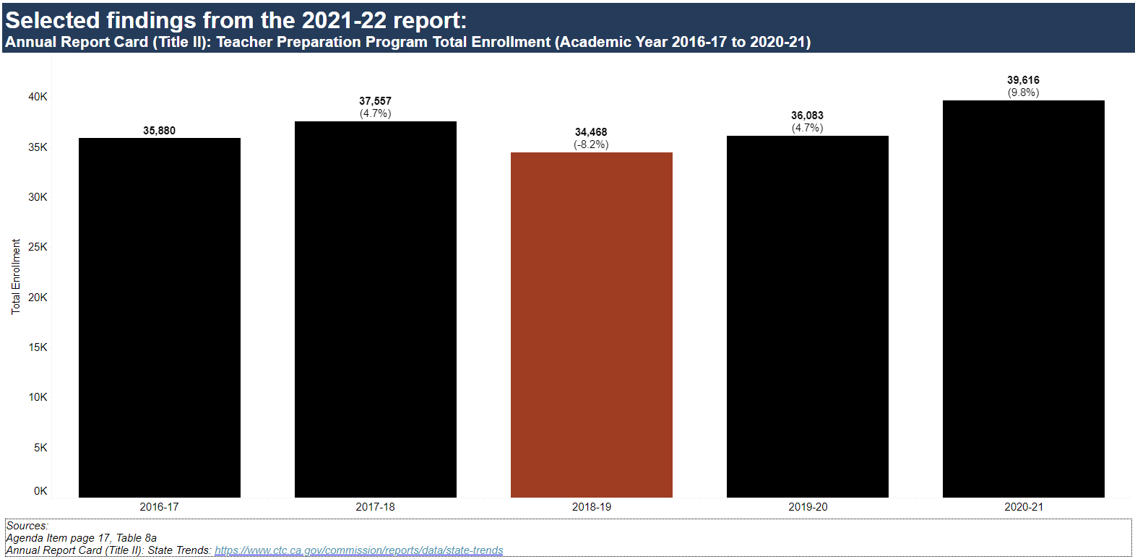
Selected findings from the 2021-22 report: Annual Report Card (Title II) Teacher Preparation Program Total Enrollment (Academic Year 2016-17 to 2020-21)
Sources
April 2023 Commission Agenda item 5C – page 17, Table 8a
State Trends

Slide 12
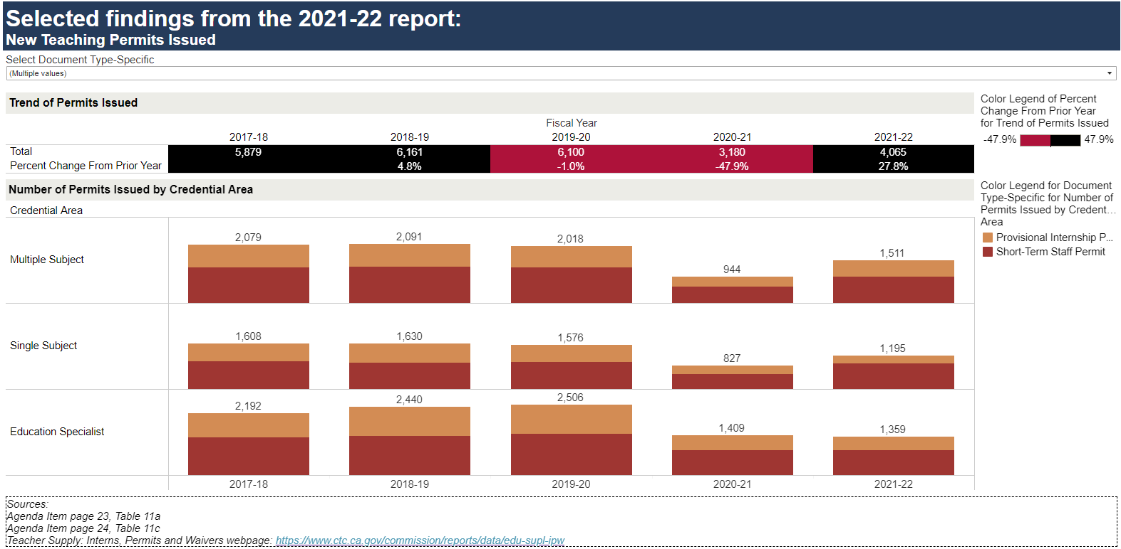
Selected findings from the 2021-22 report: New Teaching Permits Issued
Sources
April 2023 Commission Agenda item 5C – page 23, Table 11a and page 24, Table 11c
Teacher Supply: Interns, Permits and Waivers

Slide 13
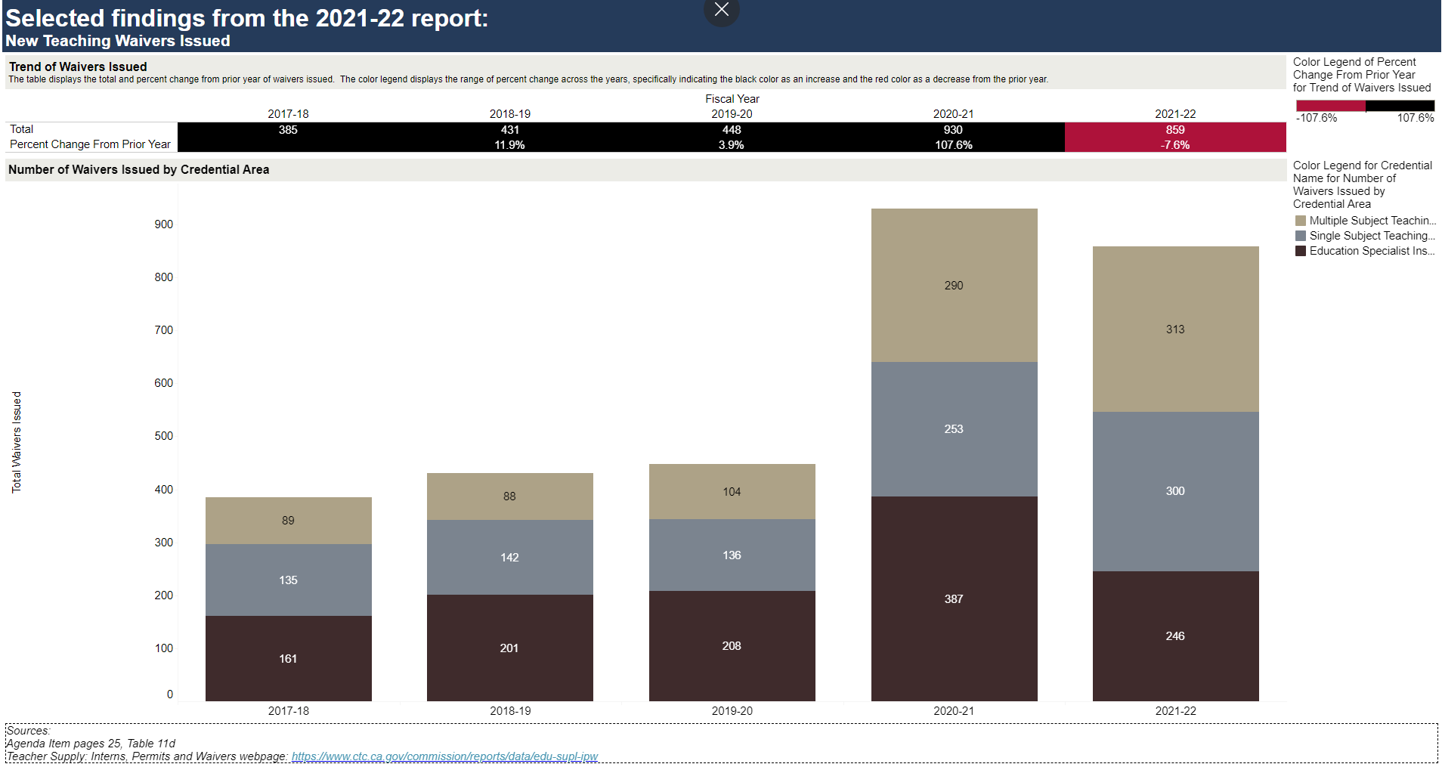
Selected findings from 2021-22 report: New Teaching Waivers Issued
Sources
April 2023 Commission Agenda item 5C – page 25, Table 11d
Teacher Supply: Interns, Permits and Waivers

Slide 14
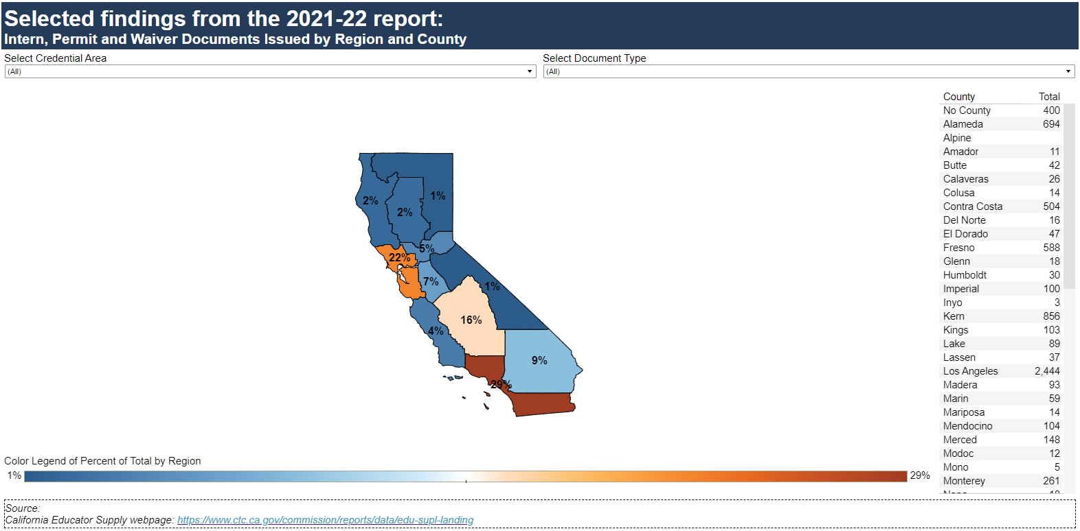
Selected findings from the 2021-22 report: Intern, Permit and Waiver Documents issued by Region and County
Source
California Educator Supply

Slide 15
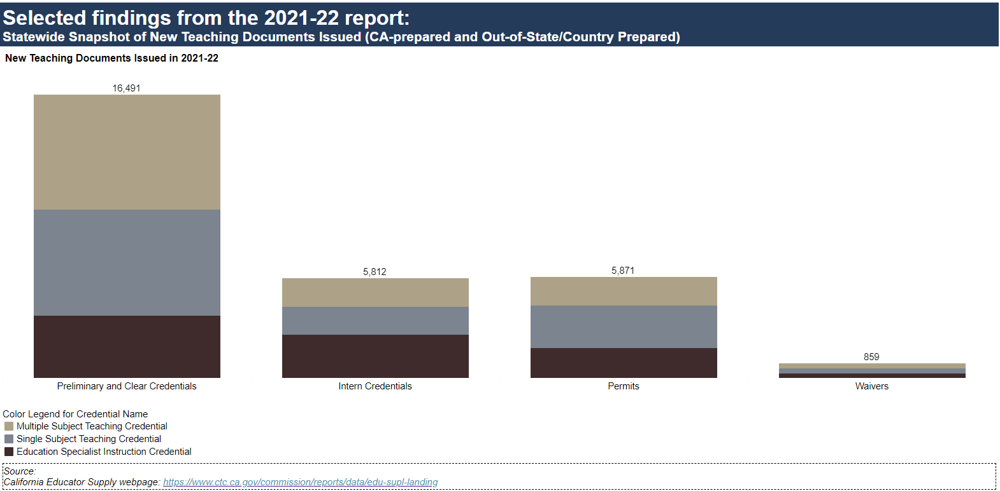
Selected findings from the 2021-22 report: Statewide Snapshot of New Teaching Documents Issued (CA-prepared and Out-of-State/Country Prepared)
Source
California Educator Supply

Slide 16
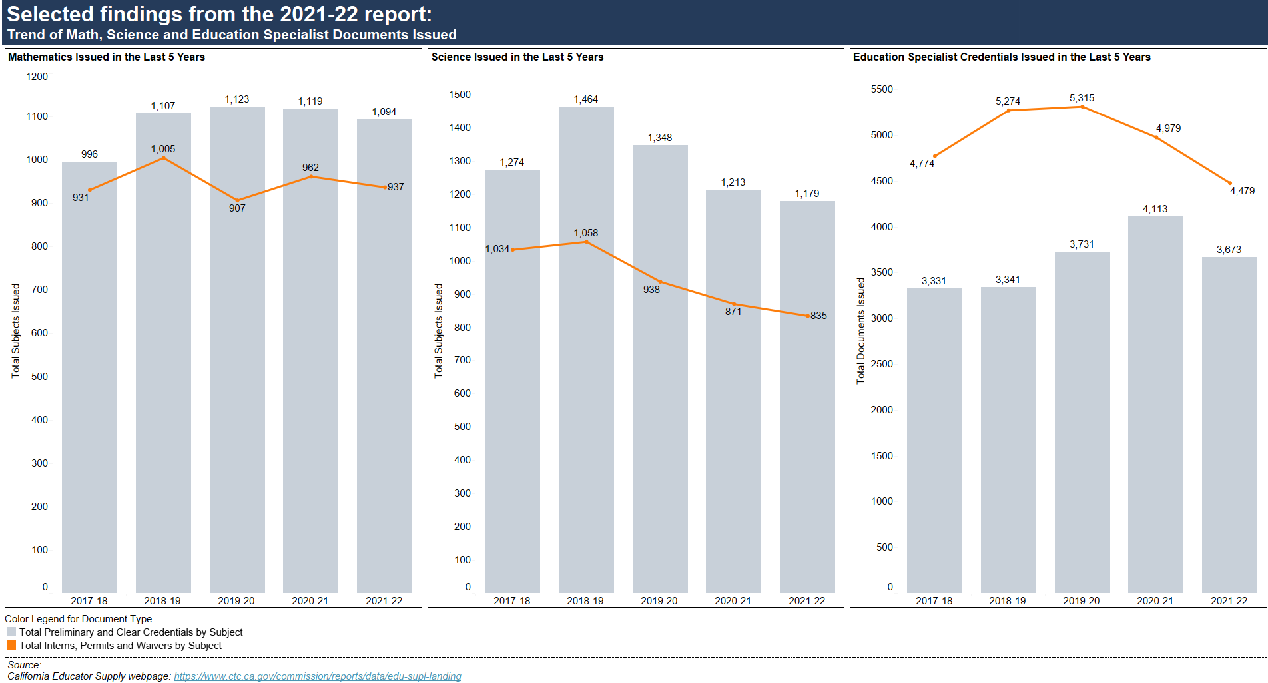
Selected findings from the 2021-22 report: Trend of Math, Science and Education Specialist Documents Issued
Source
California Educator Supply

Slide 17
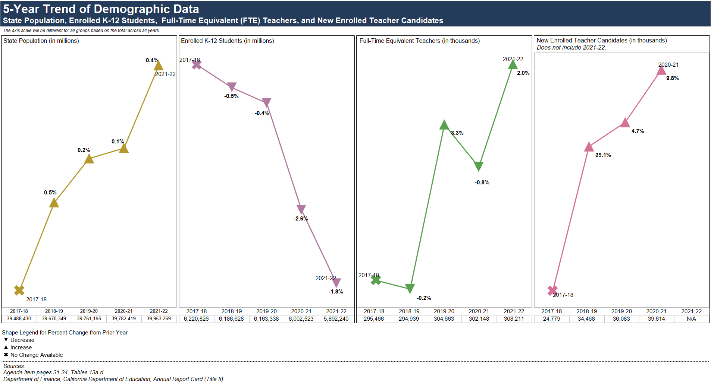
5-Year Trend of Demographic Data: State Population, Enrolled K-12 Students, Full-Time Equivalent (FTE) Teachers, and New Enrolled Teacher Candidates
Sources
April 2023 Commission Agenda item 5C – pages 31-34, Table 13a, Table 13b, Table 13c, Table 13d
Title II: State Trends
FTE Teachers: CDE Staff Demographic Data
K-12 Student Enrollment: CDE Annual Enrollment
California Population: : Department of Finance: Report P-2D: Total Population by Total Hispanic and Non-Hispanic Race

Slide 18
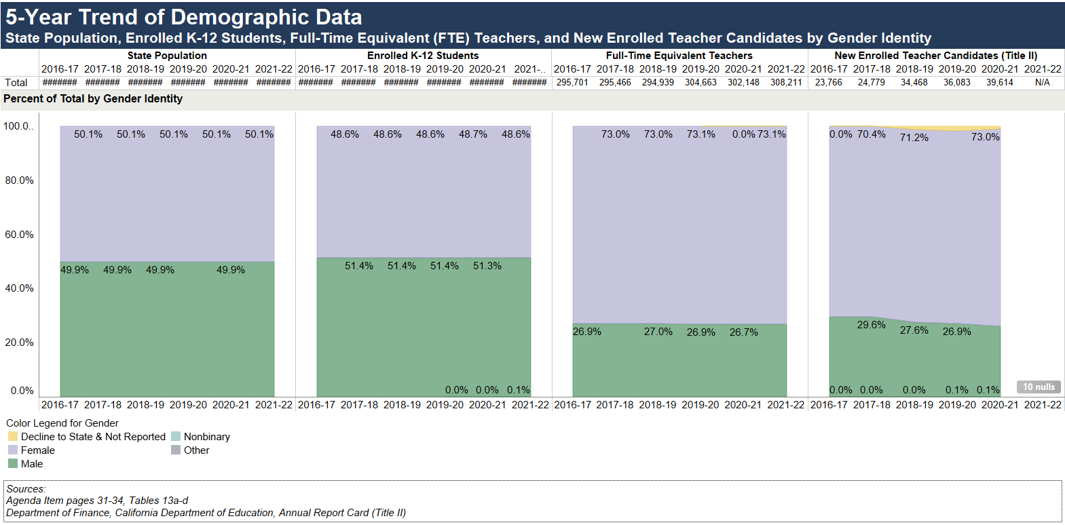
5-Year Trend of Demographic Data: State Population, Enrolled K-12 Students, Full-Time Equivalent (FTE) Teachers, and New Enrolled Teacher Candidates by Gender Identity
Sources
April 2023 Commission Agenda item 5C – pages 31-34, Table 13a, Table 13b, Table 13c, Table 13d
Title II: State Trends
FTE Teachers: CDE Staff Demographic Data
K-12 Student Enrollment: CDE Annual Enrollment
California Population: : Department of Finance: Report P-2D: Total Population by Total Hispanic and Non-Hispanic Race

Slide 19
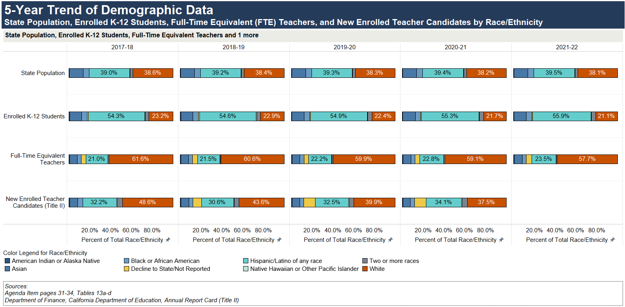
5-Year Trend of Demographic Data: State Population, Enrolled K-12 Students, Full-Time Equivalent (FTE) Teachers, and New Enrolled Teacher Candidates by Race/Ethnicity
Sources
April 2023 Commission Agenda item 5C – pages 31-34, Table 13a, Table 13b, Table 13c, Table 13d
Title II: State Trends
FTE Teachers: CDE Staff Demographic Data
K-12 Student Enrollment: CDE Annual Enrollment
California Population: : Department of Finance: Report P-2D: Total Population by Total Hispanic and Non-Hispanic Race

Slide 20
Summary
State mandate
Commission transmitted the Teacher Supply Report to the Governor and Legislature by April 15, 2023
2021-22 report highlights:
Decrease of new teaching credentials issued via the California IHE-Prepared and California LEA-Prepared program sponsors
Increase of new teaching credentials issued via Out-of-State/Country prepared
Change in the proportion of teaching credentials issued by IHEs in the past five years
Increase of intern credentials issued
Increase of STSPs and PIPs issued
Decrease of Limited Assignment permits and waivers issued
Overall increase of intern credentials, permits and waivers issued

