Slide 1
California National Board Certification Incentive Program

Slide 2
The Certification Process
In all 25 certificate areas, candidates are required to complete an assessment that includes four components. The content knowledge component is a computer-based assessment taken at a testing center; the other three are portfolio-based and submitted through an electronic portfolio system.
Component 1: Content Knowledge ​
Component 2: Differentiation in Instruction ​
Component 3: Teaching Practice and Learning Environment​
​
Component 4: Effective and Reflective Practitioner
Portfolio Components

Slide 3
Supporting Teachers through
the Board Certification Process
Teachers benefit from being supported through the National Board process, informally and formally.
Local support- Districts such as LAUSD, SFUSD, Fresno, Long Beach, and Orange County, offer supports at a district/union level
Statewide support- CTA offers a “Jumpstart” and Summer Intensive program, a BIPOC cohort, and a Community of Practice with weekly webinars, free to CTA members.
Open-to-all- Stanford National Board Resource Center and UCLA Center X offer programs that can be both in-person and virtual.

Slide 4
National Board Impacts Teaching
Teachers who engage with the National Board standards report making specific changes to their instructional practice including:
Adjusting lesson plans to meet the needs of individual students
Gaining and/or deepening knowledge in content areas
Using data in new ways to assess student progress

Slide 5
Research Shows
Students of National Board Certified Teachers demonstrate additional learning and deeper learning.
National Board Certified Teachers remain in the profession longer than their colleagues.
New teachers who are mentored by NBCTs exhibit improvement and generate additional student learning.
Targeted incentives in high-need schools can decrease turnover of NBCTs, increase the number of current teachers who become Board-certified, and encourage NBCTs to transfer into the schools.
Goldhaber, D., & Anthony, E. (2007). Can teacher quality be effectively assessed? The Review of Economics and Statistics 89(1), 134-150.
Smith, T., Baker, W., Hattie, J., & Bond, L. (2008). “A Validity Study of the Certification System of the National Board for Professional Teaching Standards” in Assessing Teachers for Professional Certification: The First Decade of the National Board for Professional Teaching Standards. Advances in Program Evaluation, Volume 11, 345-378.
Retaining SC Teachers Through National Board Certification (2020). Center for Educator Recruitment, Retention & Advancement.
Zhu, B., Gnedko-Berry, N., Borman, T., & Manzeske, D. (2019). Effects of National Board Certified instructional leaders on classroom practice and student achievement of novice teachers: A study report developed for the National Board for Professional Teaching Standards. American Institutes for Research.
Cowan and Goldhaber (2018). Do bonuses affect teacher staffing and student achievement in high poverty schools? Evidence from an incentive for national board certified teachers in Washington State. Economics of Education Review 65 2018) 138–152

Slide 6
California in 2020-21 vs. 2021-22
The number of teachers pursuing National Board Certification in California more than tripled
659 → 2,270
The number of teachers of color pursuing National Board Certification quadrupled
356 → 1,414
The share of teachers in California pursuing NBC who are teachers of color increased by 8%
54% → 62%

Slide 7
CA NBPTS Certification Incentive Program
The 2021 California state budget reestablished the National Board for Professional Teaching Standards (NBPTS) Certification Incentive Program 2021-26:
Incentive awards to National Board Certified Teachers (NBCTs) who are assigned to teach in high-priority California public schools.
Subsidy awards to teachers who have initiated the process of pursuing NBPTS certification when teaching in high-priority California public schools.

Slide 8
High-Priority Schools
California Assembly Bill 130 defines high-priority schools as a school with 55 percent or more of its unduplicated pupil count of students classified as an English learner or foster youth, or eligible for a free or reduced-price meal.
List of Eligible High-Priority Schools is located on our program website: https://www.cde.ca.gov/pd/ps/nbptsprogram.asp

Slide 9
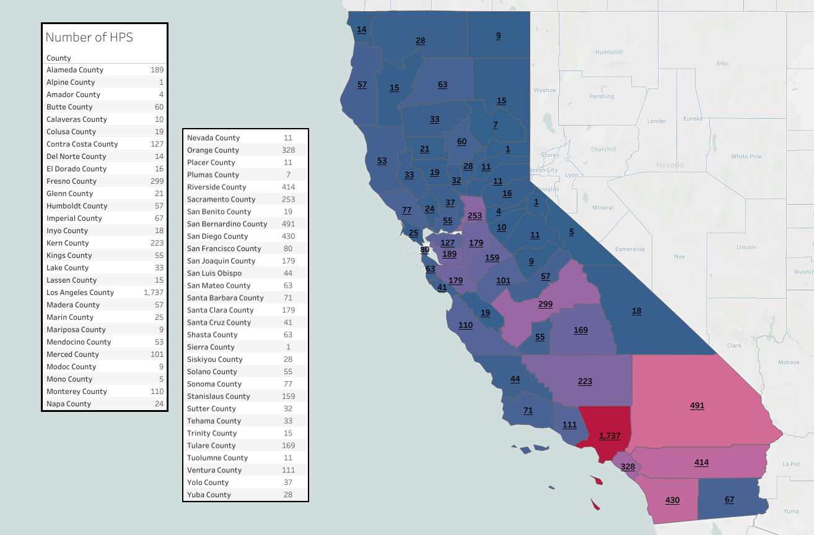
California High Priority Schools by County

Slide 10
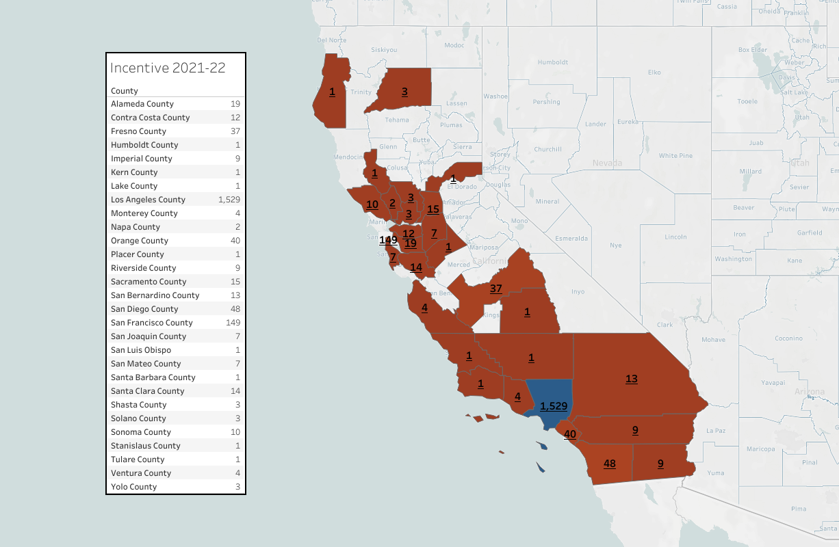
2021-22 CA NBCT Certification Incentives

Slide 11
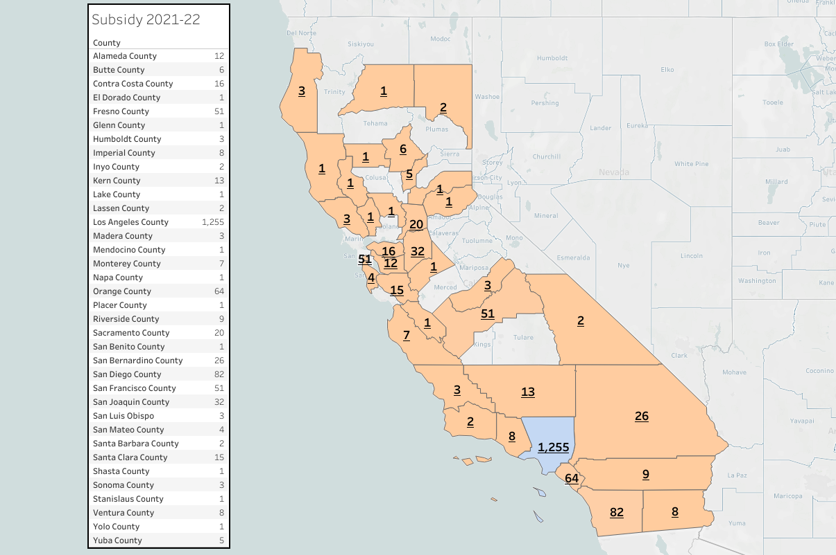
2021-22 CA NBPTS Candidate Subsidies

Slide 12
2022-23 Applications and Recruitment
Applications close on January 4, 2023 at 4 p.m.
Conference presentations
Targeted outreach to counties and districts with large concentration of High-Priority Schools
State-level discussions highlighting National Board certification as a retention strategy and using NBCTs for mentoring

Slide 13
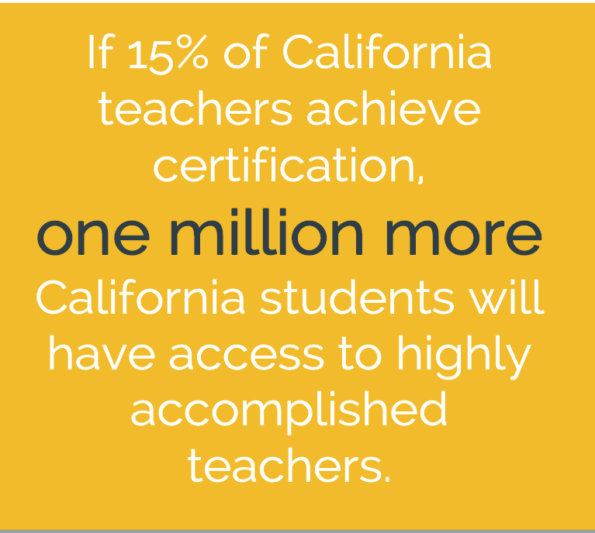
You can help!
Communicate the opportunity
Tweet
Email
Send out Flyers and Postcards
Champion NBCTs
Recognize NBCTs in your community
Highlight NBCT expertise

Slide 14
Contact Information
Reach out with Questions:
National Board for Professional Teaching Standards
Sarah Pinsky, spinsky@nbpts.org
Stacey Hicks, shicks@nbpts.org
California Department of Education
Teacher and Leader Policy Office, (916) 445-7331
Questions: NBCT@cde.ca.gov

