Slide 1
Report to the Legislature on Credentialing Related to Educator Assignment Monitoring Pursuant to Assembly Bill 1219
Presented By: Ann Harris Assignment program manager, Certification division

Slide 2
Background
Assignment Monitoring Program ensures that educators hold the appropriate credential(s) for their assignments
Prior to AB 1219: | After Passage of AB 1219:
Monitoring of certificated educator assignments conducted on a 4-year cycle “Paper-based” monitoring | Monitoring of certificated educator assignments conducted annually Creation and implementation of an assignment monitoring system
Education Code 44258.9(k) requires the Commission to report to the Legislature, by December 1, 2022:
Details on the development of the California Statewide Assignment Accountability System (CalSAAS)
Results of assignment monitoring

Slide 3
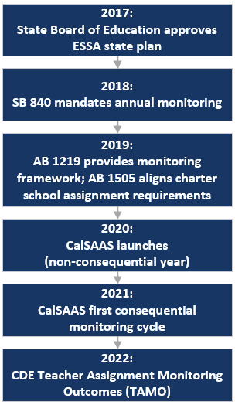
CalSAAS Timeline

Slide 4
California Statewide Assignment Accountability System (CalSAAS)

Slide 5
2019-20 Nonconsequential Year
2019-20 Monitoring Timeline:
Approximately 90% of all exceptions in the system were addressed by users
“CALPADS Error” was the most user selected determination- instances in which LEAs indicated that their reporting in CALPADS was incorrect and did not align with the assignment as it existed in the classroom

Slide 6
2020-21 Initial Consequential Year
2020-21 Monitoring Timeline: Included elective pre-monitoring
97% of the exceptions in the system were addressed by users (7% improvement)
System enhancements resulted in 13% reduction in workable exceptions compared to previous year
Data made publicly available
CDE published their Teacher Assignment Monitoring Outcomes (TAMO) dashboard on June 30, 2022

Slide 7
2021-22 Current Cycle
2021-22 Monitoring Timeline:
Second consequential year is currently in progress
Statewide workload reduced by 3,127 exceptions compared to 2020-21
System enhancements implemented to increase accuracy in final data

Slide 8
2020-21 Statewide Monitoring Results: Misassigned Educators and Courses by Determination
Overall Educators reported: 347,289
Overall Assignments evaluated: 1,500,445

Slide 9
2020-21 Statewide Monitoring Results: Misassignments by Setting
Misassigned educators broken down by educational setting:

Slide 10
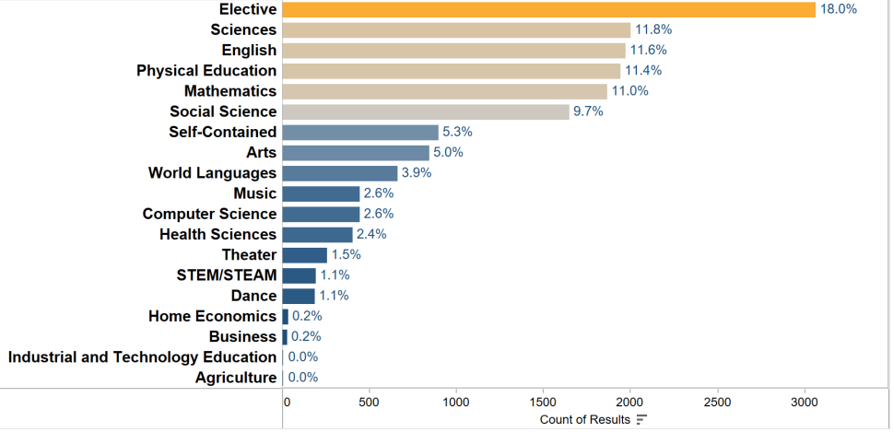
2020-21 Statewide Monitoring Results: General Education Misassignments by Content

Slide 11
2020-21 Statewide Monitoring Results: CTE Misassignments by Industry Sector

Slide 12
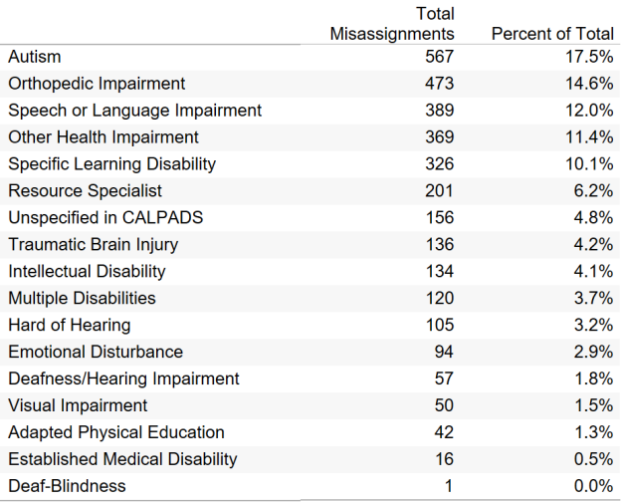
2020-21 Statewide Monitoring Results: Special Education Misassignments by Disability Area

Slide 13
2020-21 Statewide Monitoring Results: Top Alternative Special Education Placements

Slide 14
2020-21 Statewide Monitoring Results: English Learner Services Misassignments

Slide 15
2020-21 Statewide Monitoring Results: Services Misassignments

Slide 16
2020-21 Statewide Monitoring Results: Local Assignment Options
Top 4 Most Used Local Assignment Options
(Alternative Settings)
(Dual/Concurrent Enrollment)
(Staff Development)
(Departmentalized)

Slide 17
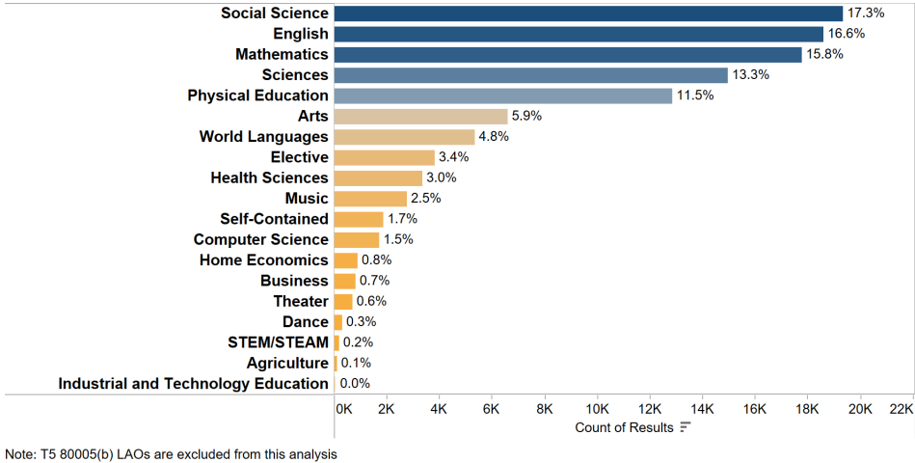
2020-21 Statewide Monitoring Results: Local Assignment Option Usage Across General Education Subjects

Slide 18
System Limitations and Considerations for Further Enhancements
Uniformity in statutory definitions for teacher data collection and reporting
Collect additional data within CalSAAS related to CALPADS reporting errors
Ability to disaggregate assignments when determining
Improve monitoring timeline
CALPADS reporting requirement improvements

Slide 19
Conclusion and Next Steps
Since the passage of AB 1219 and the creation of CalSAAS:
Annual assignment monitoring providing for timely and transparent results
Increased Statewide user participation in assignment monitoring process
System improvements implemented to increase accuracy and efficiency
Commission will launch data dashboards in coming weeks to publicly display assignment data
Recommended Action: That the Commission approve the Assembly Bill 1219 Report for transmittal to the Legislature

