Slide 1
Teacher Supply in California, 2020-21 A Report to the Legislature
cara Mendoza, administrator
phi phi lau, Research data specialist
Professional Services Division
april 2022
1

Slide 2
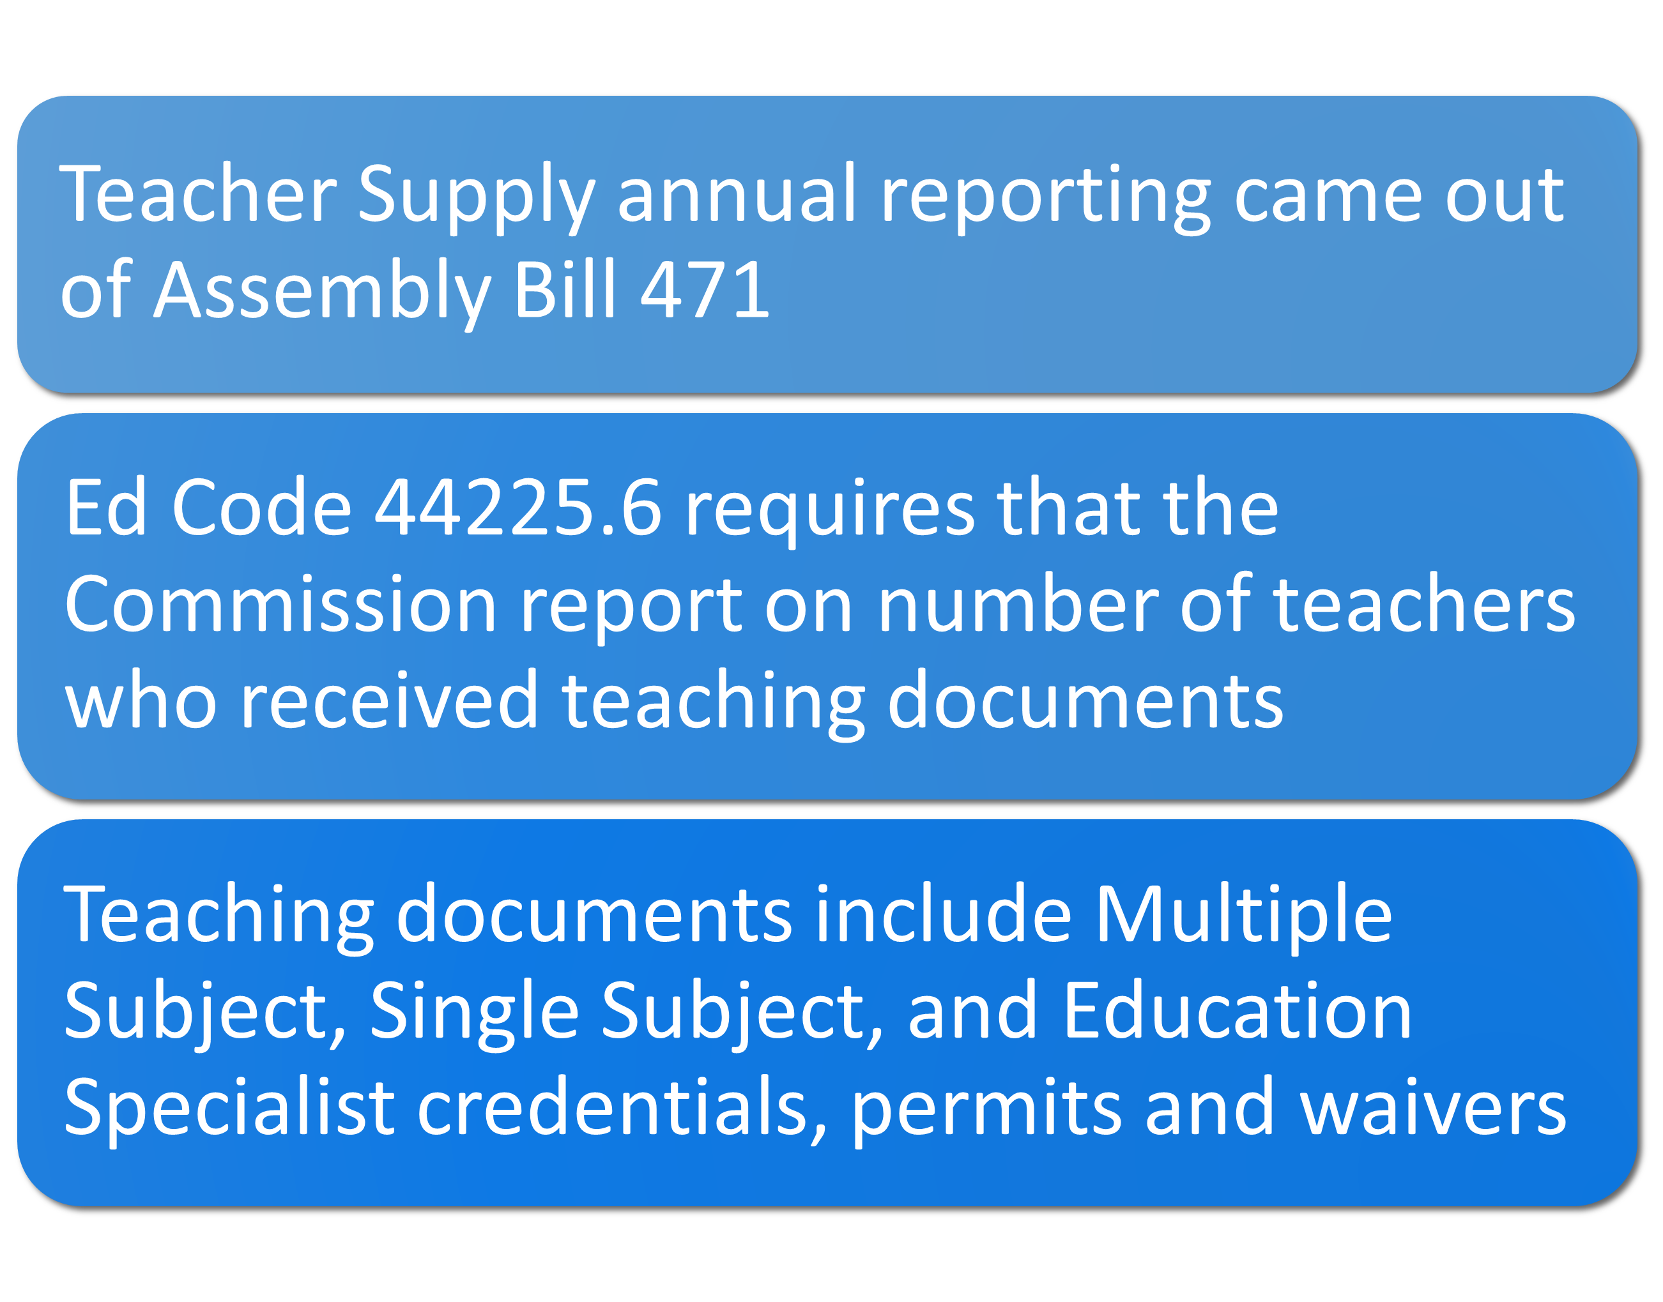
Background – Why do we submit the report every April?
2

Slide 3
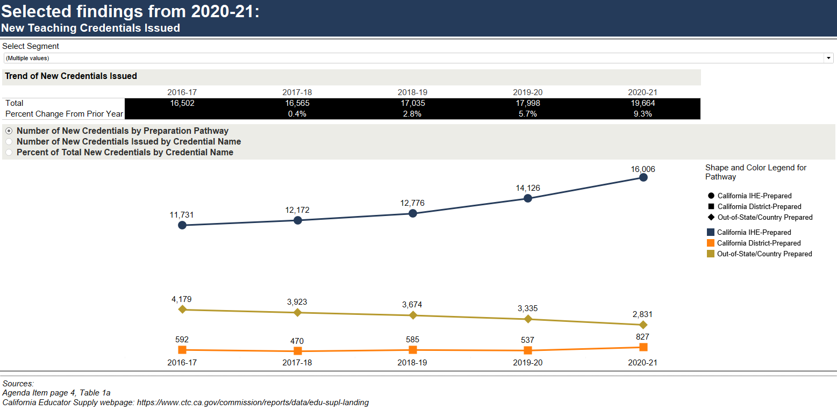
New Teaching Credentials Issued
Sources
California Educator Supply
April 2022 Commission Agenda item 3G – page 4, table 1a

Slide 4
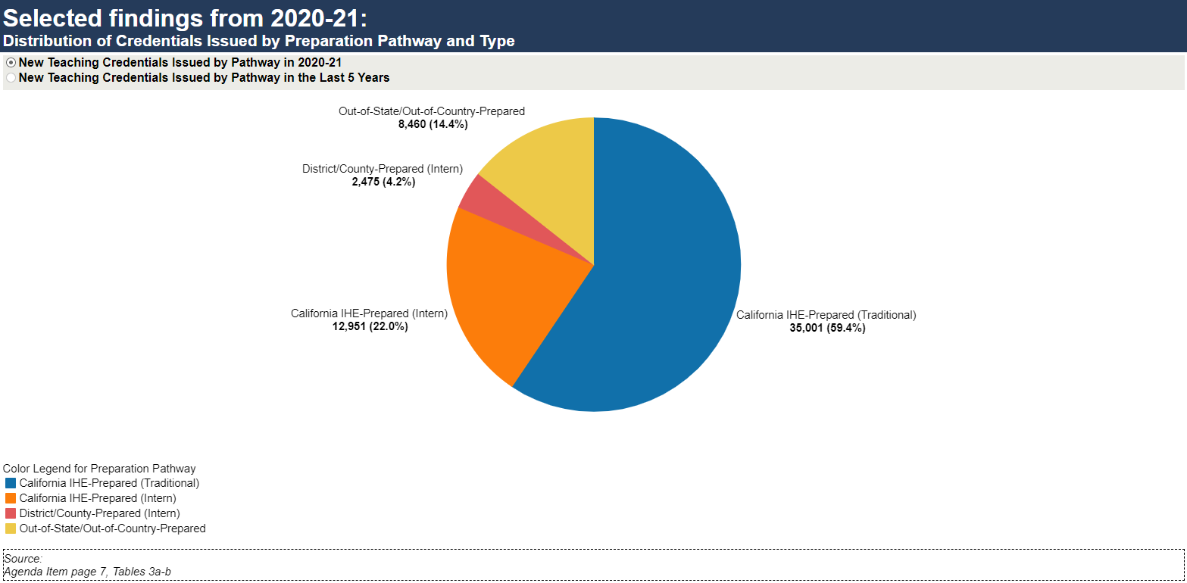
Distribution of Credentials Issued by Preparation Pathway and Type
Sources
April 2022 Commission Agenda item 3G – page 7, table 3a, 3b

Slide 5
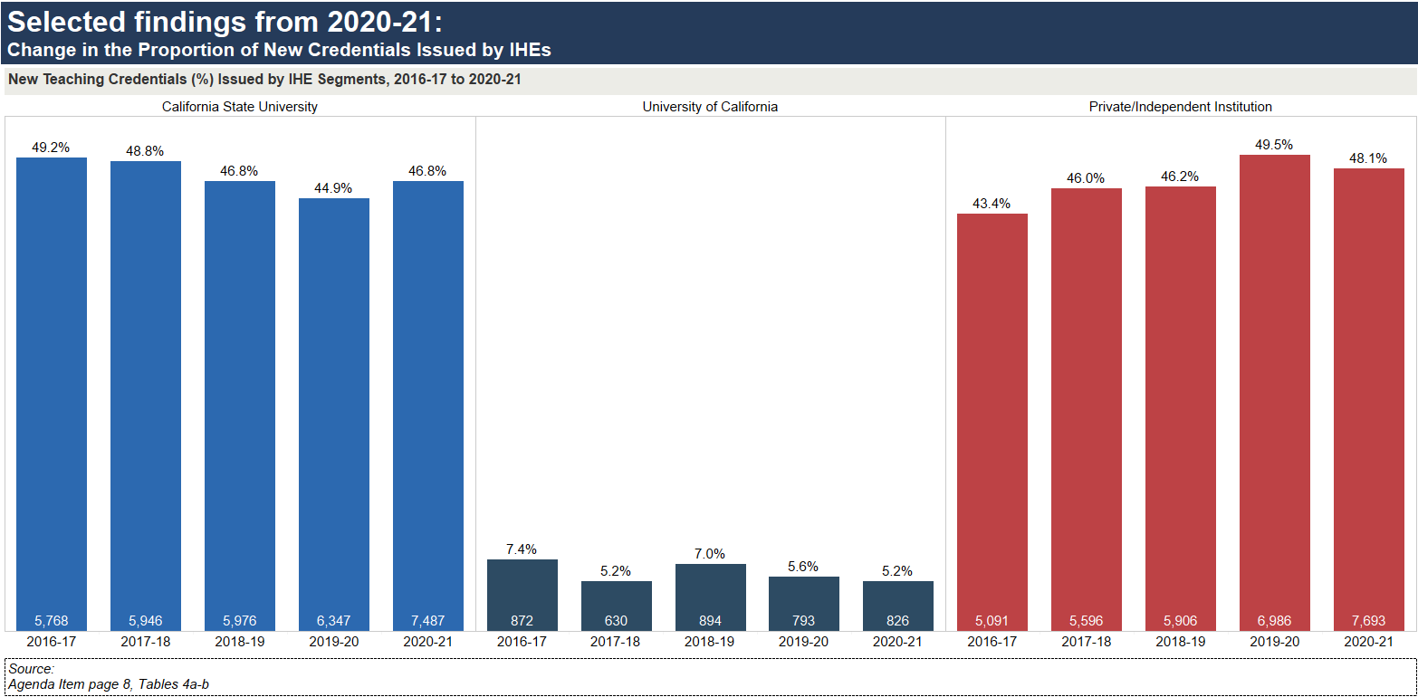
Change in the Proportion of new credentials issued by IHEs in last five years
Sources
April 2022 Commission Agenda item 3G – page 8, table 4a, 4b

Slide 6
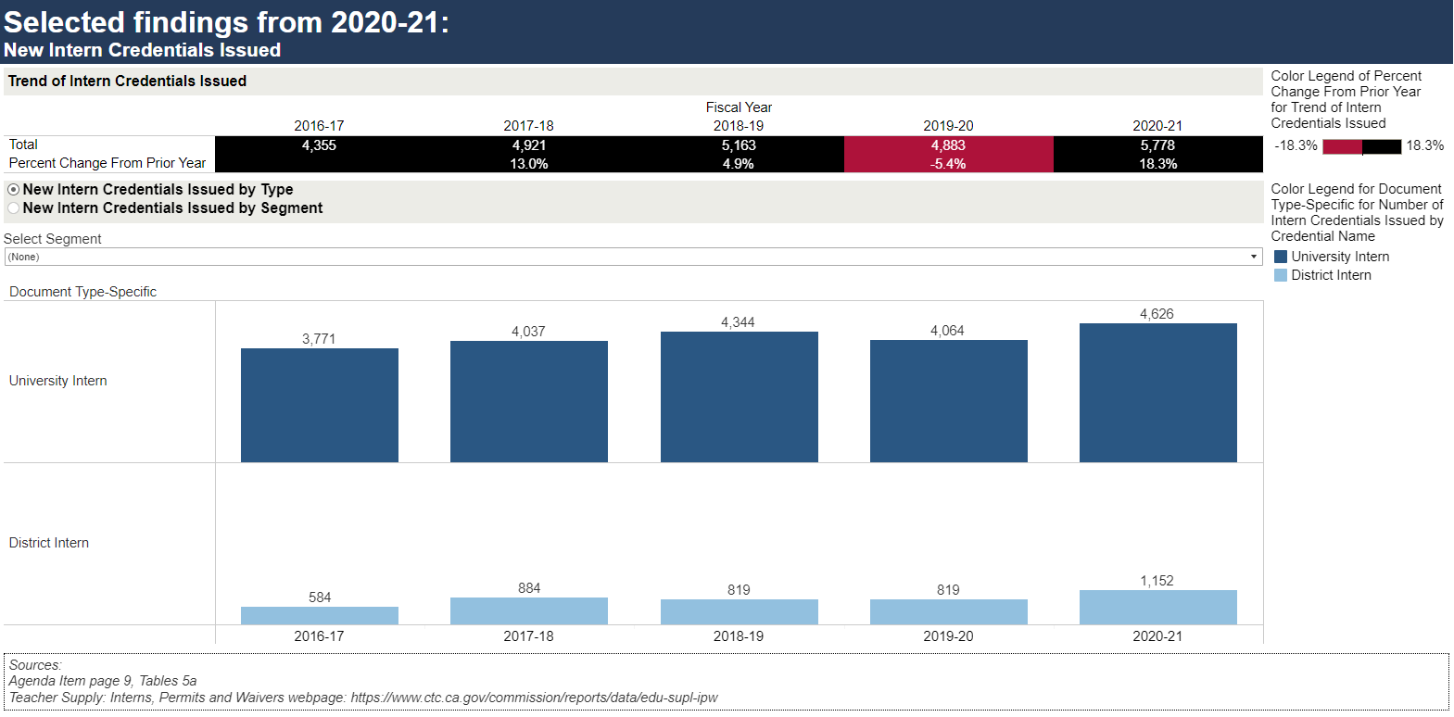
New Intern Credentials Issued
Sources
Teacher Supply: Interns, Permits and Waivers
April 2022 Commission Agenda item 3G – page 9, table 5a

Slide 7
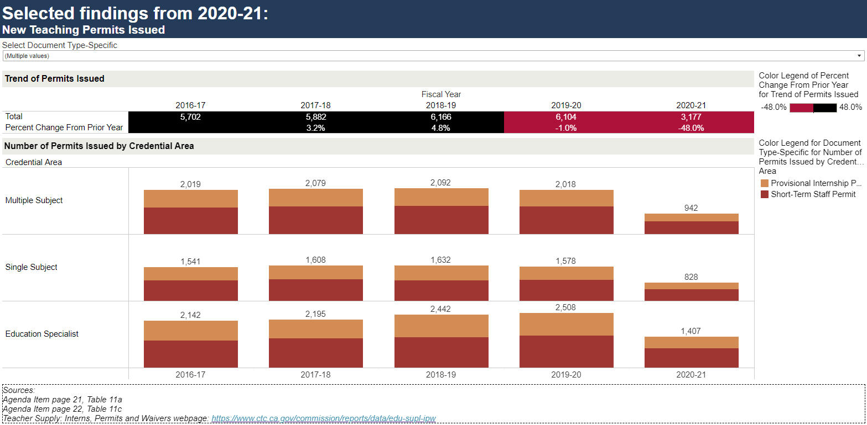
New Teaching Permits Issued
Sources
Teacher Supply: Interns, Permits and Waivers
April 2022 Commission Agenda item 3G – page 21, table 11a. Page 22, table 11c.

Slide 8
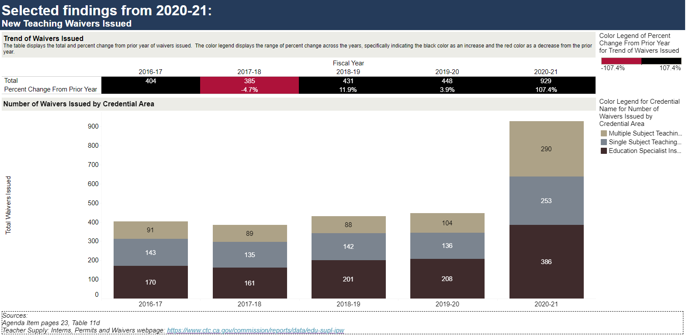
New Teaching Waivers Issued
Sources
Teacher Supply: Interns, Permits and Waivers
April 2022 Commission Agenda item 3G – page 23, table 11d

Slide 9
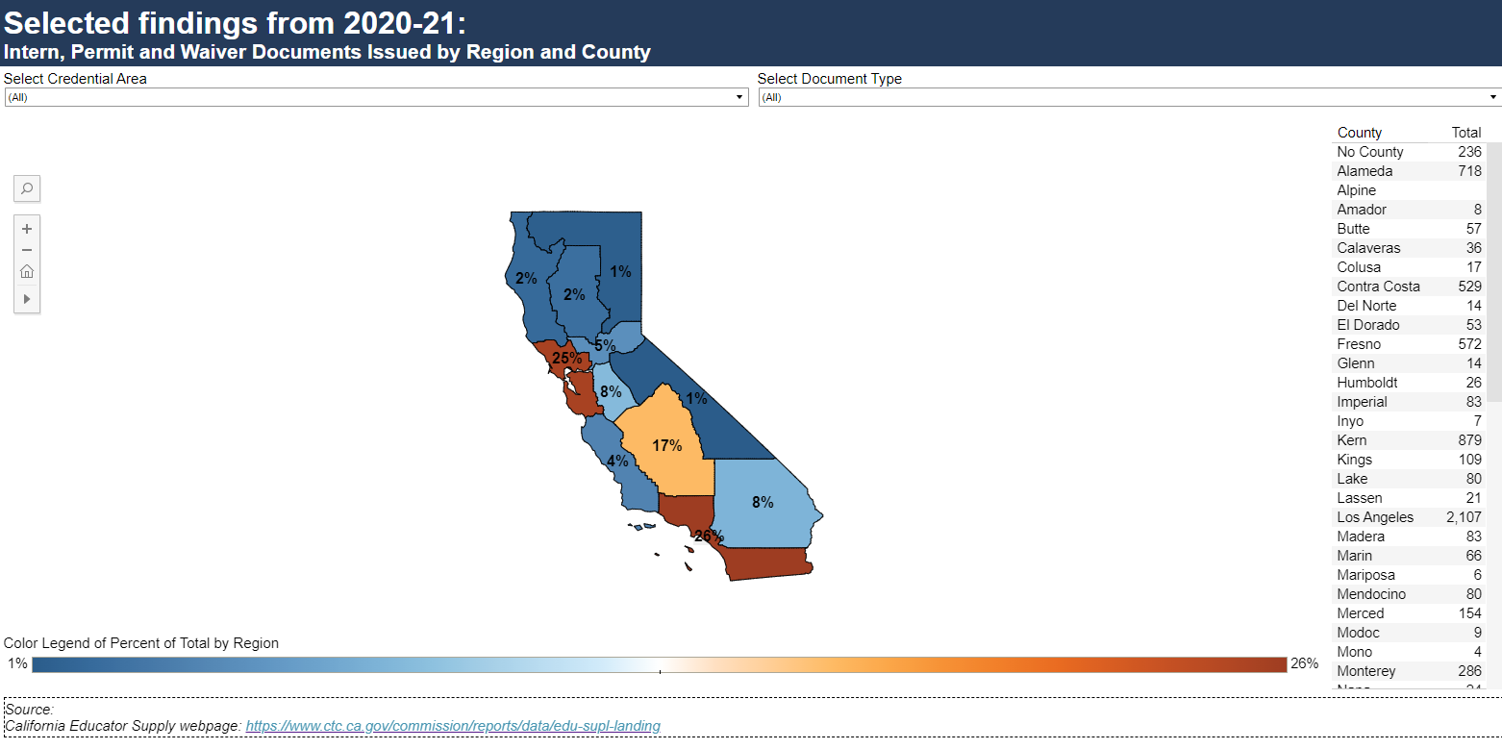
Distribution of Interns, Permits, and Waivers, by County
Sources
California Educator Supply

Slide 10
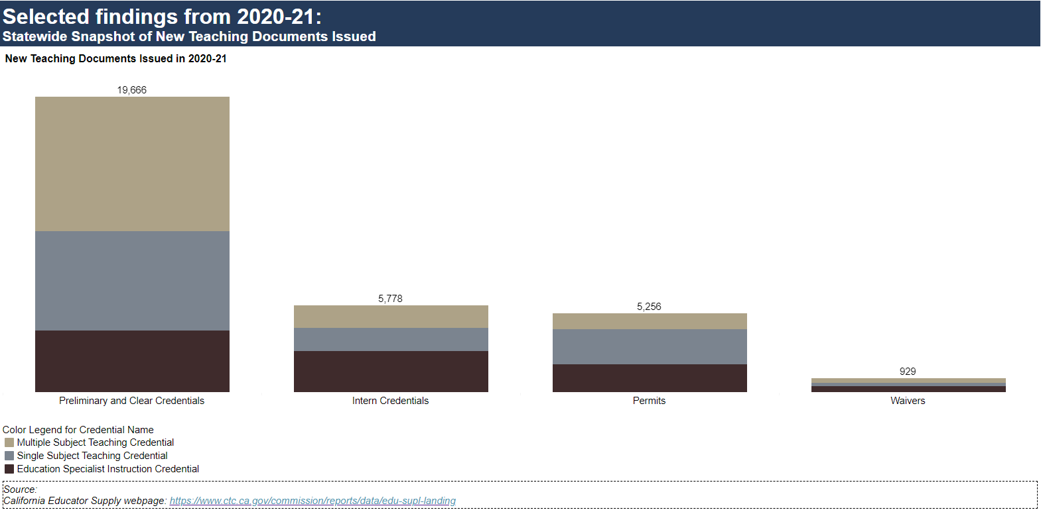
Teacher Supply, 2020-21 - Statewide picture
Sources
California Educator Supply

Slide 11
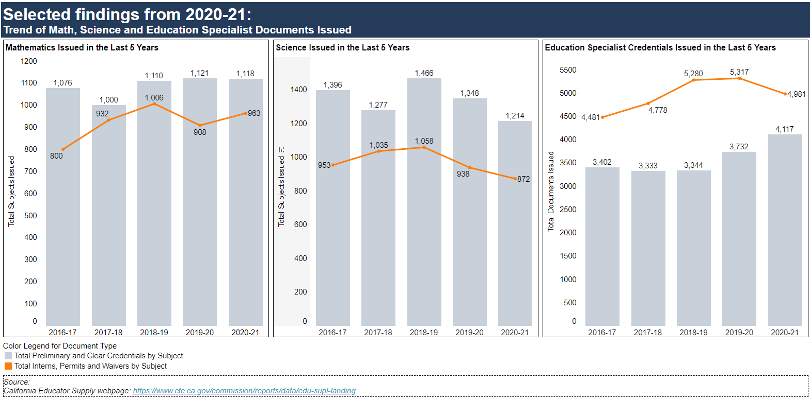
Distribution of Interns, Permits, and Waivers for Math, Science, and SPED
Sources
California Educator Supply

Slide 12
5-Year Trend of Demographic Data – State Population, Enrolled K-12 Students, Full-Time Equivalent (FTE) Teachers, and New Enrolled Teacher Candidates
Sources
Title II: State Trends
FTE Teachers: CDE Staff Demographic Data
K-12 Student Enrollment: CDE Annual Enrollment
California Population: : Department of Finance: Report P-2D: Total Population by Total Hispanic and Non-Hispanic Race

Slide 13
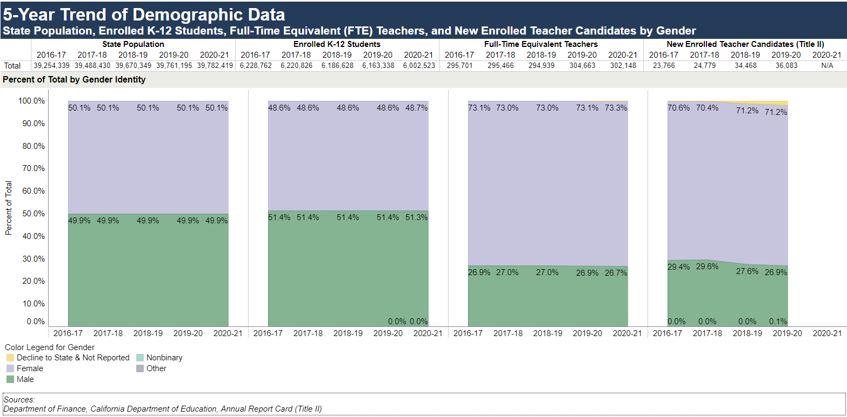
State Population, Enrolled K-12 Students, Full Time Equivalent (FTE) Teachers, and New Enrolled Teacher Candidates by Gender
Sources
Title II: State Trends
FTE Teachers: CDE Staff Demographic Data
K-12 Student Enrollment: CDE Annual Enrollment
California Population: : Department of Finance: Report P-2D: Total Population by Total Hispanic and Non-Hispanic Race

Slide 14
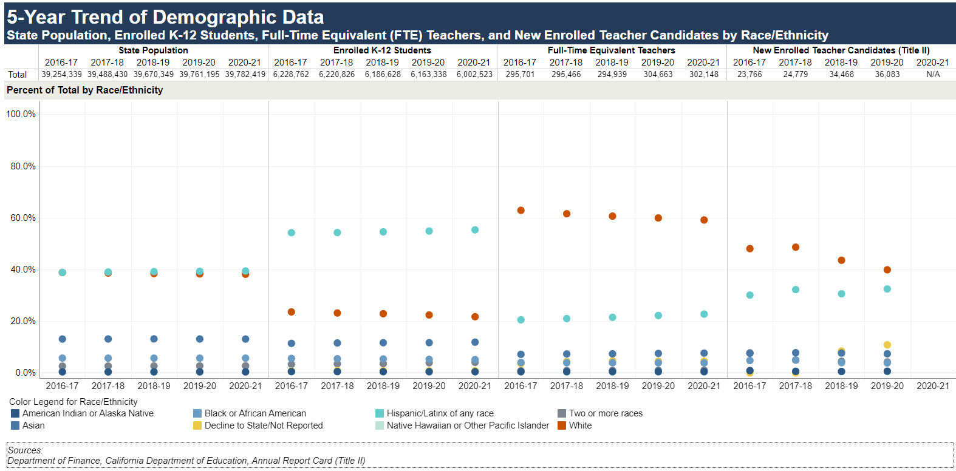
State Population, Enrolled K-12 Students, Full Time Equivalent (FTE) Teachers, and New Enrolled Teacher Candidates by Race/Ethnicity
Sources
Title II: State Trends
FTE Teachers: CDE Staff Demographic Data
K-12 Student Enrollment: CDE Annual Enrollment
California Population: : Department of Finance: Report P-2D: Total Population by Total Hispanic and Non-Hispanic Race

Slide 15
Summary
State mandate
Commission transmits the Teacher Supply Report to the Governor and Legislature by April 15, 2022
2020-21 report highlights:
Increase of new teaching credentials via the California IHE-Prepared and District/County-Prepared pathways
Steady decline of new teaching credentials issued via Out-of-State/Country prepared
Change in the proportion of teaching credentials issued by IHEs in past five years
Increase of intern credentials issued
Decrease of STSPs and PIPs issued
Increase of Limited Assignment permits and waivers issued
Overall decrease of intern credentials, permits and waivers issued

