Slide 1
Update from WestEd’s Evaluation of the Teacher Residency Grant Program
CTC Commission Meeting
February 11, 2022
Melissa Eiler White & Andrew Brannegan

Slide 2
What are teacher residencies?
Operated by a partnership between a local school district and a university or college
Incorporate a full year placement in the classroom of an expert mentor teacher
Traditionally focused in hard-to-staff schools and subject areas
Provide residents with financial support; often in exchange for a commitment to teach in the district for a specified number of years

Slide 3
Guiding questions
Who enrolls in and is hired from residency programs?
What is the early evidence that the residencies are supporting a strong teacher pipeline?
To what extent are the funded programs progressing toward characteristics of high-quality residencies?
To what extent are programs developing towards sustainability and affordability?

Slide 4
About the data
Program Data
Self-report data submitted to the CTC in the Summer/Fall of 2021.
Thirty-three of 37 programs submitted information about their residents.
Residents designated by programs as cohort 1 or cohort 2 based on their start date
WestEd survey data
Completed in spring 2021
Residents, mentors & partnership leads were surveyed on various aspects of their program experience
Survey response rate have been around 70% or higher

Slide 5
Despite a challenging context, residencies are making progress
Residents better reflect the diversity of the students they serve compared to their districts’ existing workforce.
Residents, mentor teachers, and partnership team members value their residency programs.
Residents and mentor teachers highlight the importance of residencies’ rich year-long clinical experience and the support they receive.

Slide 6
“I loved being able to be in a district that I love, with a community that I am familiar with. Being in the same classroom each day from the beginning of the year to the end of the year is super helpful for aspiring teachers. I noticed that my peers that were not residents do not have the same experiences with planning, teaching, and connecting with students and staff members that I did. I was also given more responsibilities and was able to communicate with parents. I am very glad that I became a resident and that I did not take the regular path as a student teacher. The residency program gave me hope to be hired on as a teacher in a school that I am familiar with.” - Resident
“Having a resident with me all day allows them to see all the aspects of teaching...We have more in-depth conversations about why lessons are set up in certain ways and why some content is taught in certain orders. Overall, they get a much better feel for all the aspects of being a teacher.” - Mentor teacher
”

Slide 7
Who enrolls in and is hired from residency programs?

Slide 8
RESIDENCY ENROLLMENT: There were 359 residents in
Cohort 2, an 11 percent increase compared to Cohort 1.

Slide 9
RESIDENCY ENROLLMENT: The majority of partnerships reported fewer than 15 residents.

Slide 10
RESIDENCY ENROLLMENT: There was a small increase in the proportion of residents in STEM programs.

Slide 11
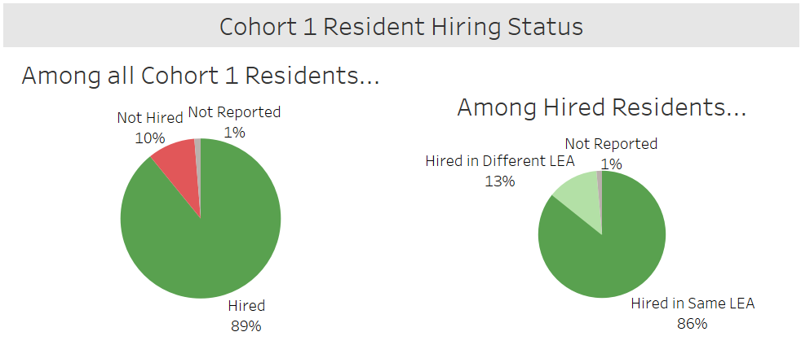
RESIDENT HIRING: 89% of Cohort 1 residents were hired and 86% of these hired residents were hired in the same LEA.

Slide 12
RESIDENT HIRING: Most programs had at least 90% of their residents hired, while 3 programs reported that 50% or fewer of residents were hired*
*Residents with a not reported hiring status were considered not hired for this analysis

Slide 13
RESIDENT HIRING: For the majority of programs, hired residents are being hired in the same LEA as their residency programs

Slide 14
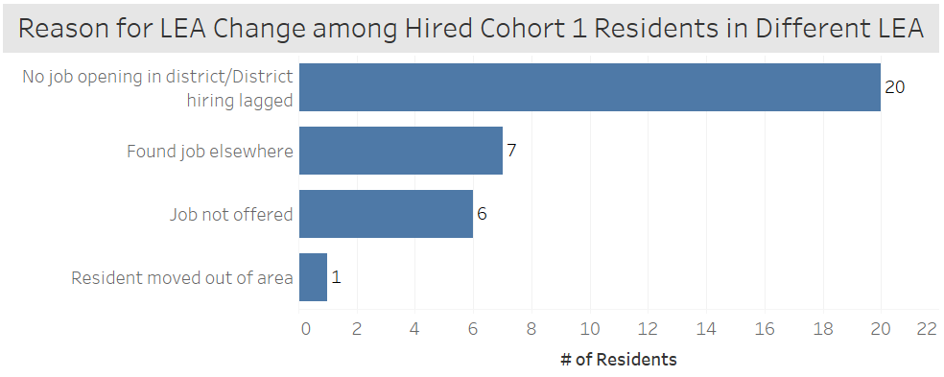
RESIDENT HIRING: No job opening in the district was the biggest reason that residents were hired in different LEAs

Slide 15
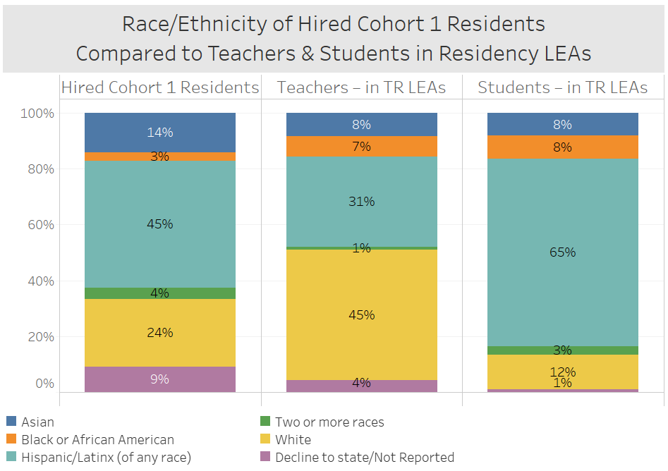
RESIDENT HIRING: Residents hired from Cohort 1 more closely reflect the demographics of students in residency LEAs than current teachers

Slide 16
RESIDENT HIRING: Residents hired from Cohort 1 more closely reflect the demographics of students in residency LEAs than current teachers

Slide 17
To what extent are residency programs developing towards sustainability and affordability?

Slide 18
Key challenges related affordability for residents surfacing
Program leads indicate that recruitment of residents is one of their greatest areas of need.
A majority of residents are experiencing financial hardships during their residency year, and residents of Color are disproportionately impacted.
Most residency programs are offering district based employment opportunities to residents, but fewer than half of residency reporting participating.

Slide 19
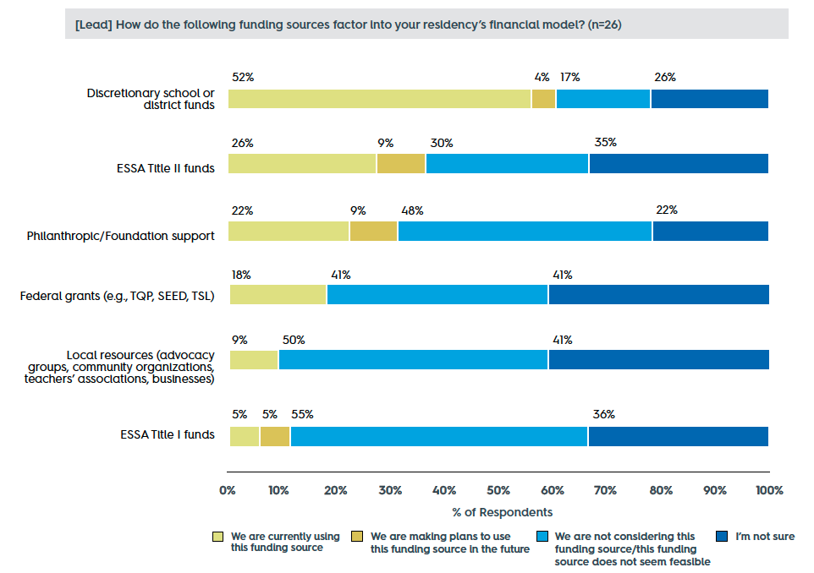
Most programs are not yet broadening their funding sources and strategies to support financial sustainability and affordability beyond the grant
As reported by program leads.
Surveys were administered in April-May 2021, before communications around ESSER funds use were widely disseminated
n=26 of 31 current program leads

Slide 20
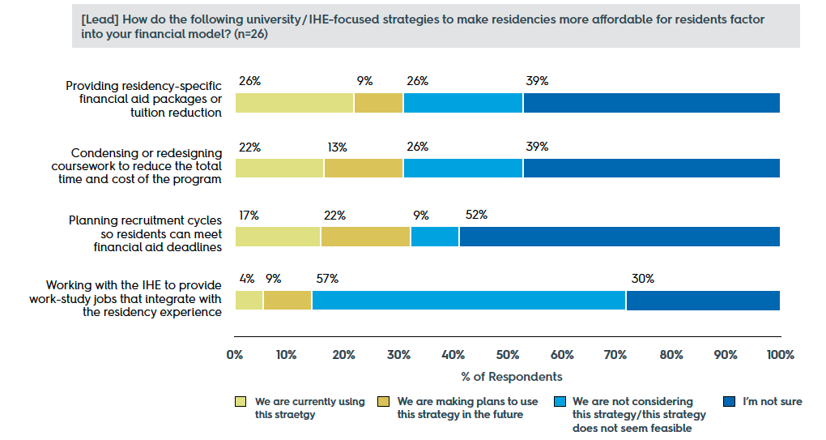
Most programs are not yet broadening their funding sources and strategies to support financial sustainability and affordability beyond the grant
n=26 of 31 current program leads

Slide 21
Summary: Policy recommendations
State leadership should consider working to:
Build a statewide vision, framework, and coherent support system for residencies that prioritizes sustainability and affordability.
Provide residencies with ongoing guidance and technical assistance to make use of non-grant funding sources and existing resources to sustain programs beyond the grant, and support affordability for candidates.
Provide clear guidance to residencies on the federal and state financial aid that is available to residents, and how to support residents to access this aid.

Slide 22
Summary: Programmatic recommendations
State leadership should create incentives, policies, and support systems that encourage residencies to:
Align their residency program with the strategic vision and goals of the district partner, ideally from the start.
Engage the right system level leaders at the outset.
Incorporate dedicated support roles responsible for sustainability planning and relationship building.
Prioritize affordability for residents from diverse backgrounds and income levels, with a focus on residents of Color and residents from local communities.

Slide 23
Thank you!

