Slide 1
Knowledge, Skills, and Abilities Needed to Teach English Language Arts/Literacy and English Language Development
DRAFT RESOURCE GUIDE
2/11/2022

Slide 2
Purpose and Intended Audience [p.1, ¶1]
Identify the knowledge, skills, and abilities that beginning teachers should know and be able to apply to implement effective literacy instruction
Compile and synthesize content and pedagogical expectations from multiple state documents
Serve as a resource guide for program planning in teacher education and for the future design team in developing the literacy instruction performance assessment pursuant to SB 488.

Slide 3
Development Process & Sources of Information [p.1, ¶2]
Determined what beginning teachers should know and be able to do based on what state documents indicate that students are expected to learn
English Language Arts/English Language Development Framework for California Public Schools
California Common Core State Standards for English/ Language Arts and Literacy in History/Social Studies, Science, and Technical Subjects
California English Language Development Standards

Slide 4
Development Process & Organization [p.1, ¶3]
Identified the Comprehensive and Integrated Literacy Model described in the California Comprehensive State Literacy Plan as the first element of the resource guide, including five overarching components:
Multi-Tiered System of Support (MTSS) & Best First Instruction
Access and Equity
Instruction for English Learner Students
California Dyslexia Guidelines
Assessment System

Slide 5
Development Process & Organization [p.1, ¶2, bullet 3]
Identified the five themes of the ELA/ELD Framework as the remaining elements of the resource guide:
Foundational Skills
Meaning Making
Language Development
Effective Expression
Content Knowledge

Slide 6
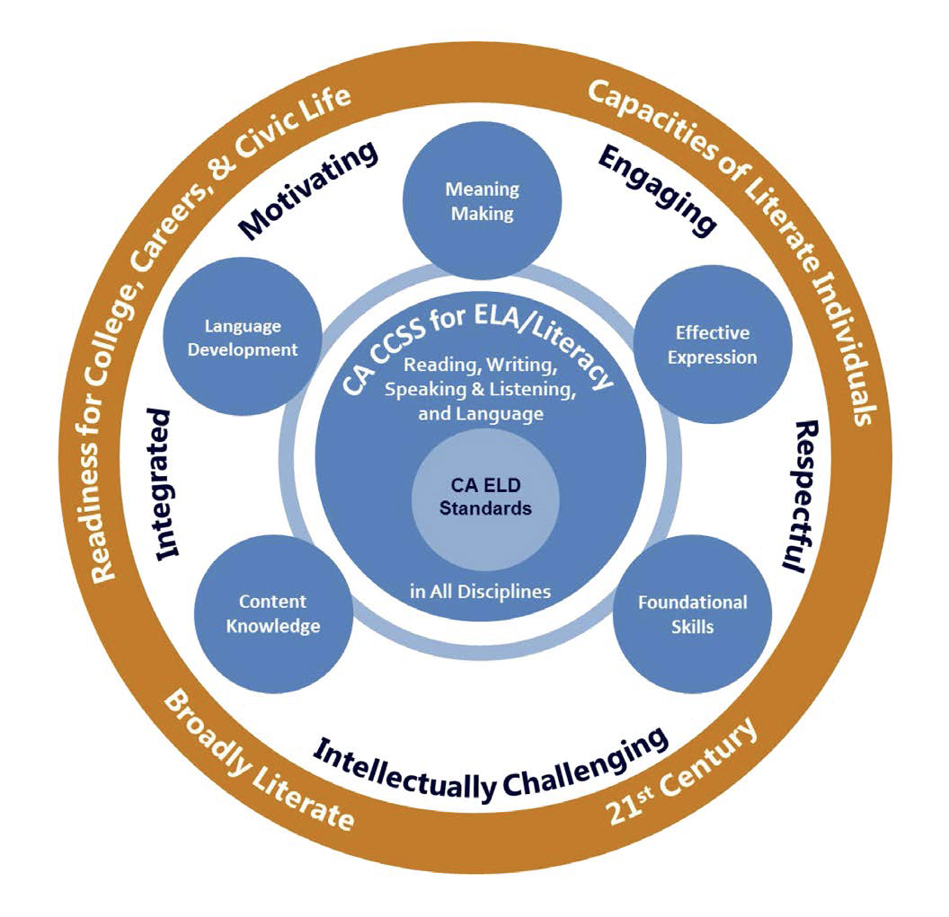
Development Process & Vision [p.2, ¶1]
The State Literacy Plan builds on the vision set forth in the ELA/ELD Framework:
Overarching Goals
Guiding Principles
Circles of Implementation

Slide 7
Development Process & Sources of Information [p.2, ¶2]
Incorporated content from four other state sources:
California Dyslexia Guidelines
Resource Guide to the Foundational Skills of the CA Standards for ELA/Literacy
California Digital Learning Integration and Standards Guidance
CTC Literacy Teaching Performance Expectations

Slide 8
Development Process & Sources of Information
Plan to review and incorporate content from three additional state sources:
California English Learner Roadmap (2018)
California Practitioners’ Guide for Educating English Learners with Disabilities (2019)
Improving Education for Multilingual and English Learner Students: Research to Practice (2020)

Slide 9
Organization [p.2, ¶3]
Table of Abbreviations [p.4]
Charts of Essential Literacy Content for Teacher Preparation for each of the six elements [pp.5-34]
Comprehensive & Integrated Literacy - Overarching
Foundational Skills
Meaning Making
Language Development
Effective Expression
Content Knowledge
Appendices A, B, C [pp.35-40]
References [p.41]
All themes work together & all are important

Slide 10
Comprehensive & Integrated Literacy Element [pp.5-7]
Five components (MTSS, Access & Equity, Instruction for EL Students, CA Dyslexia Guidelines, Assessment)
Overarching in nature, to be applied to remaining elements
Overview [p.5, ¶1] defines the element
Left column in chart identifies component & provides general references
Right column details essential literacy content for teacher preparation & provides specific references

Slide 11
Foundational Skills Element [pp.8-21]
Five components (General, Print Concepts K-1, Phonological Awareness K-1, Phonics & Word Recognition K-5, & Fluency K-5) – Their achievement is crucial, warranting high priority attention in the early school years and thereafter as needed.
General component applies across other components
Subheadings that appear in several components (Broad Content, Assessment & Tiered Instruction*, Comprehensive & Integrated Literacy, English Learner Students**, Features/Sequence of Instruction)
Subheadings that are unique to element/component (Automaticity, Spelling, Morphology/Multisyllabic Words)
*Important milestones for determining adequate progress/needed intervention
**Not the only content that applies to EL students but called out for emphasis

Slide 12
Meaning Making Element [pp.22-24]
Two components (General, Meaning Making with Complex Text [K-12])
Meaning Making applies to reading, writing, speaking and listening, and language
Although this element is shorter in length than the previous element, it is no less important.
The Foundational Skills element includes greater detail because skills are more distinct and grade specific, while the Meaning Making element includes broad concepts that extend from TK through grade 12 at increasing levels of difficulty and sophistication.

Slide 13
Language Development Element [pp.25-27]
Three components (General, Vocabulary, Grammatical Understandings/Syntax)
Note that beginning teachers are expected to have learned much of the content related to grammatical understandings/ syntax before entering their credential program. See Appendix A for details.

Slide 14
Effective Expression Element [pp.28-32]
Five components (General, Writing, Discussing, Presenting, Using Language Conventions)
These components interact significantly with those of foundational skills, meaning making, language development, and content knowledge.
For example, Spelling under Using Language Conventions is also referenced under Foundational Skills as decoding and encoding are reciprocal skills.

Slide 15
Content Knowledge Element [pp.33-34]
Four components (General, Wide Reading, Engaging with Informational Text/Disciplinary Literacy, Engaging in Research)
Content knowledge supports the development of literacy while increased proficiency in literacy supports the development of content knowledge. These effects are seen in vocabulary, comprehension, critical thinking, and more.

Slide 16
Appendices A, B, and C [pp.35-40]
Appendix A – Elementary, Secondary, and Undergraduate Literacy Content Expectations
Content expected of candidates prior to teacher preparation
Appendix B – Cross-Mode Language Processes Identified in Part II of the CA ELD Standards
Additional detail regarding the use of the ELD standards to teach EL students
Appendix C – Dyslexia Screening and Instructional Recommendations for Education Specialists
Specialized information regarding the diagnosis and intervention for dyslexia that are the purview of the education specialist

Slide 17
Recommendations for Next Steps
Revision of preliminary draft of resource guide based on feedback from you and statewide experts in the content of literacy across all the elements
Formal field review with our community and education partners
Analysis and final revision

