Slide 1
Annual Report Card on California Teacher Preparation Programs for the Academic Year 2019-20 as required by Title II of Higher Education Act
David Deguire, Director
phi phi lau, Research Data specialist
Professional Services Division
September 2021

Slide 2
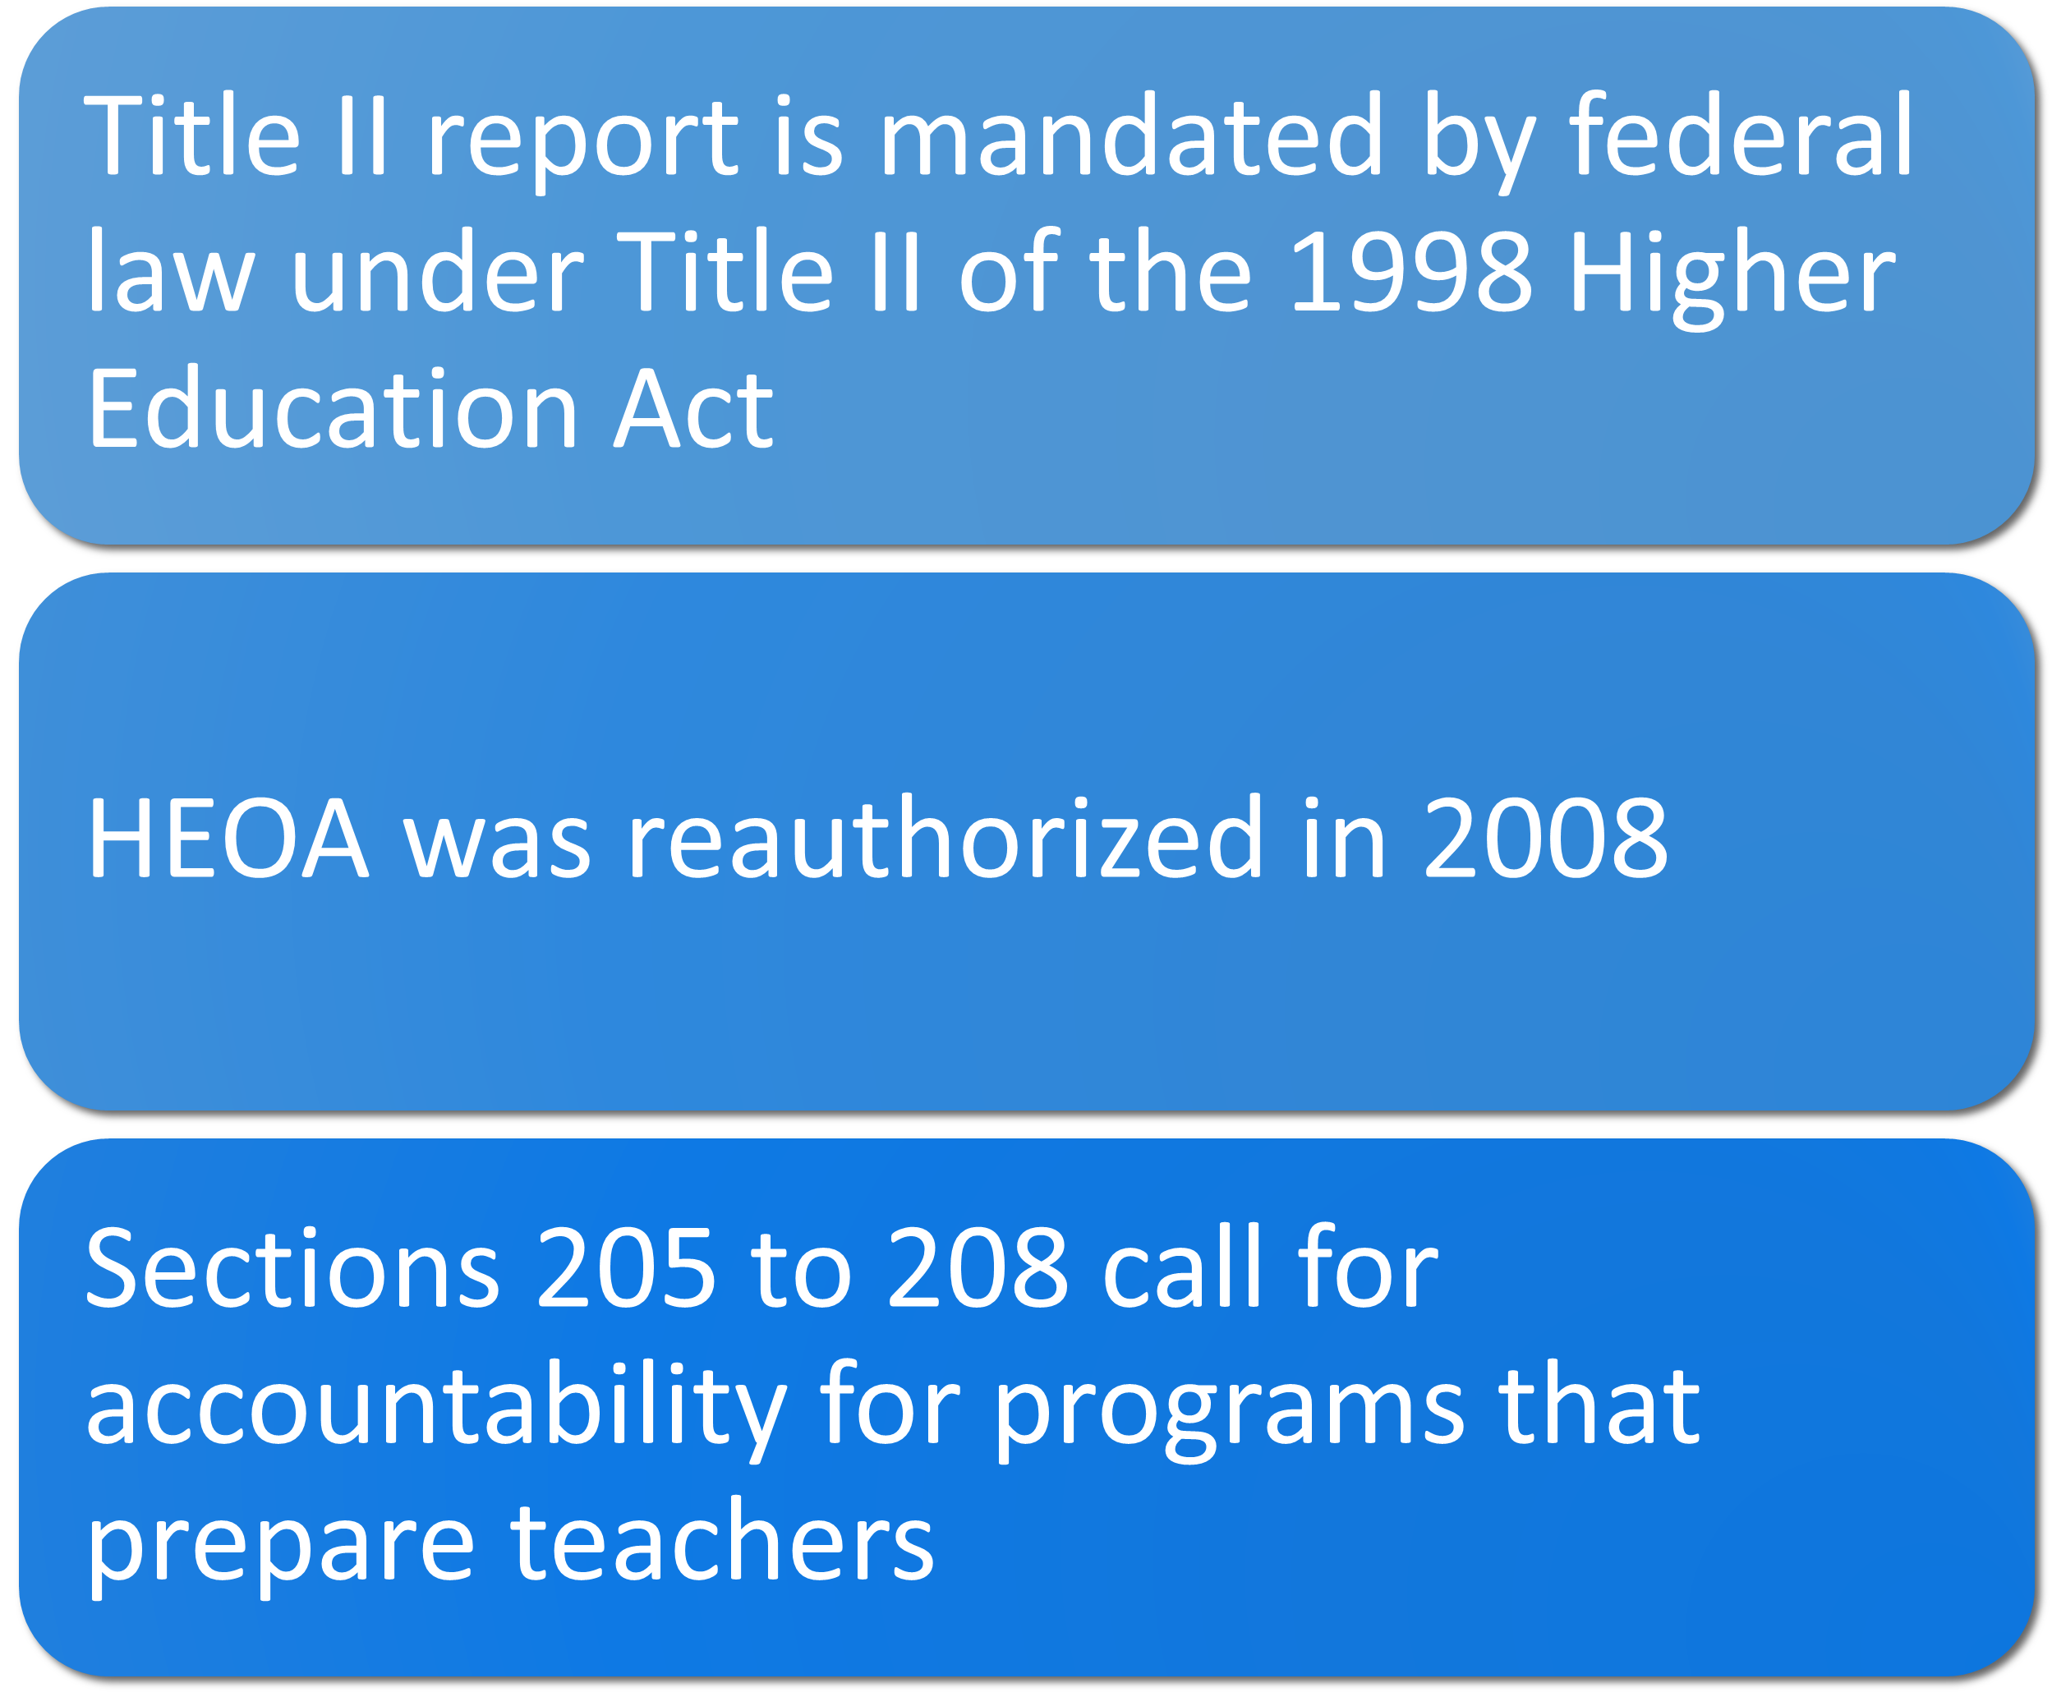
Background – What is Title II report? Why do we have to submit the report?

Slide 3
When do we submit the report?

Slide 4
How do we submit the report?
A Federal Title II contractor, designed a web-based data entry tool called the Institution and Program Report Card (IPRC)
All 50 states and the territories use this IPRC tool
State Report Card (SRC) is also a web-based data system
All 50 states and territories use SRC

Slide 5
What is in the Title II report?
Title II report includes data on Multiple Subject, Single Subject, and Education Specialist credentials only
The report does not include Designated Subjects or Services credentials
Data are reported for initial credentials only; do not report data on added authorizations or subsequent authorizations

Slide 6
Requirements for Teacher Preparation Programs
Three types of IPRCs are submitted:
Traditional Route (Student teaching programs)
Alternative route, IHE-based (University Intern Programs)
Alternative route, not-IHE-based (District/County Intern Programs)

Slide 7
Type of assessment data reported
Pass rates data are submitted for 5 groups:
Enrolled candidates who completed all Nonclinical coursework (Group 1)
Other Enrolled candidates (Group 2)
Program Completers for current year, 2019-20 (Group 3)
Program Completers for prior year, 2018-19 (Group 4)
Program Completers for second prior year, 2017-18 (Group 5)

Slide 8
What data elements are reported?
Sections | Institution and Program Report Card (IPRC) | State Report Card (SRC)
Program Information | X | X
Assurances; Annual Goals for Math, Science, Special Education | X
Assessment Data | X | X
Low-Performing Teacher Preparation Programs | X | X
Use of Technology | X
Teacher Training | X
Credential Requirements |  | X
Standards and Criteria |  | X
Improvement Efforts |  | X

Slide 9
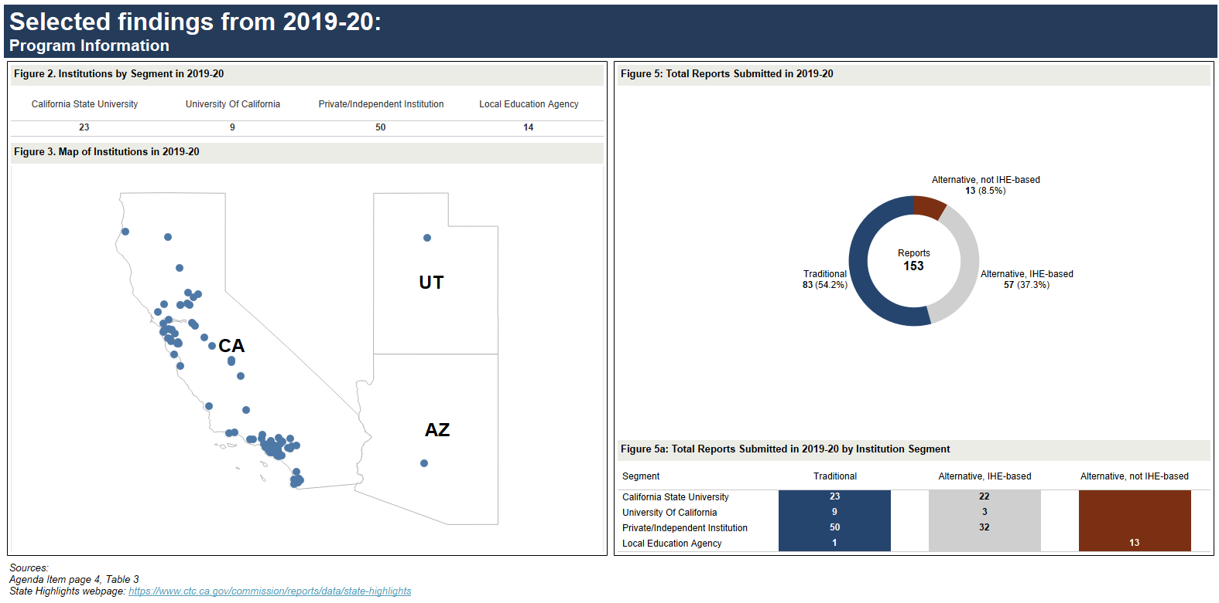
Selected findings from 2019-20: Program Information
Sources
State Highlights
September 2021 Commission Agenda item 2C – page 4, Table 3.

Slide 10
Selected findings from 2019-20: Program Information: Supervised Clinical Experiences
Sources
Figure 15: Distribution of number of clock hours required for student teaching in 2019-20: State Highlights
September 2021 Commission Agenda item 2C – page 8, table 5b.
Figure 7: Distribution of Total Student Teaching Clinical Hours in Traditional Programs: State Trends
September 2021 Commission Agenda item 2C – page 8, table 5b.

Slide 11
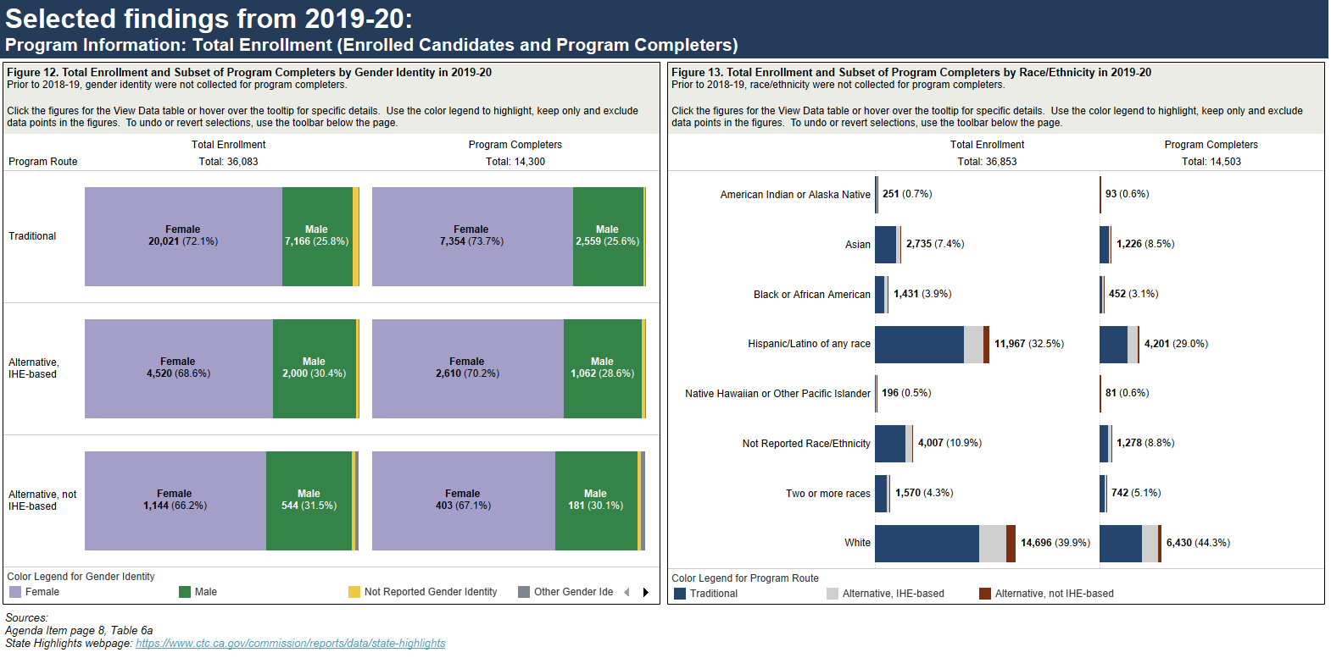
Selected findings from 2019-20: Program Information: Total Enrollment (Enrolled Candidates and Program Completers)
Sources
State Highlights
September 2021 Commission Agenda item 2C – page 8, table 6a

Slide 12
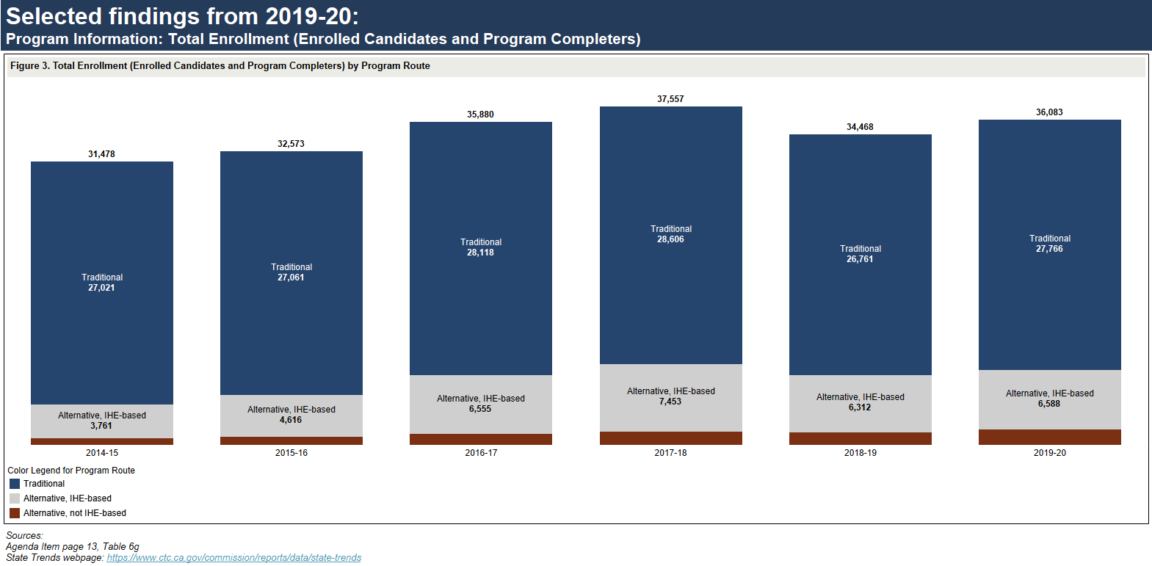
Selected findings from 2019-20: Program Information: Total Enrollment (Enrolled Candidates and Program Completers)
Sources
State Trends
September 2021 Commission Agenda item 2C – page 13, table 6G.

Slide 13
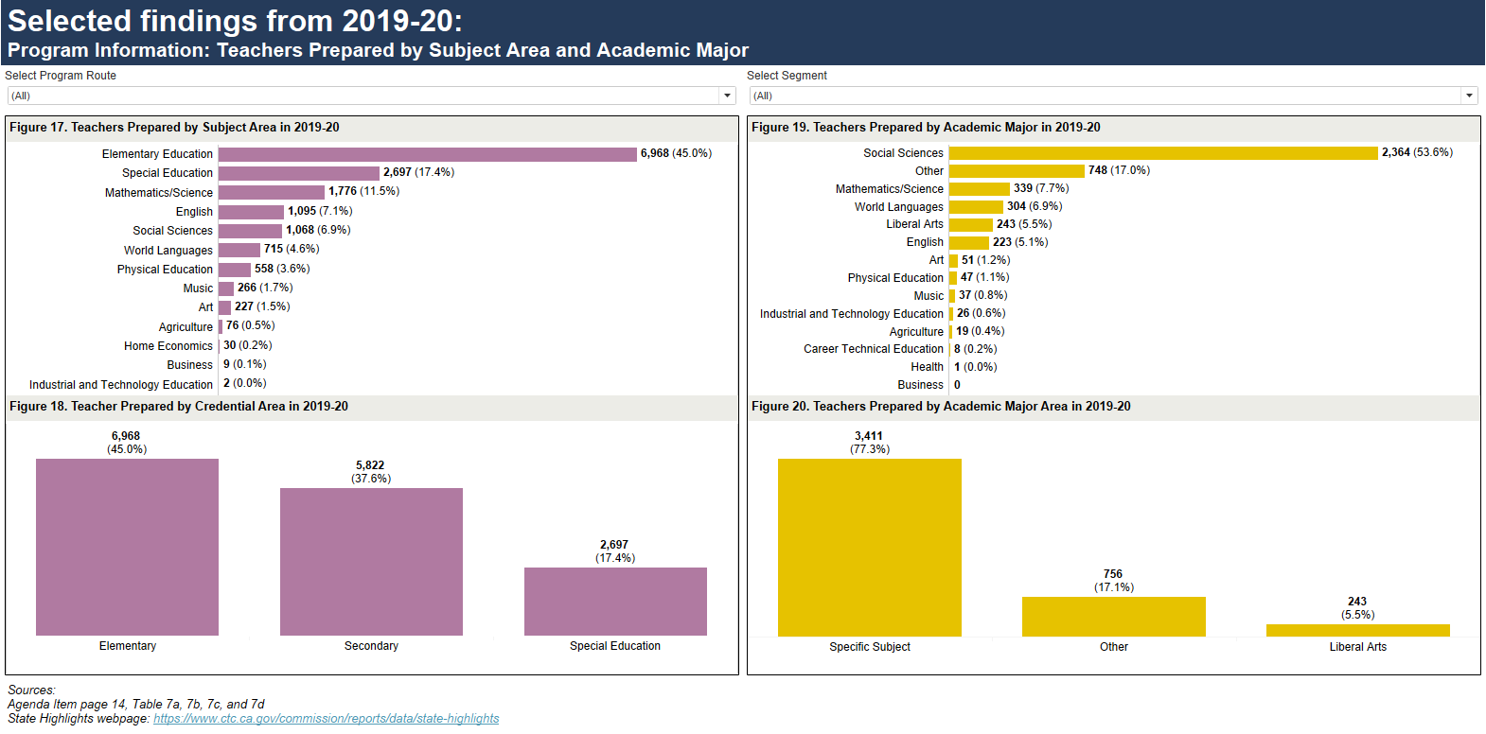
Selected findings from 2019-20: Program Information: Teachers Prepared by Subject Area and Academic Major
Sources
State Highlights
September 2021 Commission Agenda item 2C – page 14, tables: 7a, 7b, 7c and 7d

Slide 14
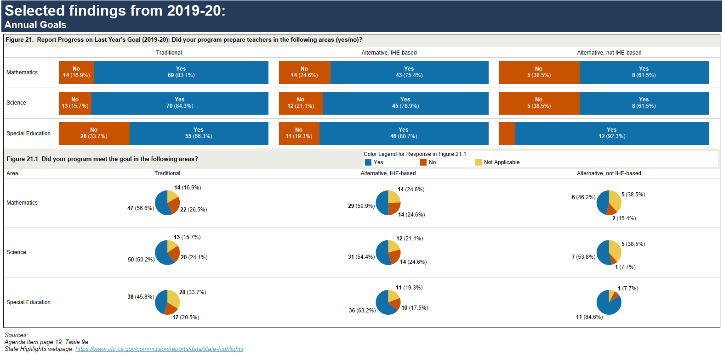
Selected findings from 2019-20: Annual Goals
Sources
State Highlights
September 2021 Commission Agenda item 2C – page 19, table 9a

Slide 15
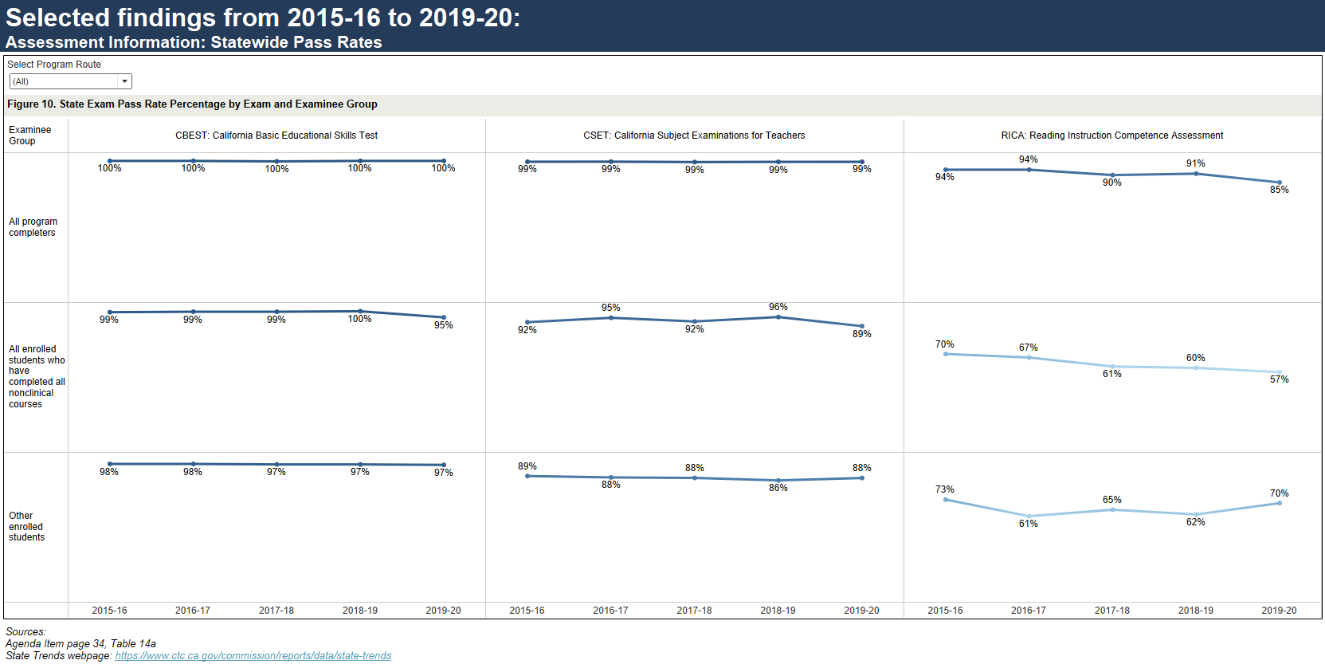
Selected findings from 2019-20: Assessment Information: Statewide Pass Rates
Sources
State Trends
September 2021 Commission Agenda item 2C – page 34, table 14a.

Slide 16
Summary
Federal mandate
Teacher Preparation programs submitted their IPRCs (April 30, 2021)
State report is due to the U.S. Department of Education (October 31, 2021)
2019-20 report highlights:
Increase in total candidate enrollment, including program completers from the prior year
More than half of total candidates identified themselves as non-White
Higher percentage of male candidates enrolled in Alternative route programs
Teachers prepared by subject area and academic major varied by route and segment
Assessment rates varied by route and segment

