Slide 1
CTC Strategic Planning Session #2
tine Sloan, Mary Vixie Sandy, Amy Reising
April 14, 2021

Slide 2
Strategic Planning Session Outcomes
Review Vision, Mission, and Values
Revisit Strategic Goals and Objectives
Identify priorities for 3 years out, 5 years out
Identify topics for future study sessions

Slide 3
Agenda
9:00 Welcome and Introductions
Zoom Norms
Strategic Planning Session Outcomes
Setting the Stage for Strategic Planning
9:30 1st Break Out Group Discussion: Vision, Mission, Values
10:00 Whole Group Debrief
10:15 2nd Break Out Group Discussion: Multi-Year Goals
11:20 Whole Group Debrief
11:45 Public Comment
11:55 Closing Comments and Next Steps
12:00 Session Adjourns

Slide 4
Public Comment
Please email your request to comments@ctc.ca.gov or call 916-322-6253 and indicate that you wish to speak on this item. Please make sure the request includes your full name, phone number if participating through the phone only, and your affiliation. Make sure the name you provide matches the name used to join the meeting.

Slide 5
Online Meeting Norms
Please unmute yourself when you would like to comment or ask a question. At other times, remain muted to reduce background interruptions.
Keep your video enabled unless your online connection is unstable.
Avoid multi-tasking during the webinar to ensure that you hear all information that is presented.
Honor time for both participants and presenters by moderating your questions/comments.
Zoom fatigue is real – give your eyes a break from time to time.

Slide 6
Topics for Future Study Sessions
Remember to add ideas to the Strategic Planning Session Jamboard

Slide 7
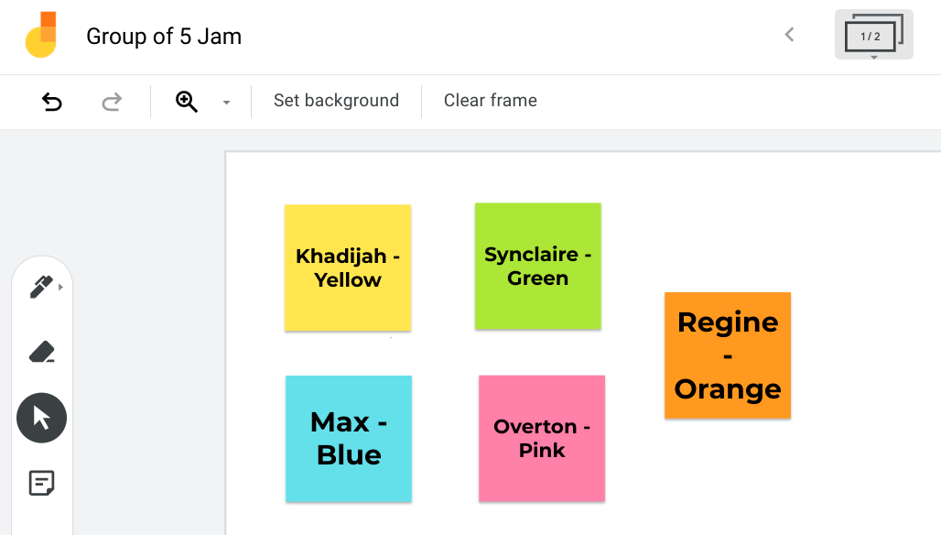
Group of 5 Jam

Slide 8
Sticky Note
WRITE YOUR IDEA/SUGGESTION HERE

Slide 9
Setting the Stage
January 2014: Commission adopted current Strategic Plan
January 2020: 2020 priorities included updating Strategic Plan
Spring 2020: CTC conducted Environmental Scan to identify key issues and trends
Summer 2020: Surveyed stakeholders (82 External Surveys received)
October 2020: Presented high-level summary of the external survey results
December 2020: Strategic Planning Session #1
February 2021: Dr. Sandy presented priorities for 2021

Slide 10
The Commission’s Mandate
Licensing California Educators
Setting Standards for Preparation
Accrediting Preparation Sponsors
Examinations and Assessments
Addressing Educator Misconduct
Teacher Recruitment and Development Grants
Public Information and Access
Stakeholder Engagement
Effective Operations

Slide 11
CTC’s Vision and Mission
Vision: All of California’s students, preschool through grade 12, are inspired and prepared to achieve their highest potential by well prepared and exceptionally qualified educators.
Mission: To ensure integrity, relevance, and high quality in the preparation, certification, and discipline of the educators who serve all of California’s diverse students.

Slide 12
CTC’s Values
We recognize and promote excellence in the preparation and practice of California’s education workforce.
We value and promote equity, quality, inclusiveness and diversity in standards, programs, practices, people and the workplace.
We are dedicated and committed to the education and welfare of California’s diverse students.
We value the voices, ideas and understanding of educators, parents, students, our partners, stakeholders and employees.
We embrace the spirit of innovation that enables us to transform our vision into reality.

Slide 13
CTC’s Multi-Year Goals
Educator Quality: Examinations, Performance Assessments, Credentialing, Discipline
Program Quality and Accountability: Standards, Accreditation, Stakeholder Participation, Data and Trend Analyses
Communication and Engagement: Transparency, Access, Public Discourse, Stakeholder Engagement, Inter-Agency Collaboration
Operational Effectiveness: Alignment of Human and Fiscal Resources, Effective and Positive Workplace, Efficient Workload Management, Focus on Continuous Improvement

Slide 14
First Breakout Group Discussion
Topic: Review Current Vision, Mission, and Values
Materials: Strategic Plan (Agenda Item, pages 2-3); Stakeholder Perspectives on CTC Mission (Agenda item, page 5)
Directions: In breakout rooms discuss the CTC’s Vision, Mission, and Values. A CTC staff person will take notes. One Commissioner will volunteer to present 3 highlights from the discussion.
How well do the current mission, vision, and values reflect the Commission’s perspective on the Agency’s role and work?
What, if anything, is missing or no longer current?

Slide 15
Group Assignments
Commissioners | Staff
Group 1: Tine Sloan, Bonnie Klatt, Mike Cooney, Michael De La Torre, Kate Brown | Lead Facilitator: Amy Reising Staff facilitators/note takers Break out 1: James Webb, Phyllis Jacobson, Zoltan Sarda Break out 2: James Webb, Phyllis Jacobson, Zoltan Sarda
Group 2: Marysol de la Torre Escobedo, Johanna Hartwig, Susan Heredia, Andrew Wall, Cindy Marten, Haydee Rodriguez | Lead Facilitator: David DeGuire Staff facilitators/note takers: Break out 1: Cheryl Hickey, Sasha Horwitz, Gil Gonzalez Break out 2: Cheryl Hickey, Sasha Horwitz, Gil Gonzalez
Group 3: Monica Martinez, Terri Jackson, Jose Cardenas, Megan Gross, Marquita Grenot-Scheyer, Annamarie Francois | Lead Facilitator: Michele Perrault Staff Facilitators/note takers: Break out 1: Erin Skubal, Cara Mendoza, Angel Lopez Break out 2: Erin Skubal, Cara Mendoza, Angel Lopez

Slide 16
Vision, Mission, Values Debrief
Directions: Each Group’s volunteer reporter will have 3-5 minutes to present 3 highlights from their discussion. Each following Group will add new ideas.
How well do the current mission, vision, and values reflect the Commission’s perspective on the Agency’s role and work?
What, if anything, is missing or no longer current?

Slide 17
Second Breakout Group Discussion
Topic: CTC Goals, Priority Goals for Year 3, Year 5
Materials: Strategic Plan (Agenda item p 3-4), Appendix B (Agenda Item), OR WORKSHEET; 2021 Initiatives and Milestones
Directions: In breakout rooms review Appendix B and discuss the CTC’s Multi-Year Goals (p. 4-5). A CTC staff person will take notes. One Commissioner will volunteer to present 3 highlights from the discussion. Please take a break as needed during this breakout discussion.
What needs to be updated or added?
What are the most pressing long-term priorities the Commission would like to address within the next 3-5 years?

Slide 18
Second Breakout Group Discussion
Directions:
Review goal statements: 3-4 minutes
Review updated Appendix B: 3-4 minutes
Review 2021 priorities: 3-4 minutes
As a group, discuss the following questions:
What needs to be updated or added?
What are the most pressing long-term priorities the Commission would like to address within the next 3-5 years?

Slide 19
Group Assignments
Commissioners | Staff
Group 1: Tine Sloan, Bonnie Klatt, Mike Cooney, Michael De La Torre, Kate Brown | Lead Facilitator: Amy Reising Staff facilitators/note takers Break out 1: James Webb, Phyllis Jacobson, Zoltan Sarda Break out 2: James Webb, Phyllis Jacobson, Zoltan Sarda
Group 2: Marysol de la Torre Escobedo, Johanna Hartwig, Susan Heredia, Andrew Wall, Cindy Marten, Haydee Rodriguez | Lead Facilitator: David DeGuire Staff facilitators/note takers: Break out 1: Cheryl Hickey, Sasha Horwitz, Gil Gonzalez Break out 2: Cheryl Hickey, Sasha Horwitz, Gil Gonzalez
Group 3: Monica Martinez, Terri Jackson, Jose Cardenas, Megan Gross, Marquita Grenot-Scheyer, Annamarie Francois | Lead Facilitator: Michele Perrault Staff Facilitators/note takers: Break out 1: Erin Skubal, Cara Mendoza, Angel Lopez Break out 2: Erin Skubal, Cara Mendoza, Angel Lopez

Slide 20
CTC Multi-Year Goals and Priority Debrief
Directions: Each Group’s volunteer reporter will have 3-5 minutes to present highlights from their discussion. Each following Group will add new ideas.
What needs to be updated, added or eliminated?
What are the most pressing long-term priorities the Commission would like to address within the next 3-5 years?

Slide 21
Public Comment
Please email your request to comments@ctc.ca.gov or call 916-322-6253 and indicate that you wish to speak on this item. Please make sure the request includes your full name, phone number if participating through the phone only, and your affiliation. Make sure the name you provide matches the name used to join the meeting.

Slide 22
Session Evaluation
https://forms.gle/pn8DPQNatE1zvfhw5

Slide 23
Closing Comments and Next Steps
Based on the Commission’s feedback and direction, the staff will begin drafting a strategic plan for consideration at a future Commission meeting.

