Slide 1
Learnings from the Formative Evaluation of the Teacher Residency Grant Program
Melissa Eiler White, Project Director, WestEd
California Commission on Teacher Credentialing
December 3 & 4, 2020

Slide 2
Background

Slide 3
Purpose of the evaluation to support:
practitioners to know whether the changes they are making are likely to move their programs closer to desired residency characteristics.
policymakers & funders to know the extent to which programs are implementing effective practices and progressing toward desired outcomes.
technical assistance providers to know how participating grantees are experiencing supports, and the aspects of supports that are especially effective.

Slide 4
Topics on the spring surveys
Leading outcome indicators:
Global program quality
Completion and employment
Program processes
Partnership
Recruitment and selection
Training for mentor teachers & supervisors
Mentor teacher practices
Coursework-clinical alignment
Resident demographics, program structure, financial sustainability
COVID-19 impact

Slide 5
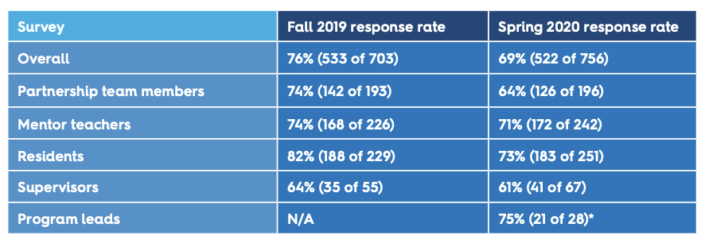
Stakeholder survey response rates

Slide 6
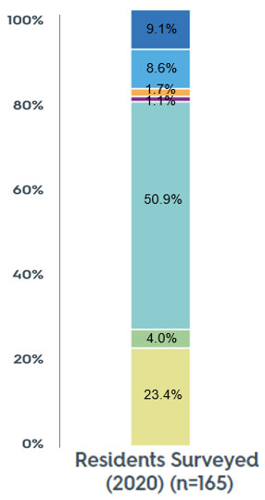
A large majority of residents self-identify as people of color

Slide 7
Residents better reflect the racial diversity of the student they serve compared with the existing teaching workforce

Slide 8
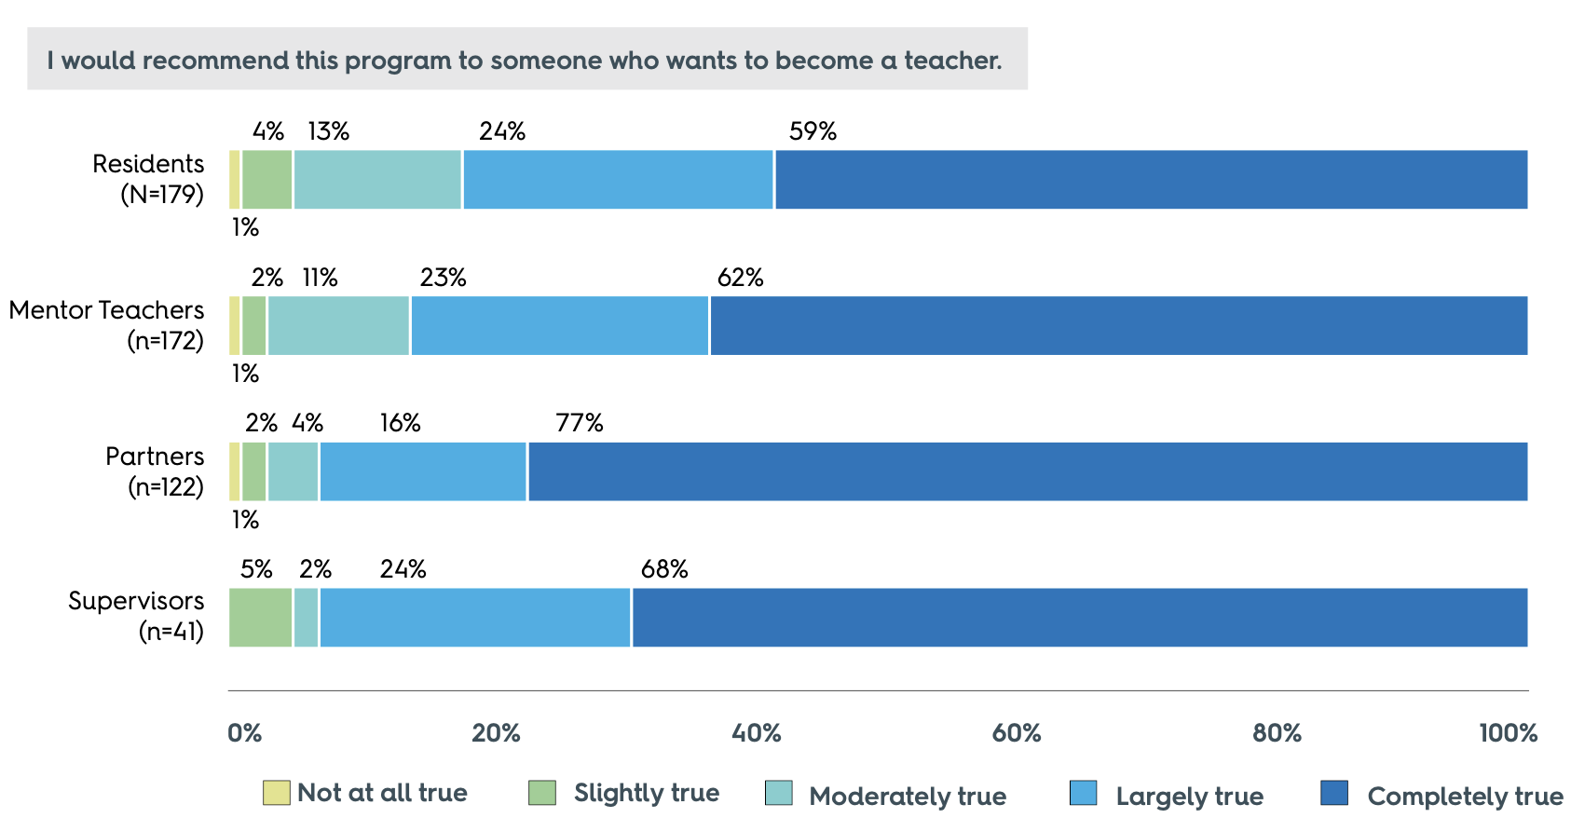
All stakeholder groups are quite positive about the program

Slide 9
“The strengths are being able to join in the classroom from the first week, setting up, understanding the classroom rules and culture so that the students know who I am from the start.” - Resident
“Having a resident with me all day allows them to see all the aspects of teaching...We have more in-depth conversations about why lessons are set up in certain ways and why some content is taught in certain orders. Overall, they get a much better feel for all the aspects of being a teacher.” - Mentor teacher
”

Slide 10
Close to 80% plan to take jobs in the partner districts

Slide 11
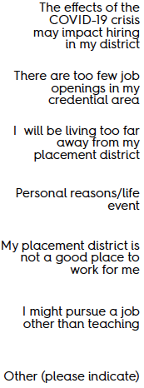
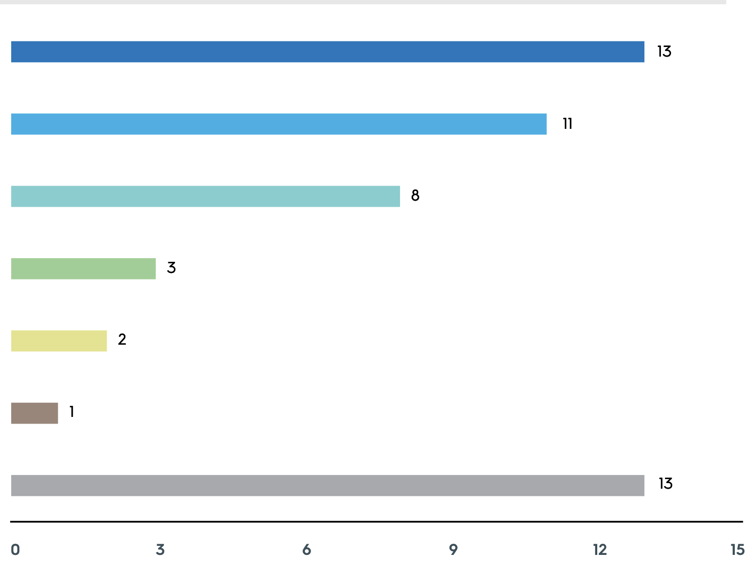
Reasons for unemployment uncertainty largely COVID driven

Slide 12
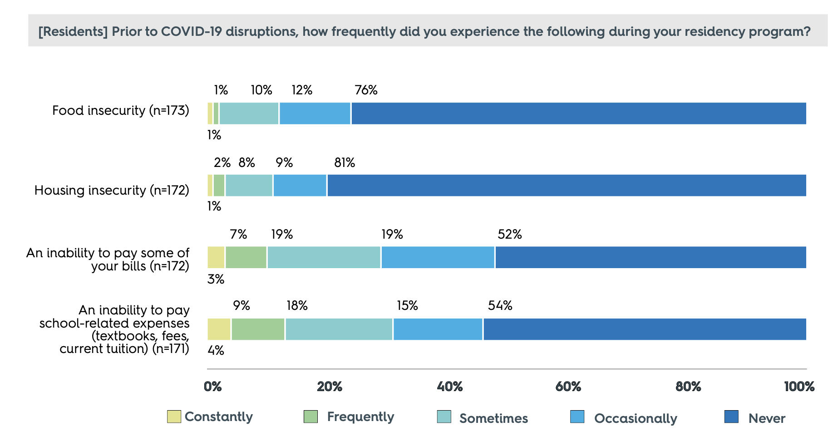
Pre-COVID: A significant minority of residents are experiencing financial hardships

Slide 13
Those financial hardships worsened in the COVID context.
“The COVID-19 crisis has caused me to lose all of my income. I relied on the income of the once per week substitute teaching to help pay bills at home that was promised from the program. I also lost my other job due to the crisis.”
Resident
76 percent of residents of color who commented on their financial situation described a negative shift, compared with just 10 percent of White residents.

Slide 14
Insights into how school closures impacted resident clinical experiences
Residents and mentors worried about a loss of teaching and learning experience
Experience of teaching a full lesson on their own
Less time to practice skills like classroom management
For SPED, particular missed opportunities such as missing IEP meetings and conducting assessments
But most resident-mentor pairs quickly adapted to an online environment
The vast majority of residents and mentors reported that they continued to collaborate
Residents supported elements of online classroom instruction, including planning lessons, conducting or assisting with Zoom meetings with students, holding office hours, grading, and researching ways to use online tools

Slide 15
Partnerships are working to strengthen key components of their residency programs
Recruiting high-ability residents, particularly residents of color.
Creating strong connections between coursework and clinical experience, including training and support for mentor teachers.
Establishing strong IHE/LEA partnerships.
Developing sustainable financial models.

Slide 16
Recommendations for policy & practice
Ensure stable leadership roles in both the IHEs and the LEAs that are participating in the residency partnership.
Ground technical assistance in expertise in building residency programs & include practical strategies and resources to accelerate the progress of the teacher residencies.
Ensure that programs are encouraged to take a stance of learning and improvement.
Prioritize supports for the cohort of residents entering their first year as teachers in 2020–21.
Ensure that residency stipends can be supplemented with additional financial aid and supports to make the full-year residency a financially viable pathway.

Slide 17
Looking Ahead to Year 2 of the Evaluation
Stakeholder surveys
Attention to the COVID context
Further insight into diversity, equity, and inclusion issues for the programs
Surveys of residency program completers
Employment data
What happens to the residents as they complete the program and move into teaching?
Spotlights on practice
Program implementation practices and resources
Webinars with partnership teams and written descriptions

Slide 18
https://tinyurl.com/y5ucmj97

Slide 19
Thank you!
Questions?
Melissa Eiler White - mwhite@wested.org

